Slide 1
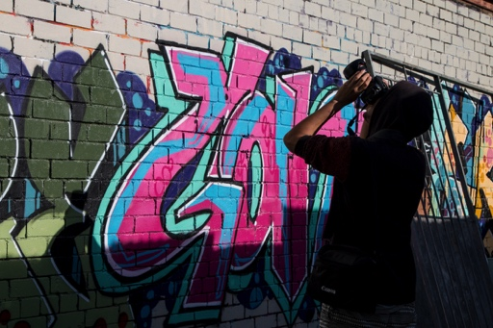

Slide 2
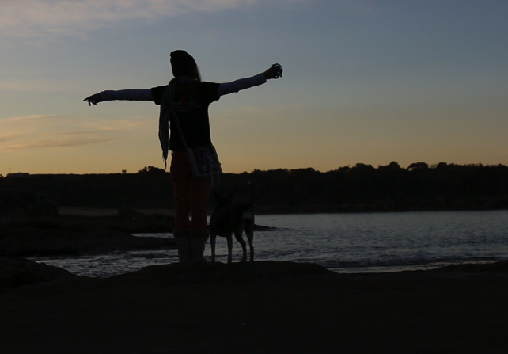
About Weave
Our Vision
To build a strong connected community
Our Mission
To empower people to change their lives

Slide 3
Background
Established in 1976 as an outreach and street work program
We now encompass 10 programs and have over 35 staff
Intensive ongoing work with 1200 individuals a year
Reach over 4500 people a year

Slide 4
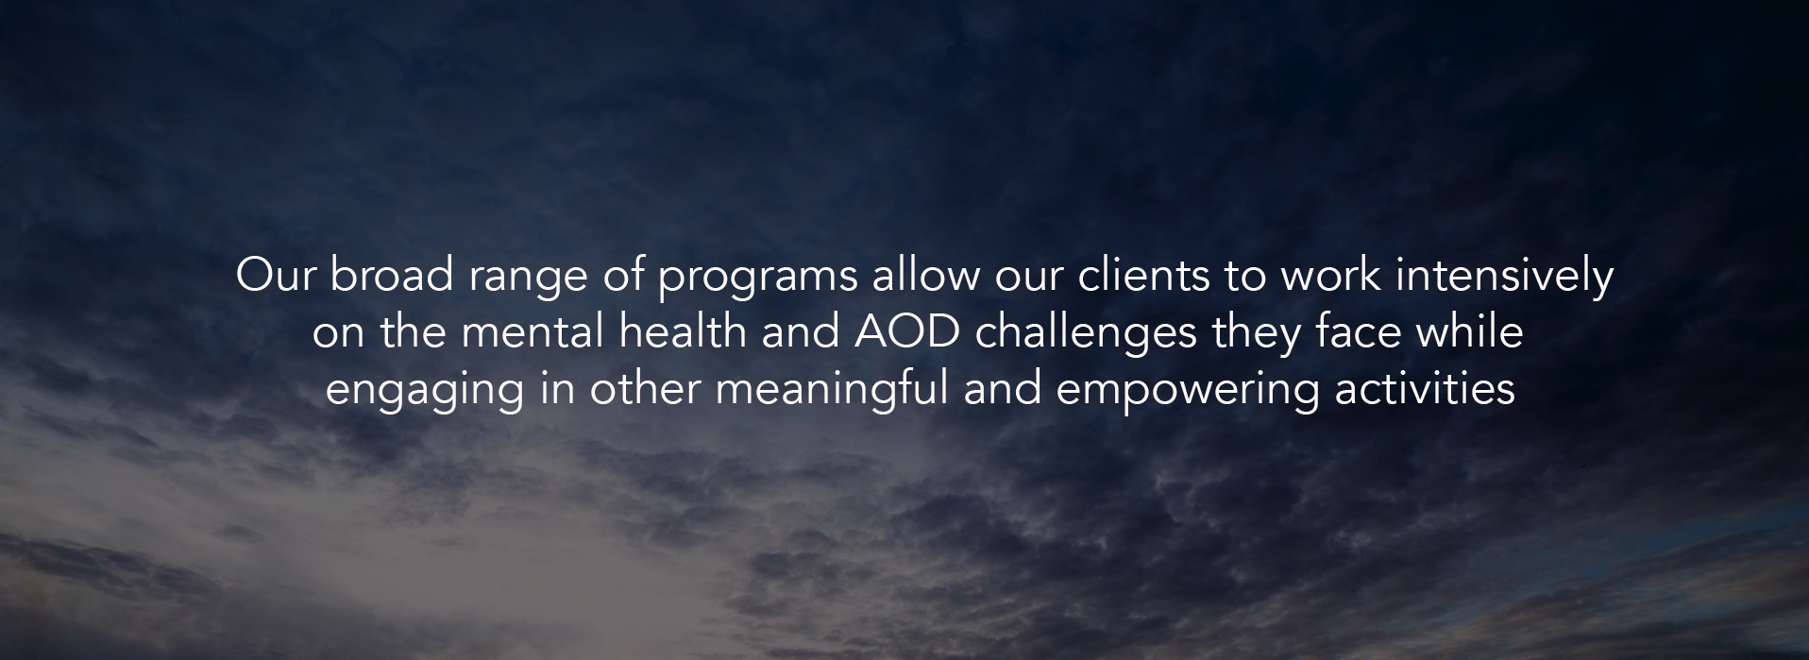

Slide 5
Who We Work With

Slide 6
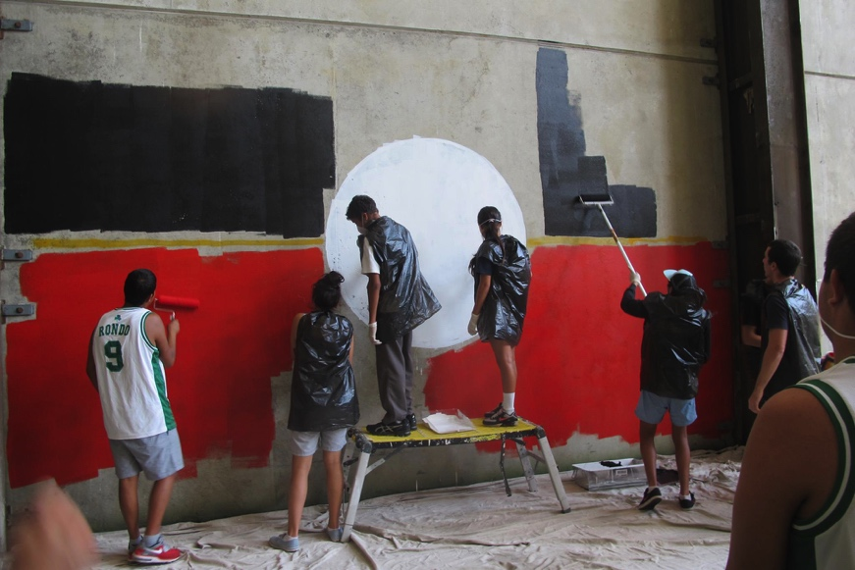
Who We Work With
Over 70% of the people we work with are Aboriginal or Torres Strait Islander people

Slide 7
Issues
Intergenerational poverty and complex trauma
Aboriginal and Torres Strait Islander disadvantage
Homelessness
Childhood abuse and neglect
Mental health and substance use issues
Poor education
Unemployment
Racism
Over representation of Aboriginal young people in the criminal justice system

Slide 8
Our Model
We are a multifunctional “one stop shop” organisation that provides access to opportunities and tailored support that provides a way up and a way forward for disadvantaged children and young people

Slide 9
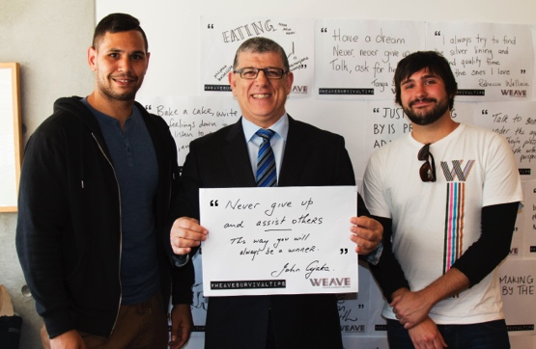
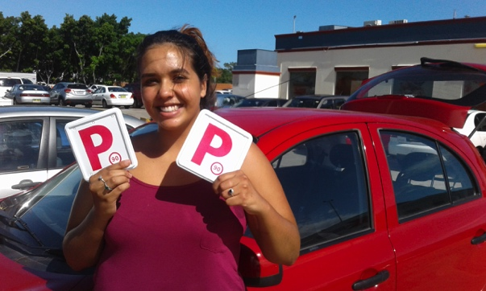
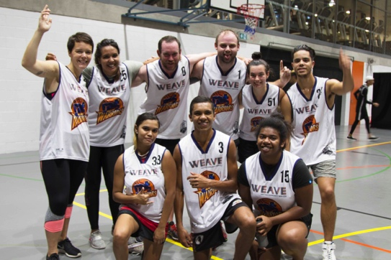
Speak Out Dual Diagnosis Program
We work with young people aged 12 – 28 years experiencing mental health and AOD challenges
We are person centered, strengths based and trauma informed; we see mental health and AOD issues as coping strategies that have helped the young person survive horrific events
We provide individualised care and long term care
We are funded by Department of Health

Slide 10
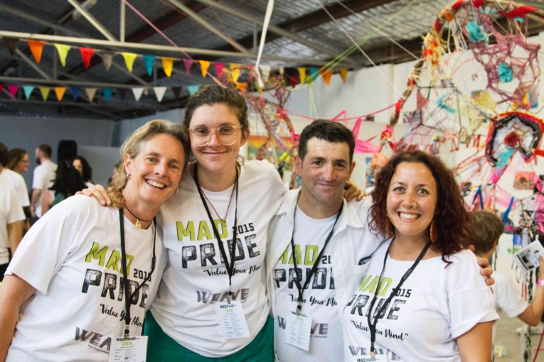
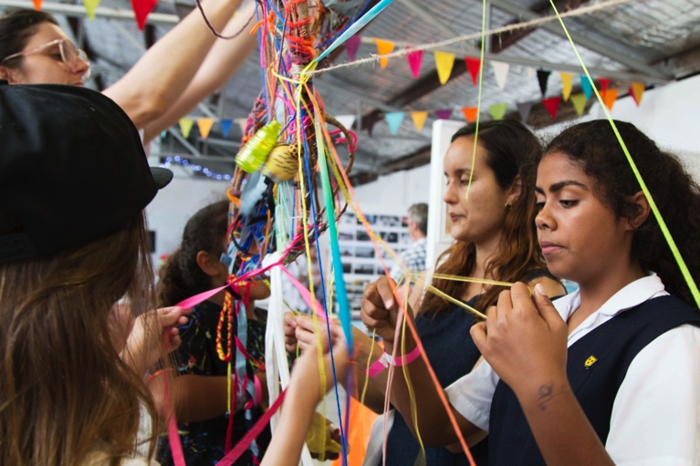
Speak Out Dual Diagnosis Program
We are a team of 10 - counsellors, caseworkers and project workers
We currently have 80 clients engaged in long-term counselling and casework support
Of these, 69% identify as Aboriginal people
50% are male and 50% are female
80% of our clients are self referral

Slide 11
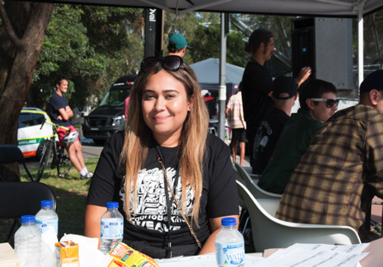
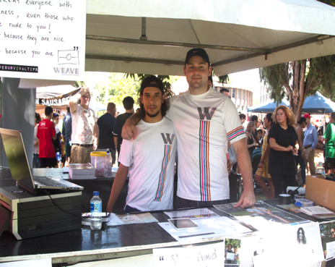
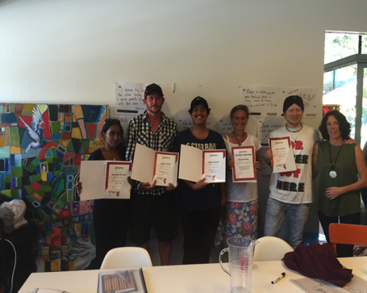
Weave Youth Leadership &
Work Ready Hub
Mental health is defined as a state of well-being in which every individual realizes his or her own potential, can cope with the normal stresses of life, can work productively and fruitfully, and is able to make a contribution to her or his community.
Ref: World Health Organisation http://www.who.int/features/factfiles/mental_health/en/
The opposite of addiction is not sobriety.
The opposite of addiction is connection.
Ref: Johann Hari Ted Talk https://www.ted.com/talks/johann_hari_everything_you_think_you_know_about_addiction_is_wrong/transcript?language=en

Slide 12
“Every single person has capacities, abilities, gifts,
and ideas, and living a good life depends on whether
those capacities can be used, abilities can be
expressed, gifts given and ideas shared” Jody Kretzmann

Slide 13
weave.org.au
www.facebook.com/WeaveYouthFamily
@weave_youth | @weavesurvivaltips
@weave_youth

