Slide 1
Youth Pathways and Transitions in difficult times: What the research tells us
Johanna Wyn
Youth Research Centre
Melbourne Graduate School of Education
The University of Melbourne

Slide 2
Table 1. Trends for young people 18-34 years in Australia 1976 and 2011
Trend | 1976 (%) | 2011 (%)
Education
Non-school qualification | 30 | 52
Bachelor degree or higher | 5 | 26
Work
Labour force participation | (M) 88 (F) 54 | (M) 79 (F) 69
Part-time employment | 11 | 34
Relationships and Identity
Married | 64 | 29
Median age of first marriage | (M) 24 (F) 21 | (M) 30 (F) 28
Born overseas | 24 | 27
Place of birth | UK Ireland 40 | UK Ireland 10
 | Rest of Europe 40 | Rest of Europe 7
 | Asia 11 | Asia 53
Religion
No religion | 12 | 29
Christian | 74 | 50
Other | 14 | 21
Source: ABS, 2013 (data from Australian Census 1976, 2011). From Woodman and Wyn 2014. Youth and Generation, London: Sage.

Slide 3
Changing Transitions
childhood
youth
adulthood
A New Adulthood?
Positive
“Choice Biographies”
(du Bois Reymond 1998)
“Emerging Adulthood”
(Arnett, 2004)
Negative
“Delayed Adulthood”
“Adulthood on Hold”
“Extended Adolescence”
(Côté 2000)
Notes:
When talking about this slide, emphasise that policies are moving towards a less linear and more relational focus. The metaphor of belonging is being used: Where and how do young people belong?

Slide 4
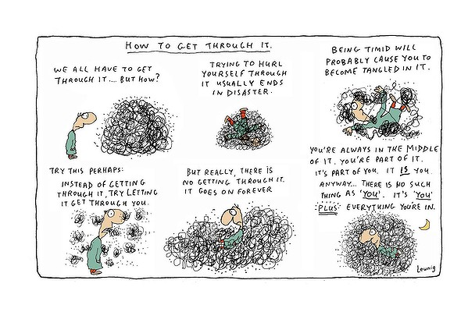
Notes:
My orientation is on the nexus between educational and youth research. Working at the YRC for over 25 years, with close connections with researchers in Europe, North America and, more recently in the Asian region.
Briefly explain my frame of reference by introducing the Life Patterns longitudinal study. Explain what a longitudinal perspective can provide:
Goals, aspirations and realities in real time
Individual trajectories, disaggregated
Mix of qualitative and quantitative data that assists in unravelling connections and helps with explanation
The picture is something like this Leunig cartoon.
Drawing on the experiences of young Australians over the long transition from education into work, my talk reflects on the way in which old anxieties and tensions in this field have been brought to the fore in recent times.
These tensions are around the role of education in supporting young people’s transitions from education into employment in an increasingly volatile and perhaps hostile external environment.
Say what I want to achieve in this lecture. Come back to this.

Slide 5
Life Patterns
Longitudinal Panel Cohort Study funded by the ARC
Cohort1: Left secondary school in 1991 (Victoria)
Cohort 2:Left secondary school in 2005 (Vic, ACT, Tasmania, NSW)
Representative by type of school, gender, SES
Oversampled in rural for cohort 2
Comparative data:
Age 23
Cohort 1: 1996 N=1925
Cohort 2: 2011 N=722
Age 25
Cohort 1: 1998 N=1410
Cohort 2: 2013 N=630

Slide 6
Employment type at age 25, in 1998 & 2013, (%)

Slide 7
Non-standard work by level of education, aged 25, 2013, (%) N=630

Slide 8
Non standard work patterns, aged 21-25, 2009-2013 (%)
Total non-standard = 70%

Slide 9
Comparison: Combining work & study aged 23 by SES and gender, 1996 (N=1925) & 2011 (N=722), (%)

Slide 10
Part time employment by Post Secondary Study aged 25 in 1998 (C1 N=1410) and 2013 (C2 N=630)

Slide 11
Physical and Mental Health aged 19-25 in 2007-2013 (mean), N=630

Slide 12
“Very important life goals in the future” aged 25, 1998 (C1) & 2013 (C2), (%)

Slide 13
“Very Important to deciding on a job for the future” aged 23 in1996 (C1) & 2011 (C2)

Slide 14
Comparison: “Very likely in 5 years from now” aged 23 in 1996 (C1) & 2011 (C2) (%)

Slide 15
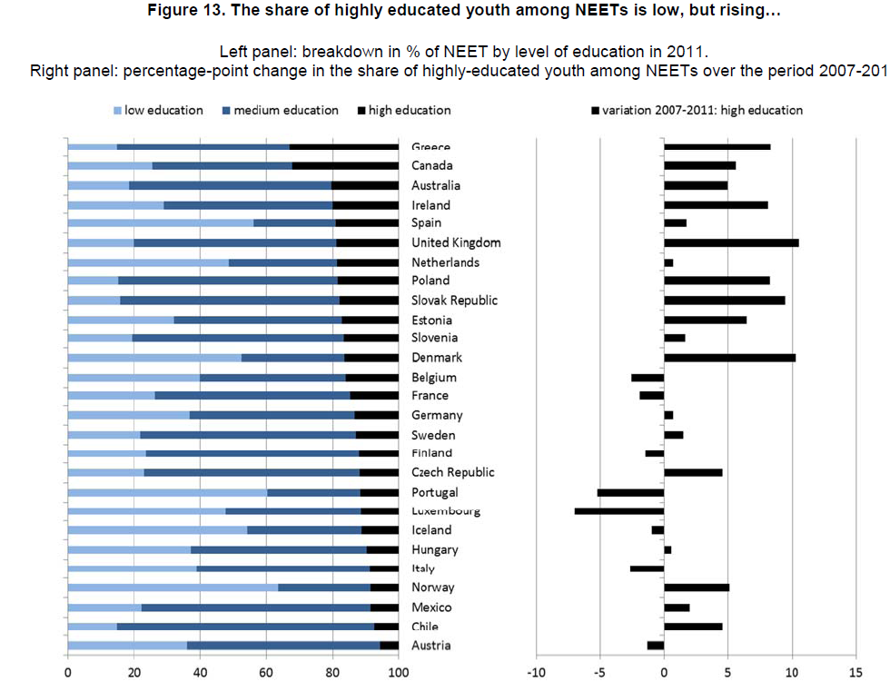
Source: Social Policies for Youth: Bridging the Gap to Independence Scoping Paper 2013, OECD.

Slide 16
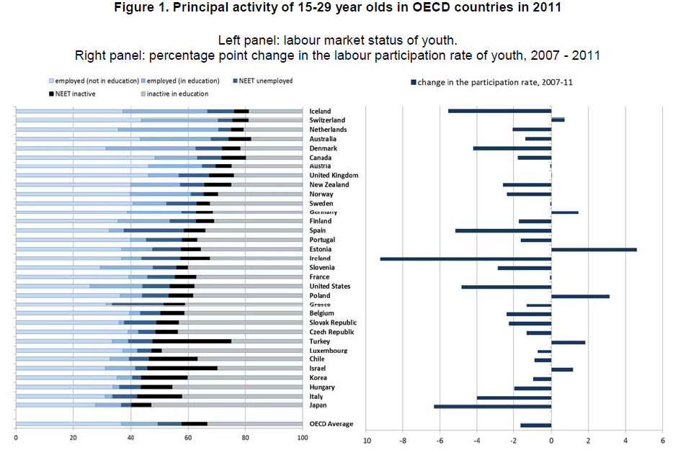
Source: Social Policies for Youth: Bridging the Gap to Independence Scoping Paper 2013, OECD.
Notes:
This slide shows that the rate of unemployment is increasing in Australia, and that we have a relatively high rate of young people employed in education

Slide 17
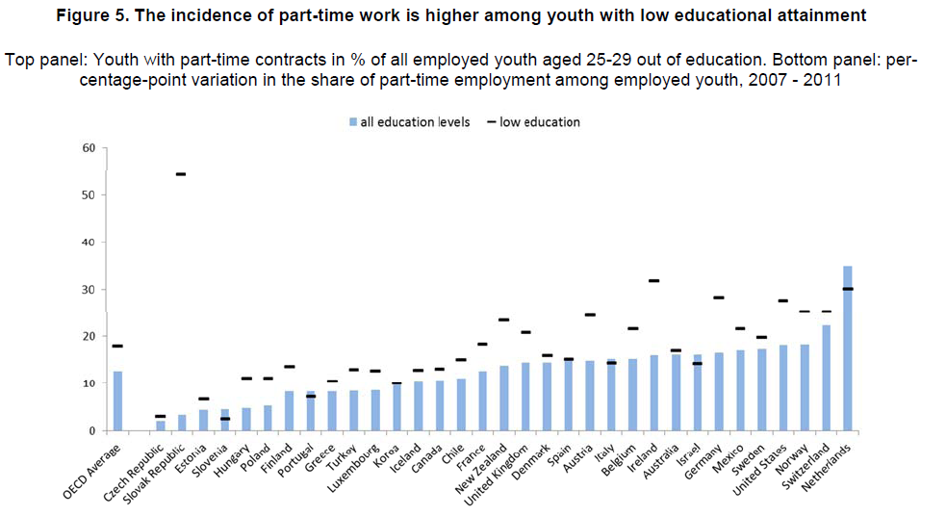
Source: Social Policies for Youth: Bridging the Gap to Independence Scoping Paper 2013, OECD.

Slide 18
Full time work 1992 – 2011 by gender, aged 19 - 38, N=274, %

Slide 19
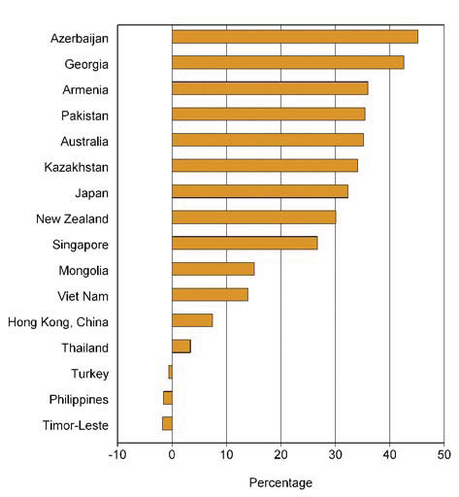
Gender Wage Gap for Selected Asian and Pacific Countries 2010
Source: Statistical Yearbook for Asia and the Pacific, 2013.UNESCAP

Slide 20
Brown, P., Lauder, H., & Ashton, D. 2011. The Global Auction: The Broken Promises of Education, Jobs and Incomes. New York: Oxford University Press

Slide 21
Effects
Longer job search time and poorer quality jobs
“Scarring”
Loss of earning power
Distrust of socio-economic and political systems
Dissatisfaction with work
Denial of the resources to build a life
Low rates of marriage and fertility
Increasing rates of mental health problems (anxiety disorders and depression)

Slide 22
Youth transitions is not a new problem
But the scale and nature of complex and failed youth transitions is a challenge to conventional understandings of education as a tool for youth transition
Notes:
Youth Transitions is not a new problem.
The same groups of disadvantaged (low SES, rural, Indigenous) have, for the last quarter of a century been the subject of policies aimed at bringing them into the mainstream.
The ‘youth bulge’ in many countries.
Youth unrest in the Middle East, UK.
In an era marked by transformations in the nature of work, new communication technologies and unprecedented levels of mobility of capital, people, information and ideologies across national and cultural borders, the role of education is increasingly complex.
New patterns of connectivity are emerging for young people, bringing new patterns of living, new forms of belonging and citizenship and new aspirations (particularly in relation to education and employment), as well as fears about cultural change and nationhood. At the same time, new inequalities locally and globally are being created, and a great many young people feel alienated from their communities, their aspirations often thwarted by institutions that promise more than they are able to deliver.

