Slide 1
National Foundation Skills Strategy for Adults
Alec Wickerson
Manager, Foundation Skills Policy
March 2013

Slide 2
Presentation Outline
Introduction
Why a National Strategy
What is the National Foundation Skills Strategy for Adults
What are Australian governments doing to improve the foundation skills levels of working age Australians

Slide 3
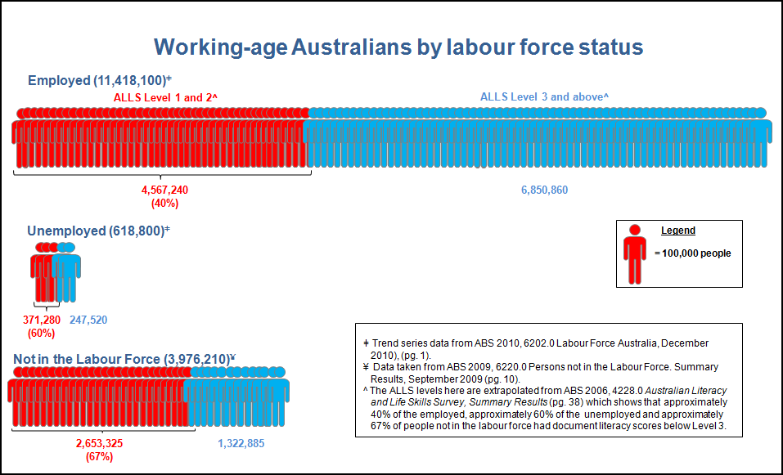
Findings from the 2006 OECD Adult Literacy and Life Skills (ALLS) Survey

Slide 4
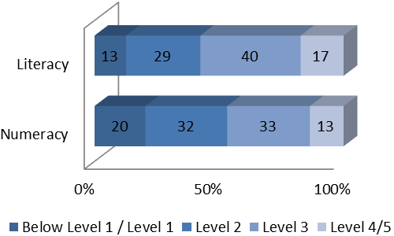
OECD Program for the International Assessment of Adult Competencies (PIAAC) 2013

Slide 5
Strategy overview
The Strategy is a framework for all Australian governments to lift the foundation skills of working age Australians (15 – 64 years).
Includes an aspirational target that by 2022, two thirds of working age Australians will have skills at ALLS Level 3 or above.
Effective from 2012 – 2022.

Slide 6
National Priority Areas
1. Raising awareness and commitment to action
2. Ensuring that adult learners have high quality learning opportunities & outcomes
3. Strengthening foundation skills in the workplace
4. Building the capacity of the education & training workforces to deliver foundation skills

Slide 7
NFSS current activity
Foundation Skills Assessment Tool
Professional Development Workshops
LLN Practitioner Scholarships
Foundation Skills Champions
Professional Standards Framework

Slide 8
Resources
Foundation Skills Workforce Development Projects, including e-newsletter www.dfeest.sa.gov.au
Foundation Skills Assessment Tool consultation schedule www.acer.edu.au/tests/fsat
Professional Development Workshops. Coming soon. innovation.gov.au/skills

