Slide 1
Foundation Skills Assessment Tool (FSAT) Melbourne, March 28th 2014
Notes:
DR

Slide 2
What is FSAT?
The Department of Industry has contracted ACER to develop an online Foundation Skills Assessment Tool (FSAT) to identify and assess an individual’s foundation skill levels.
The tool will be available free to assist approved providers and identified learners, job seekers, trainers, educators and employment services practitioners to assess their own or a client’s foundation skill levels, and help identify any gaps in skills and knowledge.
The FSAT will be based around the theoretical underpinnings of the Australian Core Skills Framework and the Core Skills for Work Developmental Framework (employability skills).
There is to be two assessments – a Full Assessment and an Integrated Short Assessment.
This integrated short assessment will provide an indicator of an individual’s skills against reading and numeracy alongside an assessment of some aspects of their core skills for work. Intention is to target lower levels of the ACSF only.
Will be developed after trialling of other assessment questions.
Website at: http://www.acer.edu.au/tests/fsat
Notes:
DR

Slide 3
Delivery of FSAT
Teacher/trainer/RTO → learner
Employment Services
Full CSfW assessment suite
Short integrated assessment
Job-seeker/individual
Full ACSF assessment suite
Entry Point/ Welcome for Approved Users
Notes:
DR

Slide 4
Platform – Key Features
Select assessments from 16 skill areas across 2 frameworks
Practitioners will be able to tailor assessments for individuals and/or groups
ACSF Assessments can be selected at suitable test taker levels: low and middle
Newly developed online interactive item types have been developed
Test takers can complete relevant assessments over time
Individual reports available to test takers against each assessment
Data and reports for RTOs include levels, indicators, question intents, etc.
Notes:
DR

Slide 5
Platform – Key Features
The FSAT assessments will include different types and styles of assessment, including:
computer-adaptive assessments
questions and responses based on scenarios
self reflective tasks
manually scored assessments for core skills where online automatically scored assessment is not (currently) possible.
Notes:
DR

Slide 6
Assessment of the ACSF
Empirically based Computer-adaptive assessment features will be used for:
Learning
Reading
Receptive listening
Numeracy
Allows questions to be selected based on the learner’s abilities – if they get a question or questions correct, they get a harder set of questions, or alternatively if they get it wrong they get an easier question. This process continues and focuses in on a more accurate estimate of their ability. Also makes the questions asked accessible in relation to their ability
Requires large number of items that need to be trialed and used.
Notes:
DR

Slide 7
Computer-adaptive assessments
Unit 4
☑☑☒☑☒
☑☒☒☑
Unit 5
☑☑☒☑☒
☑☑☒☑
Estimate of ability
Unit 3
☑☑☑☑☑
☑☒☒☑
Unit 2
☑☑☑☑☑
☑☒☒☑
Unit 1
☑☒☑☑☑
☑☒☑☑
Allows questions to be selected based on the learner’s abilities – if they get a question or questions correct, they get a harder set of questions, or alternatively if they get it wrong they get easier questions. This process continues and focuses in on a more accurate estimate of their ability. Makes the questions asked accessible in relation to their ability.
Notes:
DR

Slide 8
Computer-adaptive assessments
Unit 1
☑☒☑☑☒
☑☒☒☑
Unit 2
☑☑☒☑☒
☑☒☒☒
Unit 3
☑☑☒☑☒
☑☒☒☑
Unit 4
☑☑☒☑☒
☑☑☒☑
Estimate of ability
Unit 5
☑☑☑☑☒
☑☑☒☑
Notes:
DR

Slide 9
Assessment of the ACSF
Non-automatically scored assessments will be used for core skills where online automatically scored assessment is not (currently) possible:
Writing
Speaking
Interactive listening
These will be manually scored assessments conducted against selected prompts with assessors scoring the responses against the provided marking guides
Notes:
PMcL

Slide 10
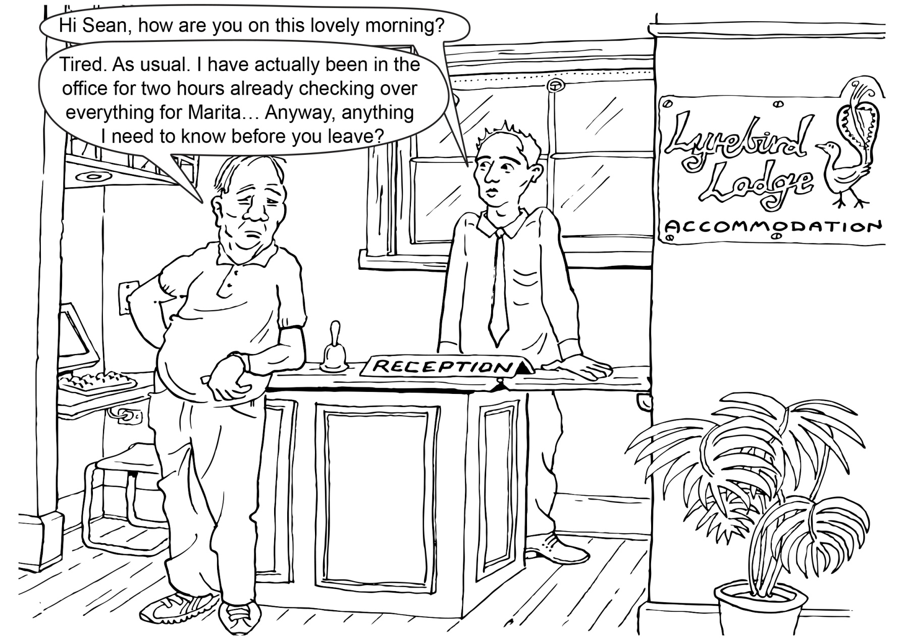
Assessment of the CSfW
Notes:
Dara

Slide 11
CSfW: Generic scenarios
A set of authentic scenarios for each Skill Area
Workplace and community settings
People, tasks, interactions that reflect real life situations (as far as possible)
No highly specific, context-dependent knowledge needed
Most respondents likely to have some past experience to bring, but some scenarios will be quite unfamiliar (sometimes that’s the point!)
Coverage
Most scenarios provide opportunity to demonstrate skills across several stages (but no single scenario captures all 5 stages)
Stages 1-4 well represented
Limited number to Stage 5
Levels 4 and 5 require good L&N skills
Notes:
Dara

Slide 12
Platform – what does FSAT look like?
Demonstration of practice assessment tasks to show how they will look and different types of interactivity and response.
Learners should undertake the practice assessment before undertaking the FSAT assessments.
http://schools.acer.edu.au/fsat
Notes:
DR

Slide 13
Thanks!
For more information visit: www.acer.edu.au/tests/fsat/fsat-latest-news
Notes:
Kate

