Slide 1
Resilient Community Education Businesses – what works
Presentation to 2012 ALA National Conference
Verna Kearney Anne Burgoyne
Acting Executive Director Eastern Metro Regional Manager
ACFE ACFE

Slide 2
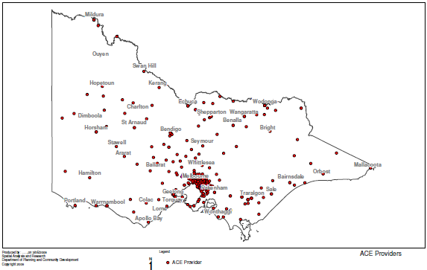
ACFE Snapshot

Slide 3
Building Resilient Community Education Businesses
Resilience
“Your organisation’s capacity to be buoyant and recover readily.”
Sustainability
“Your organisation’s capacity to mobilise resources consistently over time to respond effectively to local needs.”

Slide 4
Building Resilient Community Education Businesses
Quality teaching and learning
Building business capacity

Slide 5
Building Resilient Community Education Businesses
Learn Local sector consultation identified needs including:
sustainable business development
sustainable approaches to workforce planning
increased professional development opportunities
facilitation of communities of practice
governance

Slide 6
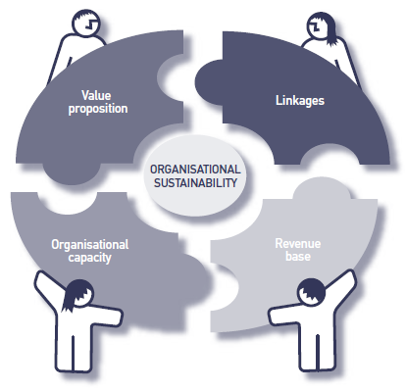
Building Resilient Community Education Businesses

Slide 7
Building Resilient Community Education Businesses
External Challenges:
Changes in Government policy
Increasing compliance requirements
Increased competition for key resources
Changes to fee structures
Changing market
New learner eligibility requirements
Community perceptions

Slide 8
Building resilience 2009-2012
ACE Capacity Initiatives:
Sustainable ACE businesses
Quality teaching and learning
in ACE
Technology for teaching

Slide 9
ACE Business Capacity and Knowledge Project

Slide 10
New Ways of Working with Business

Slide 11
New Ways of Working with Business

Slide 12
Sustainable ACE Businesses

Slide 13
Sustainable ACE Businesses
Shared Services Pilot Project
Project grants available to improve back-of-house efficiency of ACE organisations, particularly smaller rural organisations with smaller staff numbers and skill sets.
Seven demonstration projects funded over 2 years.

Slide 14
Sustainable ACE Businesses
Microsoft Agreement
The ACFE Board’s agreement with Microsoft ensures that education –level pricing of software and sufficient product licenses are available for ACE organisations
ACE learners have access to up-to-date and appropriate software
ACE organisations can undertake administrative, teaching, planning and management activity with the support of current software

Slide 15
Quality Teaching in ACE
Pre-accredited delivery = The initial vocational training that provides a pathway to nationally accredited training or employment.
Semi-formal
Informal
Formal
Learning continuum

Slide 16
Who are the high needs learners?
Culturally and Linguistically Diverse (CALD)
Disabled
Disengaged youth
Early school leavers
Indigenous
Low socio-economic status localities
Males over 45
Vulnerable workers
Unemployed

Slide 17
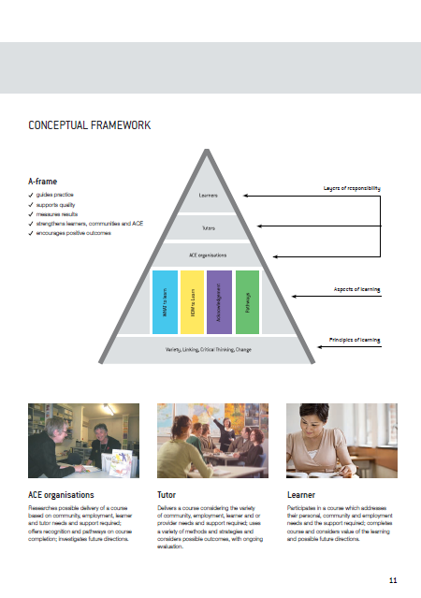
Quality Teaching in ACE

Slide 18
Quality Pre-accredited Delivery
Growing Skills for Knox Project
Coonara Community House
The Basin Community House
Rowville & District Neighbourhood House
Mountain District Learning Centre
Orana Neighbourhood House

Slide 19
Quality Teaching in ACE
“Around 1.6 million adult Victorians do not have any post-school qualifications.”
ACFE 2009

Slide 20
Quality Teaching in ACE
“Because refugees and migrants are different groups of people, with different pre-arrival experiences, it is important that the distinction be made in the services provided. Refugees have needs distinct from and additional to migrants.”
Refugee Council of Australia (2012)

Slide 21
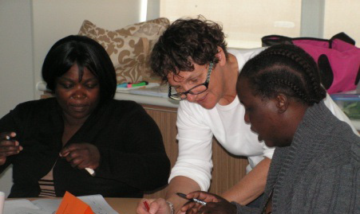
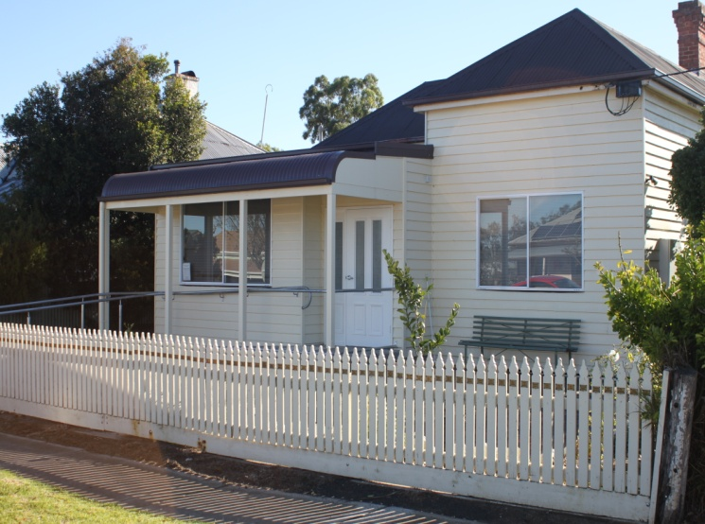
Responding to CALD Learners

Slide 22
Community Learning Partnerships
The ACFE Board has encouraged ACE organisations to foster partnerships to address specific local skills and challenges through the Community Learning Partnership (CLP) program.
Grant program
Partnerships with industry, business, individuals and community organisations
Skill development to prosper economically and socially

Slide 23
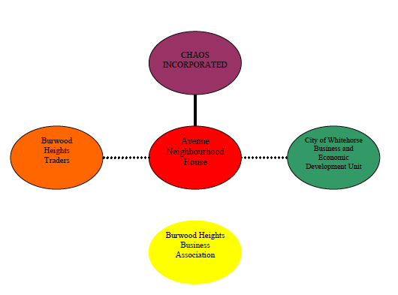
Community Learning Partnerships Open4Business – The Avenue @ Eley
Collaboration chart at project commencement November 2010

Slide 24
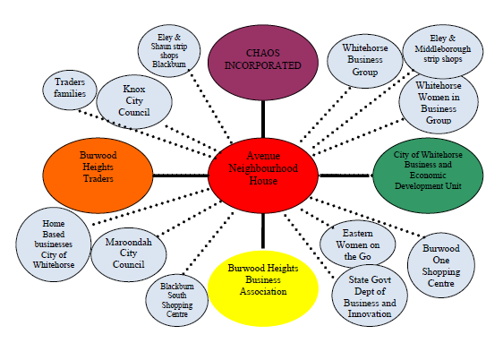
Community Learning Partnerships Open4Business – The Avenue @ Eley
Collaboration chart end project May 2012

Slide 25
Capacity and Innovation Fund
ACE Provider Business Capacity
Partnering
for Learning
Quality Teaching
Innovating
for Learners

Slide 26
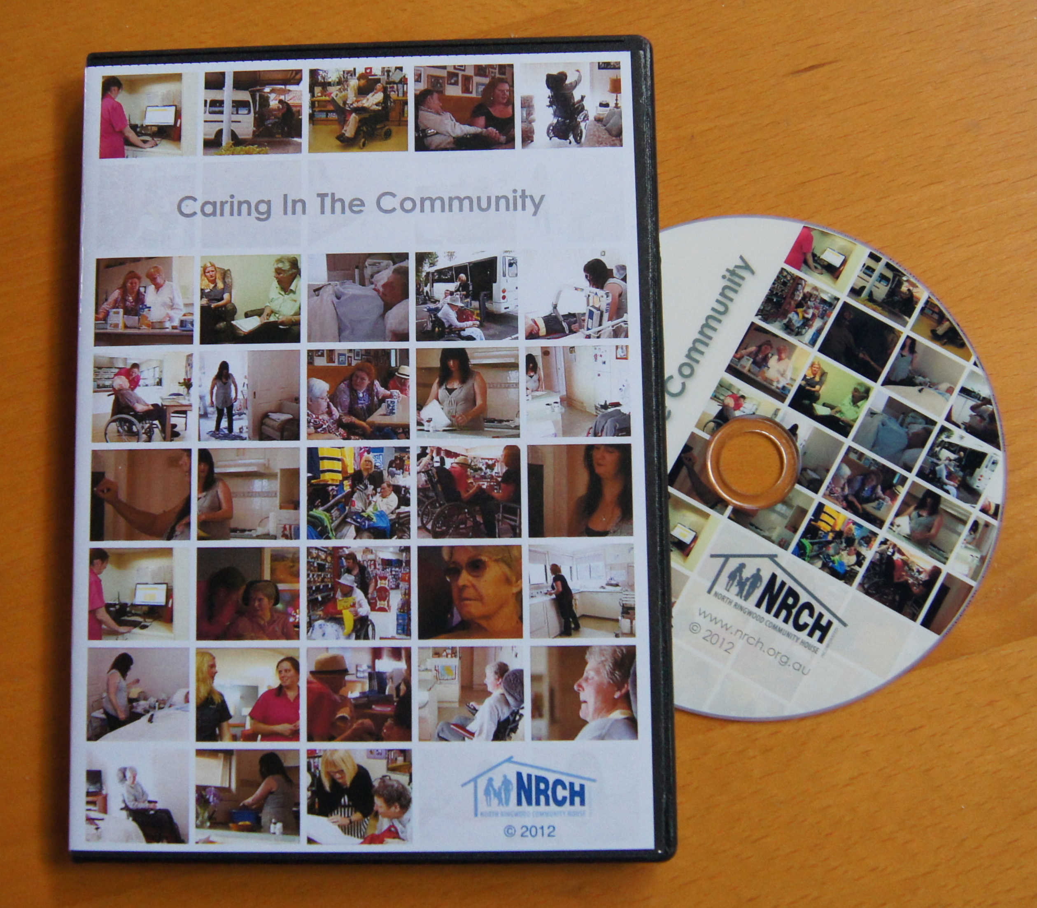
Capacity & Innovation Fund Projects

Slide 27
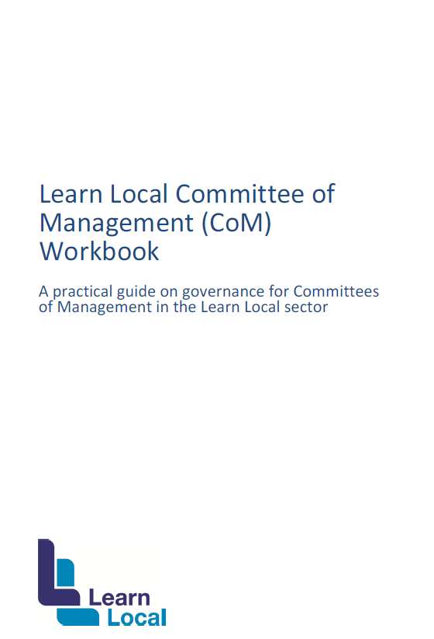
Building Resilient Community Education Businesses

Slide 28
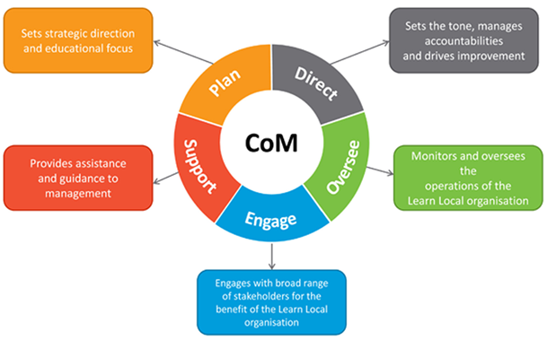
Building Resilient Community Education Businesses

Slide 29
Questions
Resources are available on the ACFE website:
www.skills.vic.gov.au/Pages/learnlocal-ACFE
Enquiries can be directed to:
acfe@edumail.vic.gov.au

