Slide 1

Making a Positive ImPrint: creative approaches & relationship building in adult education
Toril Pursell, BA Art & Anth, MA Art Therapy, AThR
Rose Marie Paduano, BA, Dip Ed Psych, M Ed Psych
Port Phillip Community Group, Melbourne VIC (www.ppcg.org.au)
Dr. Leone Wheeler, EdD, MBIT, BCA, Dip Tching (Sec), RMIT University
Notes:
-Port Phillip Community Group (PPCG) in Melbourne, VIC launched the ImPrint program designed to effectively engage, support and retain “hard to reach” adult learners. ImPrint was funded by the Adult Council for Further Education (ACFE) and developed in consultation with local services providers and RMIT University. The pilot engaged ten participants in a series of creative-based, personal development workshops. The workshops were accompanied by ongoing individual support mentoring to stimulate positive social outcomes.‘Making a Positive ImPrint’ will share tips about how PPCG engaged and retained participants. The Group Facilitator and Social Support Mentor will discuss their respective roles. The ImPrint curriculum accompanied by vignettes will illustrate key challenges and enablers to accessing adult education in the community development sector.

Slide 2

Workshop structure
Introduction: RMIT and ImPrint context report
ImPrint team roles and a relationship focussed learning framework
Reaching the ‘hard to reach’ learners- promotion, referral and evaluation methods
Enablers and barriers to learner engagement
Curriculum and creative approaches to adult education
Participants and building relationships
Conclusion
Notes:
-Note what is PPCG (bring brochures and business cards)

Slide 3


Introductory activity
Each person select up to 2 cards that relate to working with “hard to reach” adult learners
What makes some a “hard to reach” learner? What is the first enabler or barrier that comes to mind?
In pairs share which cards you chose and why.
Write down key words and/ or questions.

Slide 4


RMIT Context Report
Literature Review
Who are the “hard to reach”?
Going beyond labels
Practical strategies
Case Studies
Interviews
Recommendations for next phase of project
Notes:
-’Participation’ comes before ‘pathways’
-Progress is not linear

Slide 5
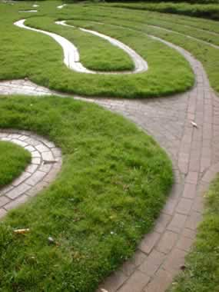

RMIT Context Report
Adult education for marginalised learners:
Pathways or plateaus? (Glamorgan and Kelly)
Notes:
-’Participation’ comes before ‘pathways’
-Progress is not linear.

Slide 6
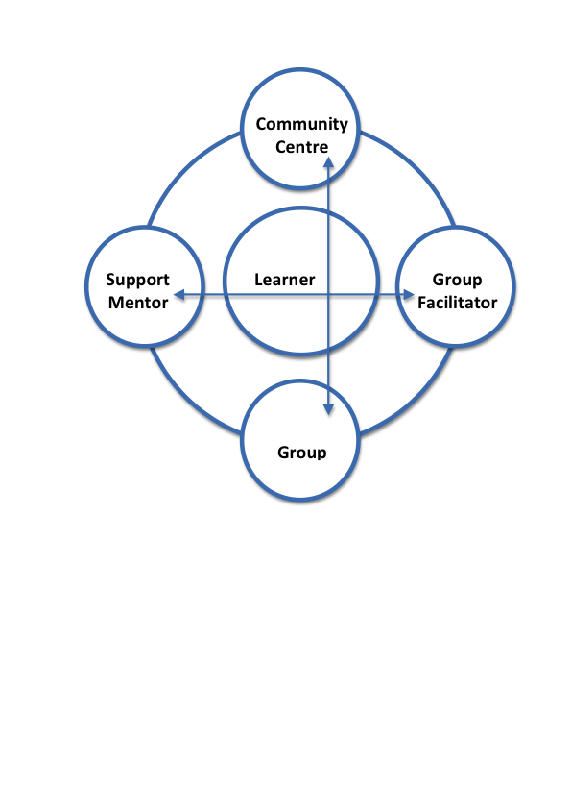
A relationship focussed learning framework
Notes:
Note role of RMIT and other stakeholders.

Slide 7
ImPrint team roles
Group Facilitator (GF)
Support Mentor (SM)
Develop ‘alternative’ curriculum with A-Frame & participant feedback
Facilitate weekly group workshops & excursions to engage ‘hard to reach’ learners- make non-formal learning fun
Address questions, conflicts and concerns within group
Collaborate and share information with Support Mentor
Document & evaluate process
Locate and select ImPrint participants
Provide regular individual support via meetings and telephone
Encourage course retention by identifying enablers and barriers to course participation
Resolve conflicts between participants and address concerns about curriculum
Develop pathways on completion of ImPrint
‘Modelling a positive working relationship’
Notes:
-ImPrint workshop time-frame & structure
-Scaffolding and fading for mentoring

Slide 8
ImPrint: How it works
Promotion
Referral process
Evaluation methods
Notes:
-Recommendations for Aframe and Ethics forms, to simplify and not patronise

Slide 9

Participant background & self-reporting
Majority of participants were middle-aged males in single household
Most were on DSP or equivalent
Reasons for joining ImPrint were generally out of interest or ‘something to do’
Extremely varied literacy levels, learning styles and interests (age mid-20’s to early-70’s, culturally diverse)
ACFE self-reporting pros and cons
Retention rates between Block I and Block II

Slide 10
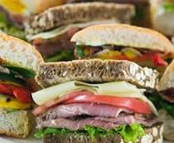


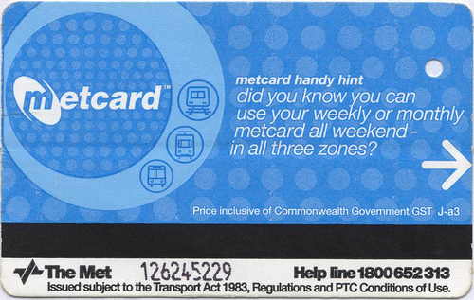

Enablers & barriers to engagement
Enablers: Life experience, group dynamic, Support Mentor and incentives
Barriers: Anxiety, fear, addiction, mental health challenges, socio-economic status and negative learning experiences
Prolonged isolation and lack of exposure to social groups
Notes:
-Side effects of medication
-Ability to express opinions
-Incentives: Meals, social inclusion, Metcards, food vouchers, support mentoring, certificate etc.

Slide 11
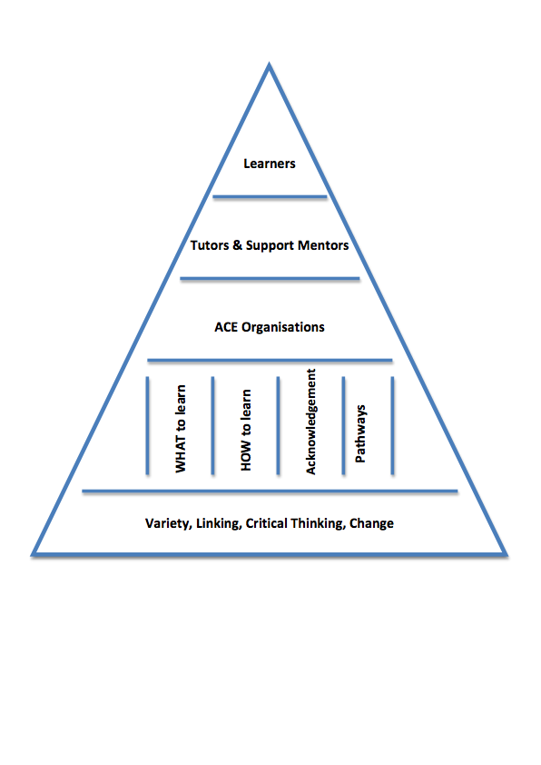
Curriculum
Input/ Relevance
Social component &
normalising
Practice & application
Feedback & sharing
Professional care
Notes:
-Side effects of medication
-Ability to express opinions
-Incentives: Meals, social inclusion, Metcards, food vouchers, support mentoring, certificate etc.

Slide 12


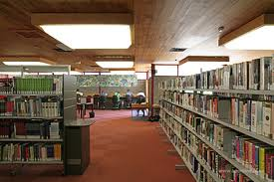



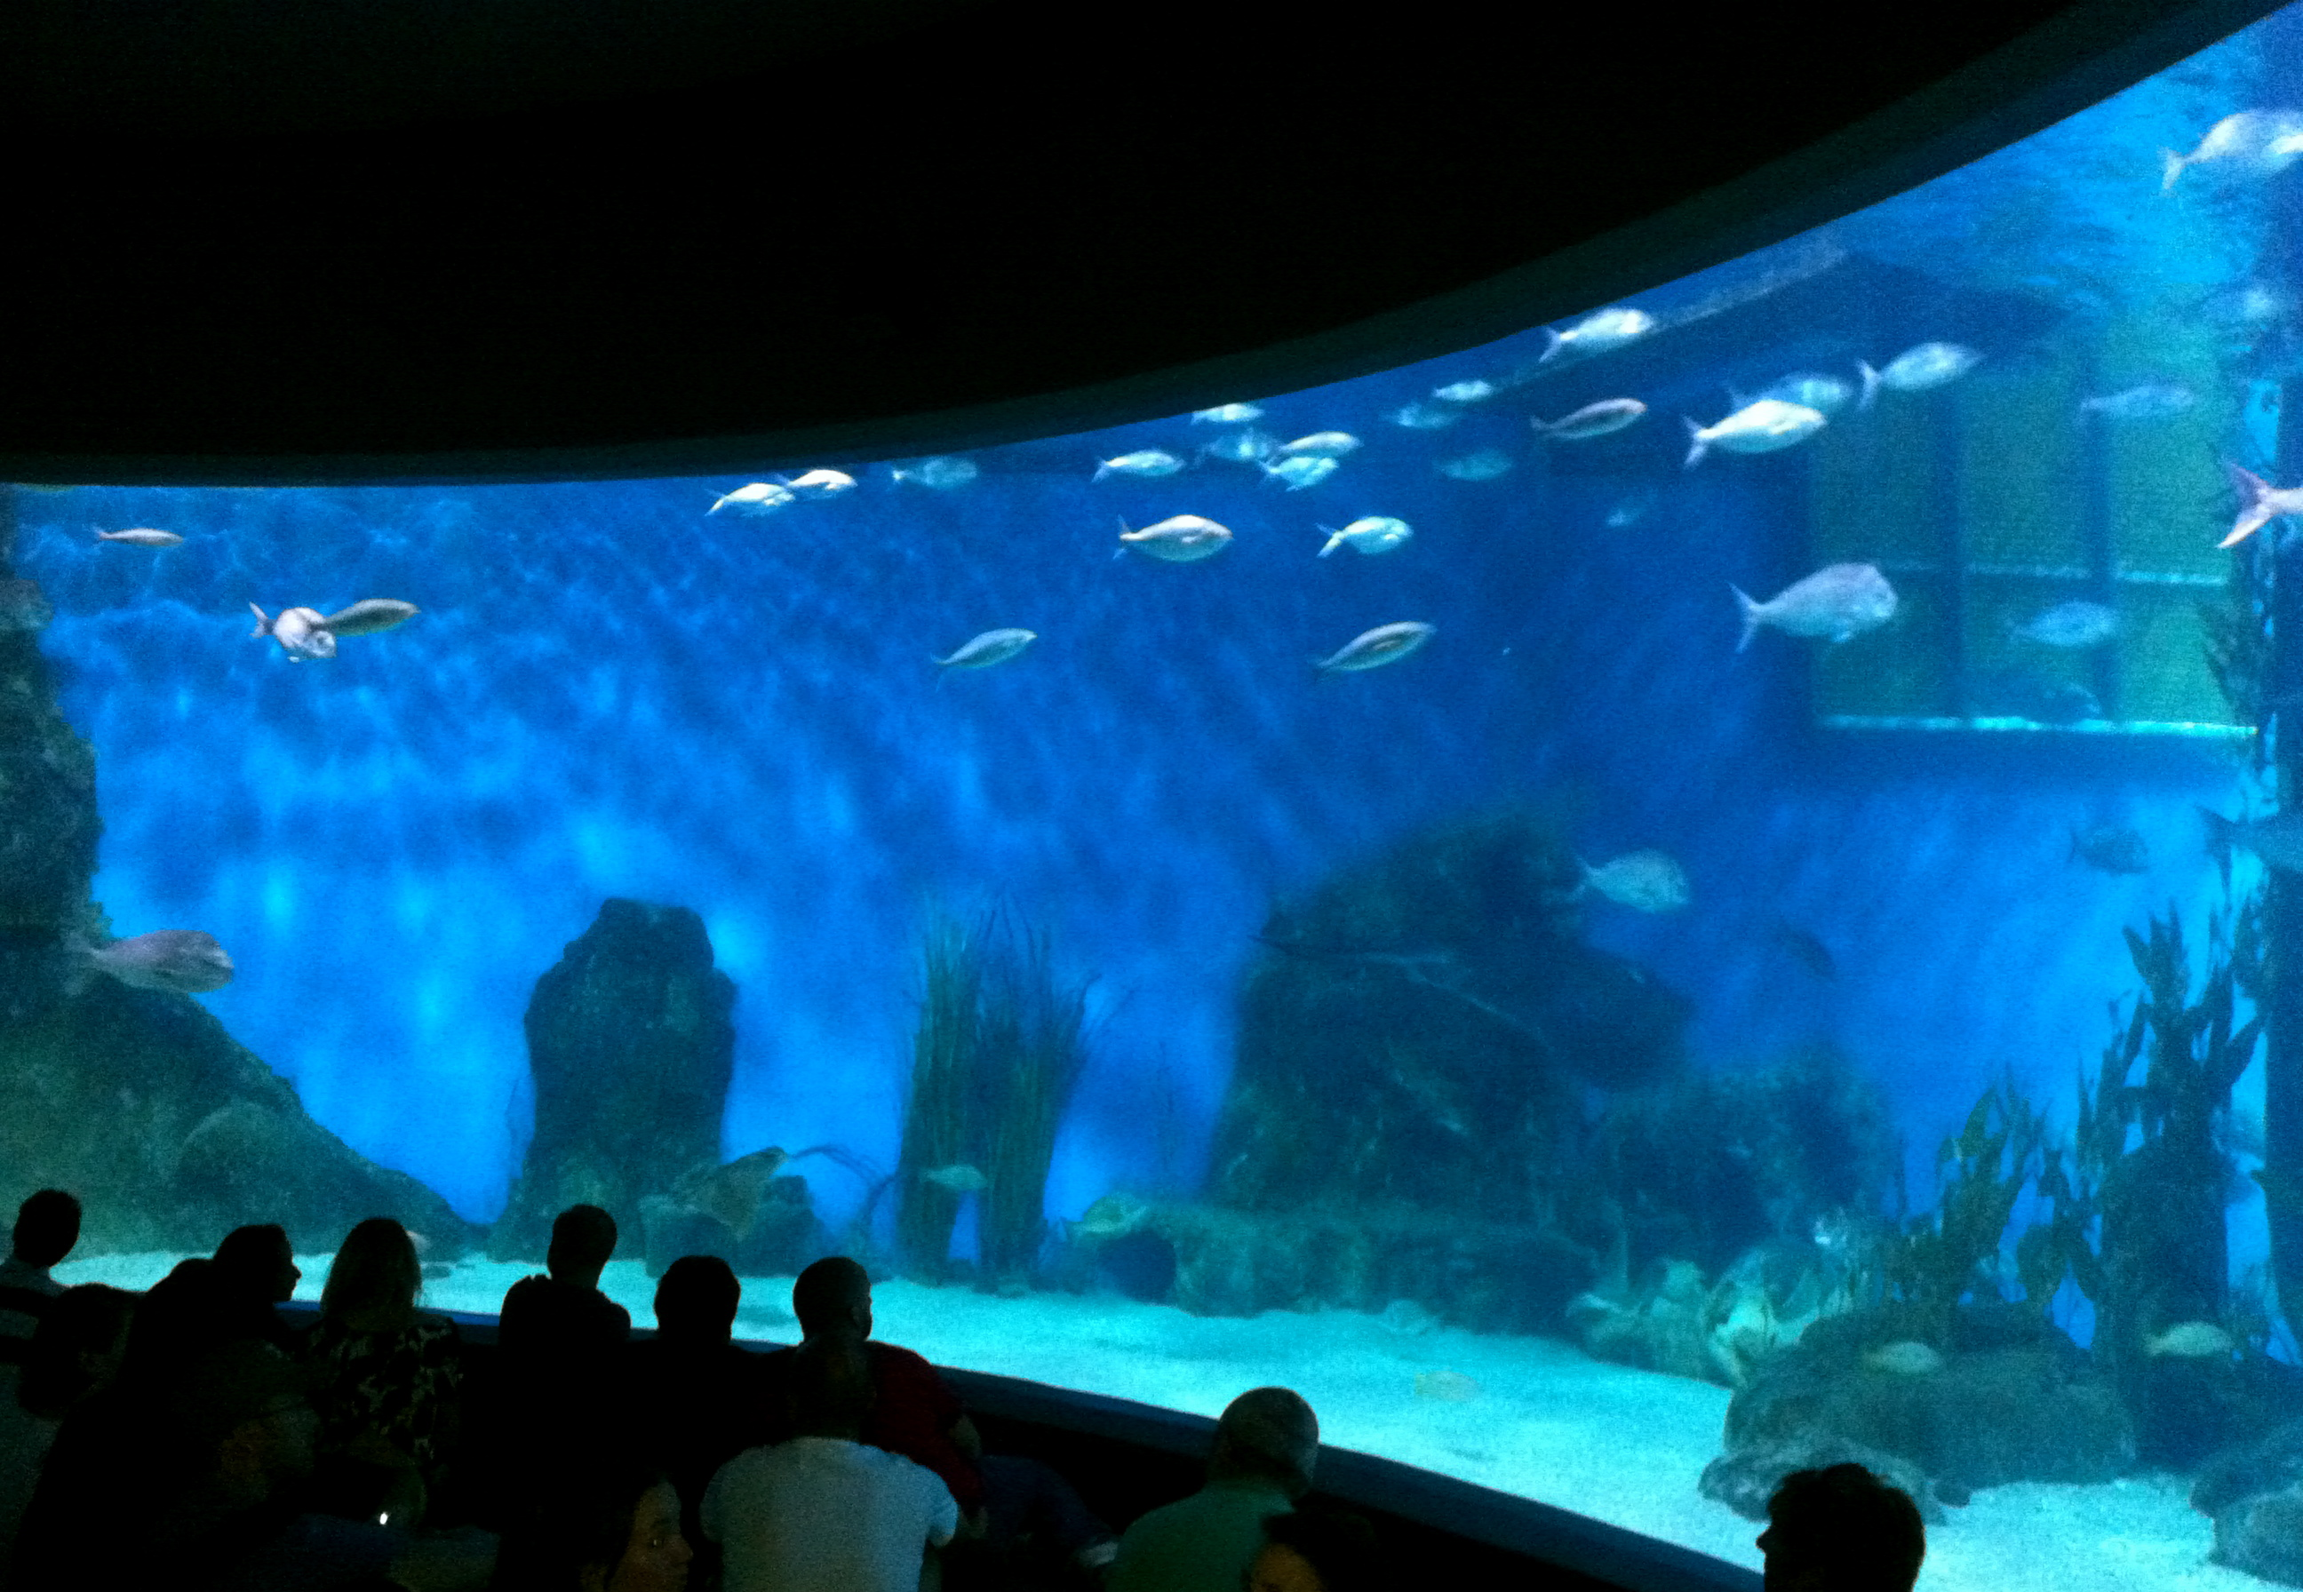
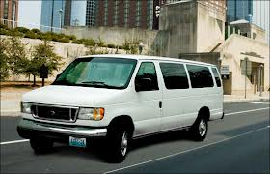
Creative approaches to adult education
Notes:
-Life Experience Counts reference

Slide 13

Process & outcomes of ImPrint exhibition

Slide 14
Participants and building relationships
Then
Now
Participant A: Looking for mentoring, unhappy social life and confident in groups
Participant B: Depression, alcoholism, ABI and other health problems
Participant C: Chronic mental health issues, PTSD, lack of social contact
Participant D: General mental health difficulties, limited social contact, language barriers
Participant A: Computer training neighbourhood house, counselling, art group, designing small business plan and job applications
Participant B: Our Voices steering committee, computer training, swimming, Photoshop session
Participant C: Art program, mental health intervention
Participant D: Kitchen work, English, counselling, driving program, assisting with church duties

Slide 15
The voice of participants
The benefit of having Rose there was that Rose is a person that has been able to diffuse conflict during the week before the participants got to the group session with Toril. It enabled Toril to remain impartial.
The development of social skills, increasing confidence and the importance of group acceptance ….. translated to everything I do and I consider it the basic building block of life.
I actually set a whole lot of goals and set targets and all sorts of stuff. So I did a huge, what do you call it, 10-page plan. I tick things off and I did the, what do you call it, the eight-week check-up today.
I can see I've really progressed and I've done so much more than what I actually thought so I'm getting work up and running, I've really increased in confidence, brilliant. Brilliant, brilliant. The fact that I can keep going and do follow-ups with Rose is just fabulous.

Slide 16
IMPRINT: CONCLUSION
Re-considering the definition “hard to reach”
A new ACFE model with Support Mentor & positive relationships
Transparency and communication
Co-facilitating to ensure needs are met
The importance of adequate planning, clear purpose, and learner input
The power of a shared meal, incentives and the politics of language
Longer-term pilot programs w/ emphasis on transition phase before ‘pathways’
Engaging support services (linking in)
Creative approaches and building relationships = a rehearsal ground
Notes:
-Do not rush implementation stage (why we are doing something is more important and what we are doing)
-Evaluation is only as hard as planning is poor’ –Inner South Health Training
-Acknowledge the financial and time constraints within community development sector

Slide 17

References
Ahern, S. 2011. Social Meals Program A Qualitative Analysis: A Comprehensive Report and Recommendations for the Social Meals in Rooming House Program in the City of Port Phillip, Melbourne. St Kilda Community Housing Ltd. [Online]. Available: http://www.stkch.org.au/wp-content/uploads/SMP-a-qualitative-analysis.pdf [Accessed 4th May 2012]
Brackertz, N. 2007. Institute for Social Research working paper: Who is hard to reach and why? Melbourne: Swinburne University of Technology.
Nechvoglod, L. & Beddie, F. 2010. Hard to reach learners: What works in reaching and keeping them? Melbourne: NCVER.
Neef, M. A. 1991. Human Scale Development - Conception, Application and Further Reflections. New York and London: The Apex Press.
McGivney, V. 1999. Informal learning in the community: a trigger for change and development, Leicester National Institute of Adult Continuing Education, NIACE.
Notes:
-Toril to include Block II outline
-Brochure of ‘How To’

