Slide 1
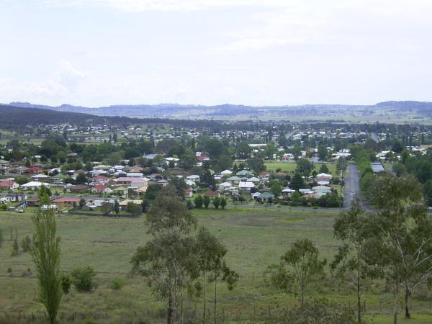
Lifelong Learning = Resilient Communities
Reflecting on the theme for the
2012 Adult Learning Australia Conference
Dr Roslyn Foskey
Adjunct Lecturer in Education
University of New England

Slide 2
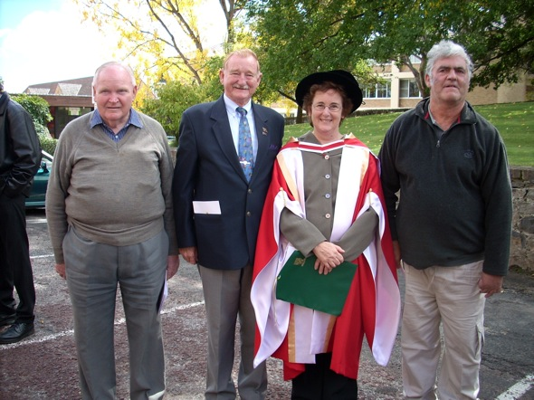
Lifelong Learning:
Easy to say but hard to define:
Learning throughout life,
formal and informal,
structured, evolving and emergent

Slide 3
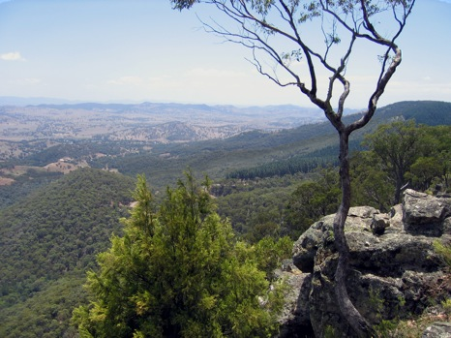
Resilience: one word but many meanings
* Norris et al (2008) - 21 representative definitions at five different levels of analysis (individual, community, social, ecological system and biophysical).
* Zhou et al (2010) – 27 definitions and five core themes: vulnerability, social attribute, social-ecological attribute, attribute of a specific geographical area &biophysical attribute
Three ontological metaphors for resilience……

Slide 4
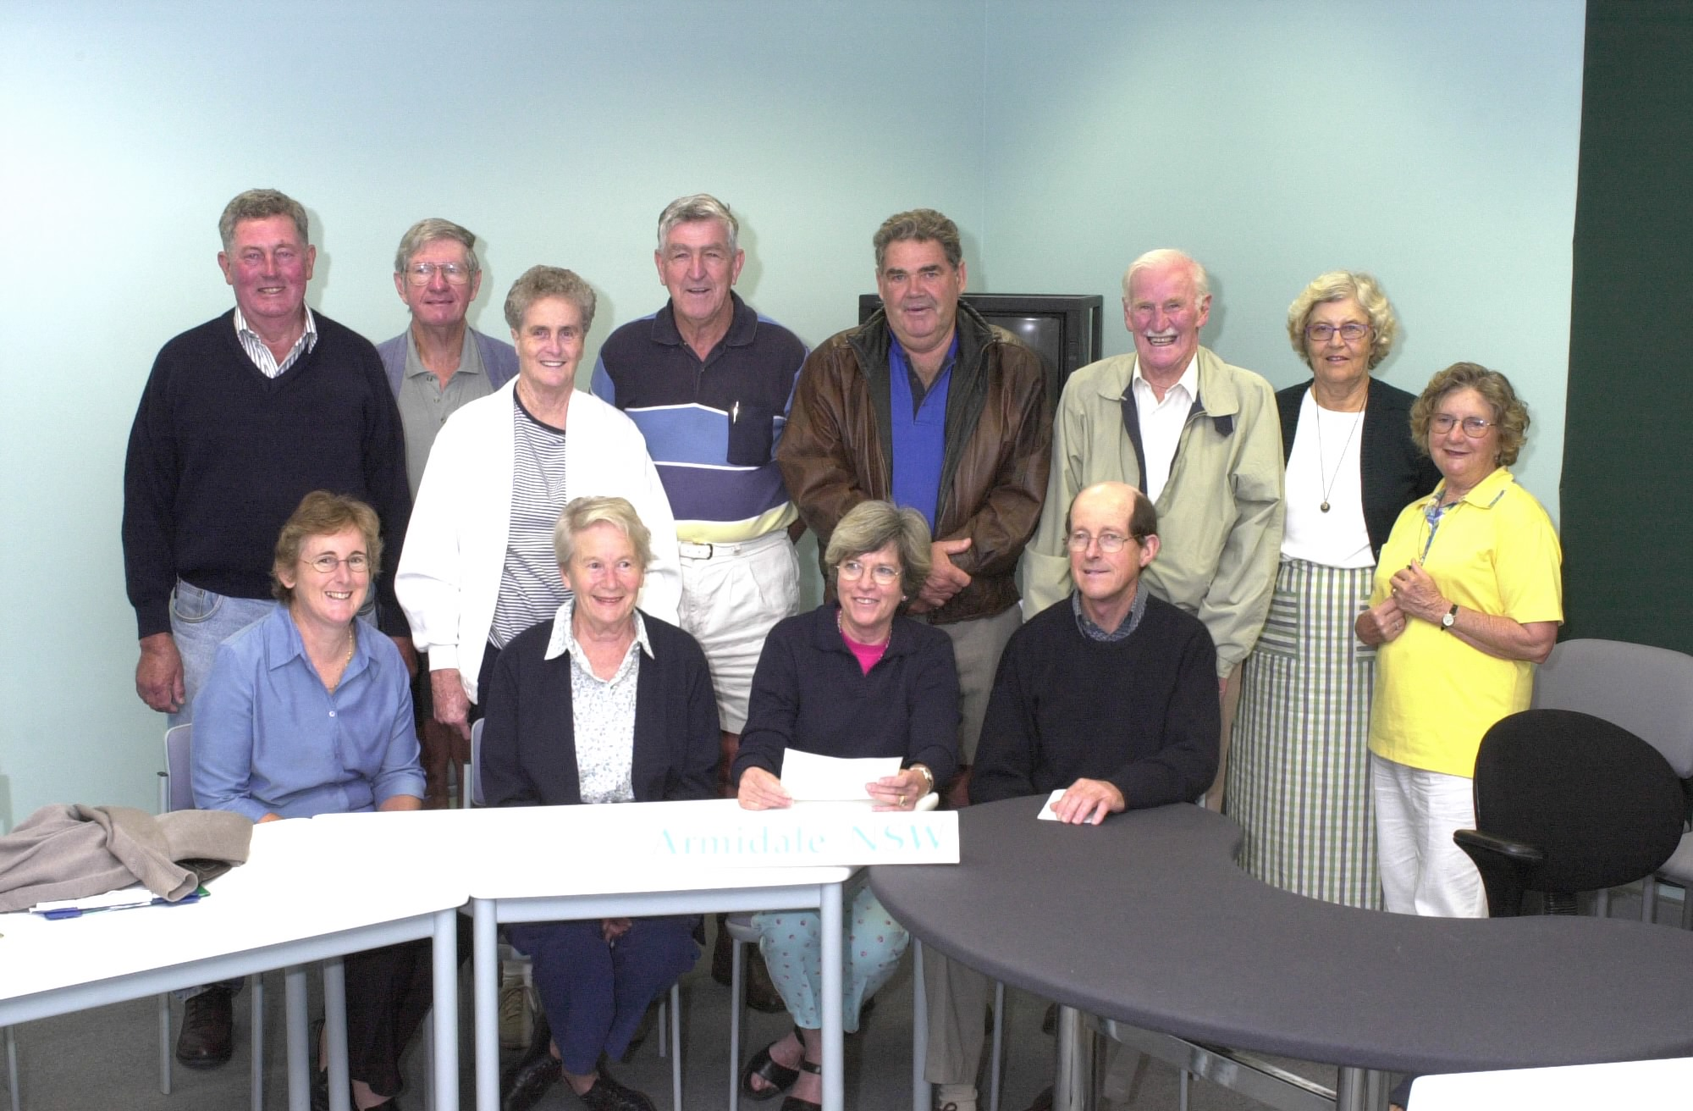
Engineering /Bouncing Back
* Roots in physics as the ‘capacity of a material or system to return to equilibrium after displacement’ (Norris et al 2008:127).
* In this conceptualisation the measure of resilience is both the ‘resistance to disturbance, and the speed by which the system returns to equilibrium’.
(Davoudi 2012:300)

Slide 5
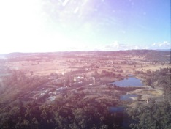
Ecological/ Bouncing Forwards:
* The capacity of a system to ‘absorb a disturbance and reorganize while undergoing change so as to still retain essentially the same function, structure, identity, and feedbacks’ (Walker et al 2004:1).
* In this conceptualisation of resilience there is the possibility of multiple stable states (Davoudi 2012).
* Resilience is adaptation and transformation in the sense of ‘bouncing forward’ to a new form of stability.
(Shaw 2012:309)

Slide 6
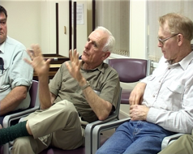
Socio-ecological/Evolving
* Perceiving the world in unordered ways.
(Snowden 2005)
* Irreducible uncertainty, rather than return to order.
(Hardy 2009)
* Learning as ‘the very dynamic of emergence in complex systems’ as well as ‘the sudden jumps in the systems phase states, its transformations, as it experiences disturbances and internal fluctuations’
(Fenwick, Edwards & Sawchuck 2011:29).

Slide 7
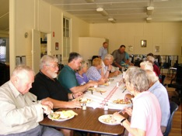
Resilience: best understood as a process
……particularly when combined as in the ALA conference theme with learning and community …..

Slide 8
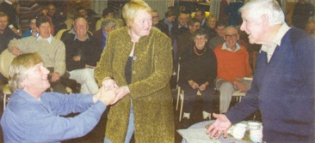
Community – another of those slippery terms:
Community Event
Rural Community
Learning Community
Community of Practice
Community Group
Community of Place
…..etc, etc, etc …….

Slide 9
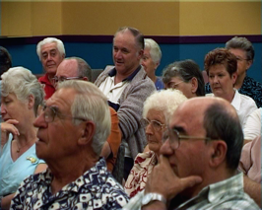
Drawing on (rural sociologist) Wilkinson
in differentiating
the social field
(organisational)
from the
community field
(emergent & evolving)

Slide 10
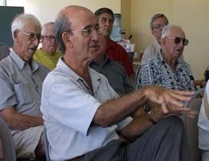
And now for some clips from the audience interaction during Mature Men Matter performances to open up the conversation……………

