Slide 1

2012 ALA National Conference
Lifelong Learning = Resilient Communities
Participation and Productivity – the keys to economic sustainability. Developing a new national workforce development strategy.
Robin Shreeve
CEO, AWPA
11 October 2012

Slide 2


The Australian Workforce and Productivity Agency
Began as Skills Australia. Expert independent Board with expertise in industry, economics, education and academia
Provides independent advice to the government on current, emerging and future skills needs and workforce development needs
Remit expanded in March 2009 to look at full scope of labour market and give advice on HE & VET
2011 Budget announcement -extended role as Australian Workforce and Productivity Agency. Responsible for National Workforce Development Fund. Legislation passed June 2012.
1 July 2012 – became the Australian Workforce and Productivity Agency
Back row (L to R): Dr John Edwards,
Heather Ridout, Keith Spence
Middle row: Prof. Gerald Burke,
Peter Anderson, Ged Kearney
Front row: Marie Persson,
Philip Bullock (Chair), Dr Michael Keating AC
2

Slide 3



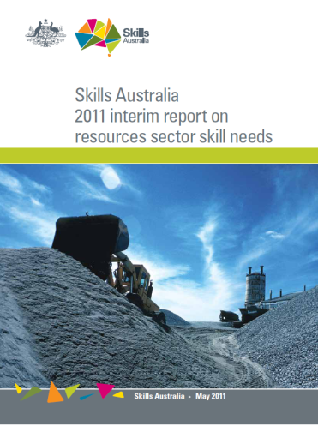





Key advice to Government to date
Foundations for the Future – June 2009
Australian Workforce Futures: a national workforce development strategy – March 2010
Annual advice to Department of Immigration on Skilled Occupation List for General Skilled Migration program – 2010, 2011, 2012
Skills for prosperity: a road map for vocational education and training – May 2011
Energy efficiency in commercial and residential buildings: Jobs and Skills Implications – May 2011
2011 interim report on resources sector skill needs – July 2011
Defence Industry Workforce Strategy – January 2012
Better use of skills, better outcomes – May 2012
Future Focus: Australia’s skills and workforce development needs – July 2012
3

Slide 4
The Agency operates mainly at the national level...
National level
  National Workforce Development Strategy - 2010 and 2012 (Australian Workforce futures, 2010)
  Annual Skilled Occupations List (SOL) for General Skilled Migration
Industry level
  National Resources Sector Skills Needs Annual Update
  Workforce Development Strategy for Defence Materiel Industries
Enterprise level
  Workforce Development Plan strongly recommended for funding for National Workforce Development Fund submissions
4

Slide 5
The Agency’s Focus
Priorities
Policy
Research
National Workforce Development Fund
Sectoral Workforce Development Needs
5

Slide 6
Why skills are important

Slide 7
The basic argument – Professor Gerald Burke for the Brotherhood of St Lawrence
Improvements in education and skills can lift the proportion of the population participating in employment and raise the productivity of those employed.
Increased participation means a reduction in size in the non-working population and the cost of supporting it.
For the least advantaged it means reduced dependency on welfare with benefits in income, health, social engagement and opportunities for their children.
While there are costs in lifting the skills of the least advantaged there is overwhelming evidence that the economic and social payoff are considerably greater.
The payoff will be greater if the education and training is efficiently and effectively provided.
This includes providing skills that facilitate ongoing learning, that meet industry need, that are of high quality and if employers are able to make good use of available skills.

Slide 8
The pay-off from investment
An investment of an additional 3% per annum in Tertiary Education can achieve a workforce participation rate of 69% by 2025 compared to the IGR projected rate of 64%(1)
  69% is consistent with increased access to employability skills and experience overseas
A participation rate of 69% will halve the projected age-dependency ratio and improve government budgets.
Approximate estimates (Productivity Commission methodology) show an annual improvement in the operating balance of Australian governments of around $24 billion (05/06 dollars)(2)
In addition there would be improvements in productivity through upskilling.
Source: (1)(2) Skills Australia (2012), Australian Workforce Futures
8

Slide 9
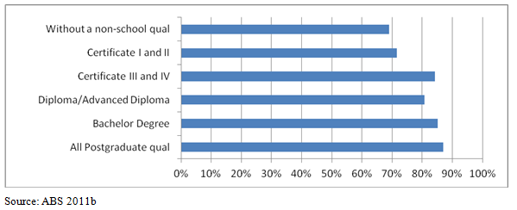
Achievement in education and training has considerable effect on employment
Employment by highest qualification, persons 25-64, Australia 2011
(% of population in each group)
9
Notes:
Source: Burke, G, Skills, Brotherhood, 14 August 2012 (Draft paper)
Pg 2 of paper...
Achievement in education and training has considerable effect on employment. The table shows that just under two thirds of the Australian population aged 25-64 in 2011 had a non-school qualification. Persons with qualifications were much more likely to be employed. E.g. 83% of persons with qualifications were employed and only 69% of those without qualifications. For females, 77% of those with qualifications were employed compared with 59% of those without.
VET qualifications at Cert I and II do not have a large impact on average but they can be shown to provide considerable benefits in employment for those person who had left school at year 10 or earlier.

Slide 10
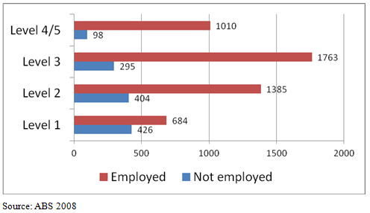
A person’s level of literary or numeracy is a broad indicator of educational achievement
Employment and population by numeracy level, persons 25-59, Australia 2006
10
Notes:
Source: Burke, G, Skills, Brotherhood, 14 August 2012 (Draft paper)
Pg 2 of paper...
A person’s level of literacy or numeracy is a broad indicator of educational achievement. The table shows the distribution across five levels of persons assessed bon the numeracy test. It shows that just over 60% of those at numeracy level 1, the lowest level, are employed whereas over 90% of those at levels 4/5 are employed.
Income varies by literacy level and by qualification level. In 2006 of all persons 25 to 59 at literacy level 4/5 about 66% were in the highest two income quintiles and 20% in the lowest two quintiles. At the lowest literacy level about 17% were in the highest two income quintiles income quintile and 50% in the lowest two quintiles.

Slide 11
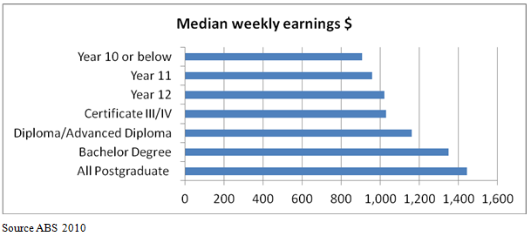
Higher qualifications = higher rate of return
Earnings, employed persons 15-64 by level of qualification, Australia 2009
11
Notes:
Source: Burke, G, Skills, Brotherhood, 14 August 2012 (Draft paper)
Pg 3 of paper...
The table shows the relation of qualifications to earnings among those who are employed. The variation of income for all adults (the employed plus those not employed), is greater than the variation in earnings because of the higher proportion of those with qualifications who are employed.
Rate of return studies using data on education and earnings show for most levels of qualifications that there is a high private rate of return (e.g. Lee and Coelli 2010). This appears to have changed little in recent years despite the considerable growth that has occurred in the % of employed persons with qualifications.

Slide 12

12

Slide 13
Skills vs experience gap?
Project Manager - A demonstrated track record in project management for Construction Projects to the value of $30M or over, with a minimum of 10 years experience to support this. Must hold a professional qualification in Construction.
Structural Engineer - Demonstrated track record in structural engineering for construction projects, (26 levels and upwards) with a minimum of 10 years experience to support this. Must hold a professional qualification in Structural Engineering.
Site Manager - Knowledge and experience in Site Management for low level construction projects, $10M-$40M. Must have excellent communication skills, and a minimum of seven year's experience within the construction industry
Senior Site Manager - Must have substantial knowledge and experience in Site Management for high rise construction projects, (15 levels and upwards) to the value of $40M, knowledge and experience in Occupational Health & Safety regulations, and excellent communication skills. A minimum of eight years experience and a tertiary qualification is required.

Slide 14
Student returns – VET and HE
Source: KPMG Econtech , Economic Modelling of Improved Funding and Reform Arrangements for Universities (2010)
14

Slide 15
Distribution of qualifications within occupations
Source: A well-skilled Future, Richardson,S and Teece, R (NCVER, 2008)
Notes:
Source: NCVER “A well-skilled Future: Program 6: Maximising the future value and effectiveness of VET” Pg 12 of A well-skilled future
The link between skills and qualifications is also attenuated by the fact that many people who do have qualifications do not use them in their current job.
The table above illustrates the loose match between qualifications and jobs.
The chart shows that many people work in skilled occupations without a relevant qualification, or any qualifications at all. For example, 1/3 of people working in highly skilled managerial, administrative and associate-professional occupations have no post-school qualification at all. And approximately a further 1/3 have vocational qualifications. Even in the case of the professions and trades, close to 1/3 of workers do not have a relevant qualification.
The other important insight from chart is that many people with qualifications are employed in jobs that do not require their qualification. Eg 13% of advanced and intermediate clerical and services workers, 9% of elementary clerical and service workers hold university degrees: they are clearly overqualified for these jobs. The reasons for this underuse of qualifications are complex, for discussion of underuse of VET qualifications, see Richardson et al (2006). Chart also shows that even many skilled jobs do not actually require the person doing the job to have a relevant qualification.
The essential point to conclude is that measures of supply of and demand for skills are imprecise, and in many (but not all) cases qualifications are not a close proxy for either. It follows that the formal VET system is only part (albeit an important part) of the mechanisms for balancing supply and demand.

Slide 16
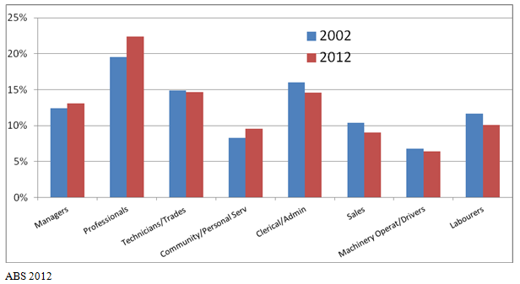
Faster growth in occupations with qualifications
Shares of employment in major occupations, Australia 2002 and 2012, percent
16
Notes:
Source: Burke, G, Skills, Brotherhood, 14 August 2012 (Draft paper)
Pg 4 of paper...
In Australia the changes in the structure of employment show up in the faster growth of employment in occupations where workers usually have qualifications. Of even greater importance has been a considerable increase in the proportion of persons within occupations holding qualifications. This is least so in trades where it seems shortages have required the employment in recent years of workers without full qualifications and in the professions where the large majority already held qualifications. The increase in the proportion with qualifications is largest in community and personal services where more complex work has led qualifications being required for a larger range of occupations.

Slide 17
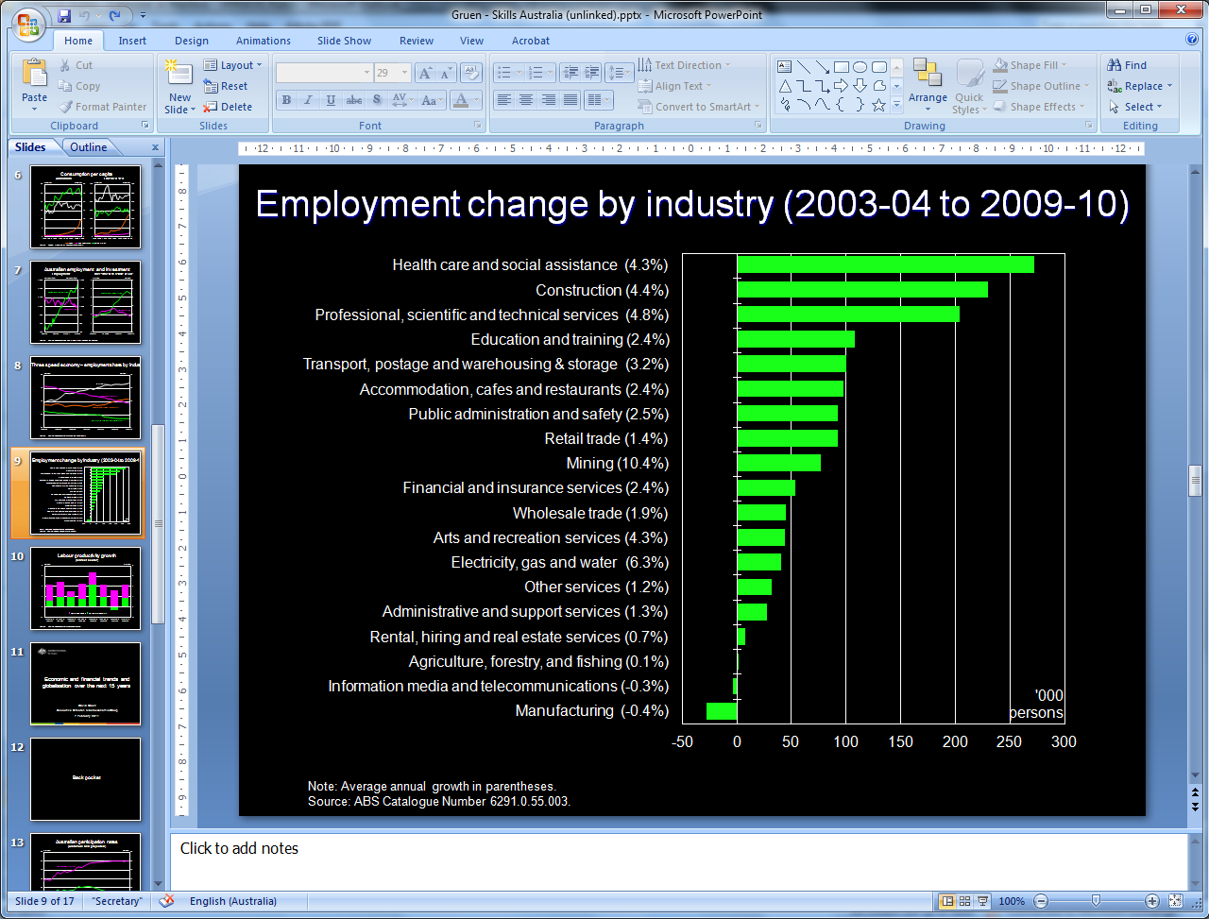
17
Source: Economic and Financial trends and globalisation over the next 15 years Presentation by Dr David Gruen (Executive Director, Macroeconomic Group, Treasury) to Skills Australia/Academy of Social Science Australia Scenario Development Forum 7 February 2011)
17
Notes:
Changing structure of Australian industry over the last decade- very large growth in health and social assistance and other service industries; and drop of jobs in manufacturing. (Table shows percentages and actuals.)
But looking back over past trends only shows a partial picture and is an inexact way of factoring in future skill needs. Skills Australia conducted extensive scenario planning and modelling of future needs based on work by Access Economics. This analysis has been used as the basis of calculating the estimates of additional funding required by the sector.
17

Slide 18
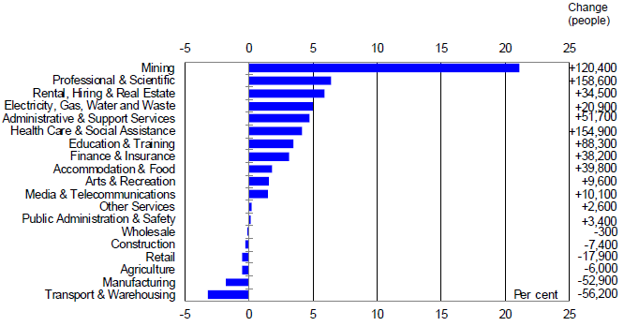
Employment growth by industry – May 2009 to May 2012 annual average percentage change
Source: Dolman, B., Gruen, D., Productivity and Structural Change, 10 July 2012
18
Notes:
Source: Ben Dolman and David Gruen (Australian Treasury), Productivity and Structural Change, 41st Australian Conference of Economics, 10 July 2012
See pg4 of paper...
The chart shows that over the three years since May 2009, employment in agriculture, manufacturing, construction, wholesale and retail trade, and transport, postal and warehousing services has fallen by a combined 140,700 people. At the same time, employment in the rest of the economy increased by 733,000 people, with the mining sector alone accounting for 120,400 jobs. Most households that have lost jobs are finding new ones and benefiting from the mining boom. The flexible exchange rate has contributed to the pressure facing some industries in recent years as part of its role in maintaining macroeconomic stability. As a shock absorber, it allows the economy to benefit from the increase in demand in one sector without leading to generalised wage and price pressures. The significant restraint it imposes on other parts of the economy helps ensure that the ecoonmy overall does not overheat.
In terms of growth in average incomes, however, it is as well to recognise that, in at least two ways, the tail-breezes of the past are becoming the head-winds of the future.

Slide 19
The challenges we face

Slide 20
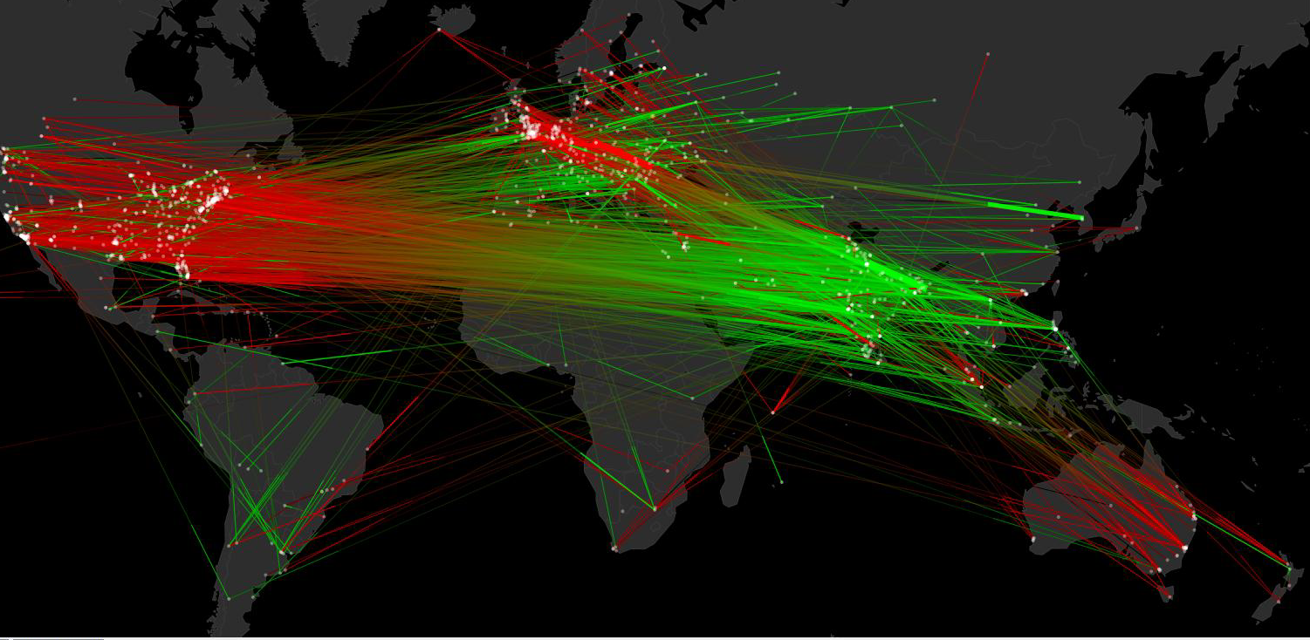


Slide 21


Slide 22
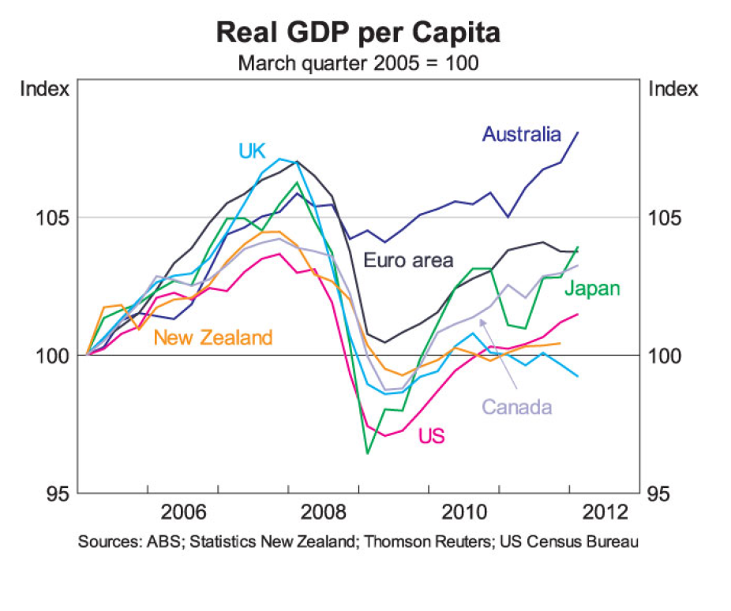
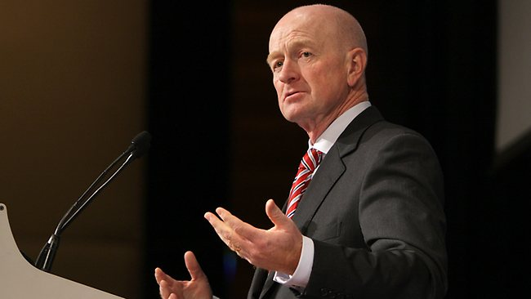
Australia in the global environment
“... An objective observer coming from outside would, I think it must be said, feel that Australia’s glass is at least half full.”
Glenn Stevens, Governor, RBA, Address to the American Chamber of Commerce (SA) AMCHAM Internode Business Lunch Adelaide, 8 June 2012
22

Slide 23
Creating a new world order (or reviving the old one)
(Chris Richardson – Deloitte Access Economics)

Slide 24
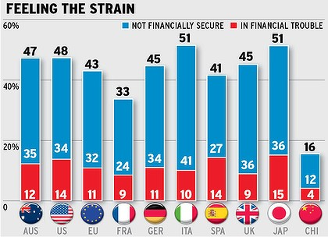
Boston Consulting Group – Consumer Sentiment Survey 2012
24

Slide 25
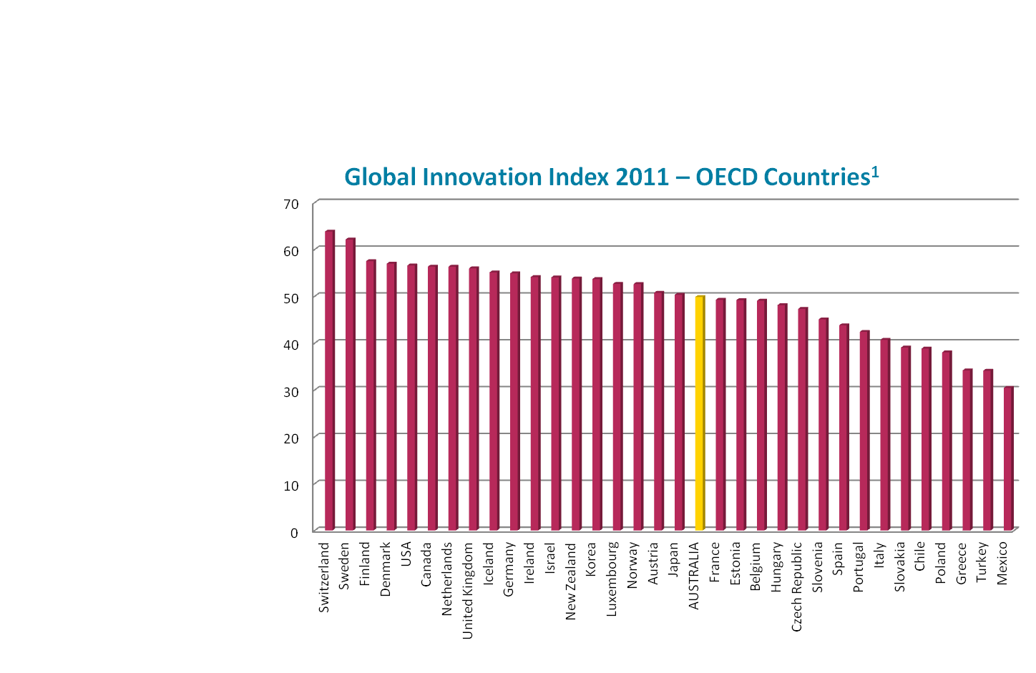
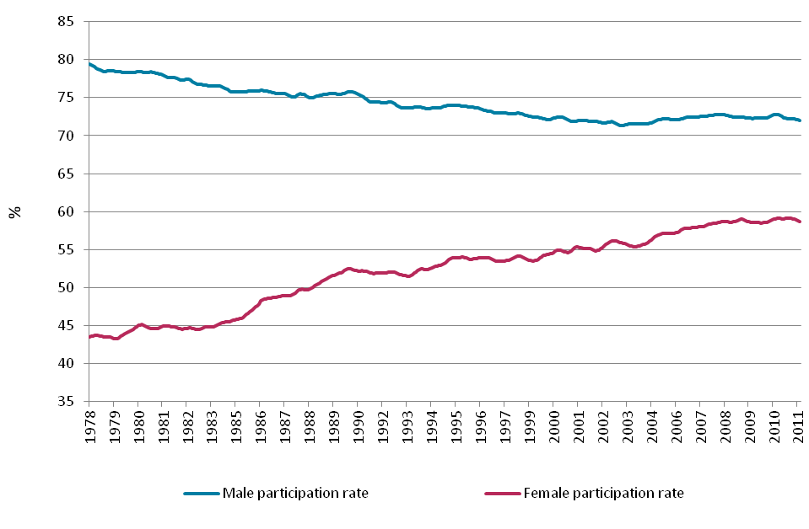
Where are we now?
Weak productivity
Source: ABS National Accounts 2010/2011 (5204.0)
Innovation – middle of pack
Source: www.blobalinnovationindex.org
Declining competiveness
Source: http://www3.weforum.org/docs/WEF_GCR_CountryProfilHighlights_2011-12.pdf
Variable participation
Source: Labour Force, January 2012, ABS Cat no. 6202.0 Table 1. Trend series
Notes:
25

Slide 26
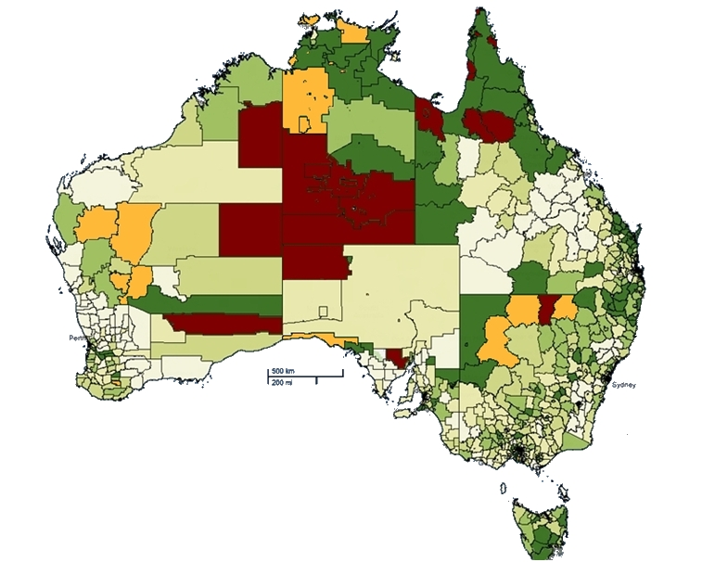
The shortage v unemployment paradox
Unemployment rate
 | 15.0% and over
 | 10.0% to 14.9%
 | 7.0% to 9.9%
 | 5.3% to 6.9%
 | 4.0% to 5.2%
 | 2.9% to 3.9%
 | 0% to 2.8%
Notes:
Regional disparities in employment and education are a key challenge for policymakers. Participation in work and study varies widely across Australia according to geographical location, but the issues facing different regions are not homogenous. Declining industries, structural adjustment and a shift from production to services have fundamentally altered the type and amount of work available in some regions. Australia is increasingly described as a ‘patchwork economy’: one which is characterised by strong growth in some regions while others lag behind. Pockets of high unemployment are therefore correlated with the ageing of a low-skilled labour force.
Yet other parts of Australia are experiencing strong growth and a resulting lack of skills and labour, particularly where there is competition from the resources sector or where there are difficulties in attracting people to work in particular locations. Finally, for some regions, barriers to participation are a matter of supply rather than demand, coalescing around the related issues of low skills, disadvantage, youth disengagement and a lack of entry-level positions. Indeed there is evidence to show that some people who do not expect to find work, or have even dropped out of the workforce altogether, relocate to depressed regions due to the lower cost of living in these areas.
Clearly, then, there can be no one-size-fits-all approach to regional challenges. The disparity in the distribution of resources, population, infrastructure, services and development poses a major challenge for policymakers.

Slide 27
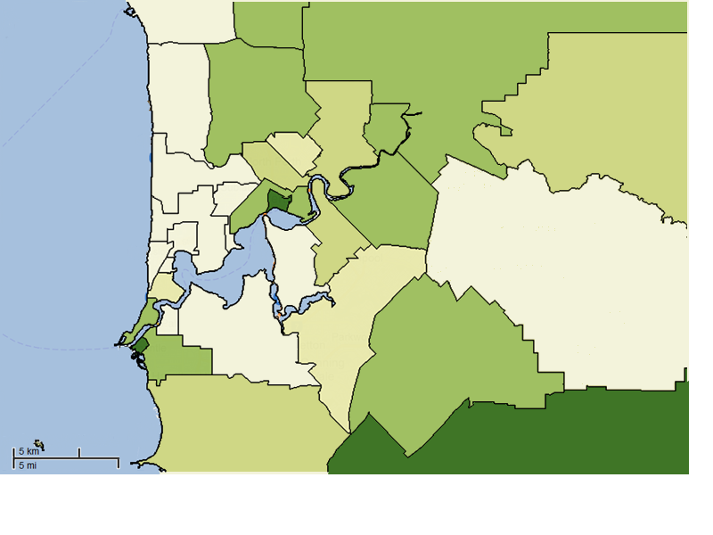
Variable unemployment in Perth metro area
Unemployment rate
 | 7.0% to 9.9%
 | 5.3% to 6.9%
 | 4.0% to 5.2%
South Perth (C)
 | 2.9% to 3.9%
 | 0% to 2.8%
Freemantle (C) Inner
PERTH
Source: DEEWR Small Area Labour Markets, December quarter 2011.

Slide 28
“Productivity is a measure of how efficiently an economy is operating. Productivity growth comes about by doing things better today – more efficiently – than we did yesterday”.
Source: Dolman, B., Gruen, D., Productivity and Structural Change, 10 July 2012
28
Notes:
Source: Ben Dolman and David Gruen (Australian Treasury), Productivity and Structural Change, 41st Australian Conference of Economics, 10 July 2012

Slide 29
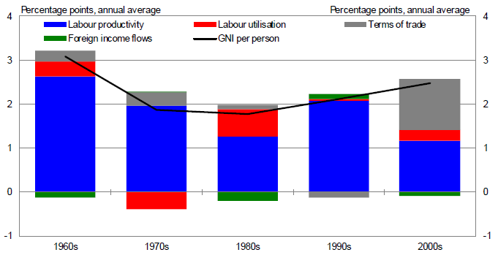
Contributions to growth in average incomes by decade
Source: Dolman, B., Gruen, D., Productivity and Structural Change, 10 July 2012
29
Notes:
Source: Ben Dolman and David Gruen (Australian Treasury), Productivity and Structural Change, 41st Australian Conference of Economics, 10 July 2012
See pg 2 of paper...
The chart shows average annual growth in real gross national income (GNI) per person, which is a measure of the purchasing power of income Australians earn from productivity, net of income flows to foreign owners of factors of production. The economic recovery after the recession of the early 1990s was led by strong productivity growth. Australia, together with the US and a small number of other countries, saw a resurgence in productivity growth to rates not seen since the 1960s. The resurgence was led by service sector industries, like wholesale trade and banking, that seized on new advances in information and communication technology to transform the way they did business (Parham, Roberts and Sun 2001). This was supported by continued productivity growth in industries like telecommunications and electricity, gas and water supply arising from substantial reductions in their workforces following corporatisation and privatisation of their operations, and a reduction in their levels of investment. Productivity levels in these industries rose towards the international technology frontier.
In the past decade or so, the economy has taken a different path. The boom in Australia’s terms of trade has lifted the exchange rate, lowering the costs of imported goods and boosting the purchasing power of Australian incomes. This has added 1.2% per year to growth in average incomes since the turn of the century, in contrast to previous decades when the terms of trade made no significant contribution.
On the other hand, it is now widely recognised that growth in Australian labour productivity – output per hour worked – has slowed since around the turn of the century, notwithstanding stronger data in the past few quarters. Labour productivity growth explained less than half of the growth in average incomes since the turn of the century, compared to an average of around 90% of income growth over the four previous decades.

Slide 30
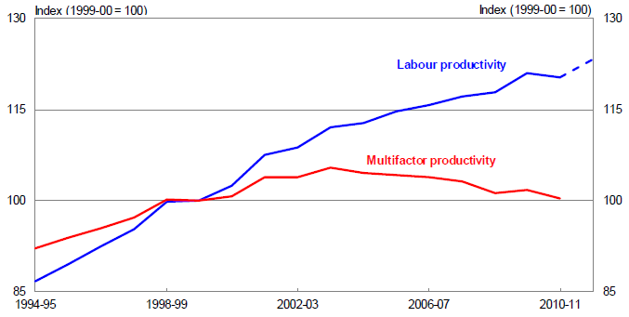
Multifactor productivity has scarcely grown this decade
Market Sector Productivity
Source: Dolman, B., Gruen, D., Productivity and Structural Change, 10 July 2012
30
Notes:
Source: Ben Dolman and David Gruen (Australian Treasury), Productivity and Structural Change, 41st Australian Conference of Economics, 10 July 2012
See pg3 of paper...
Multifactor productivity – the output produced from a bundle of labour and capital inputs – has scarcely grown at all this decade (see chart). While the deterioration in performance is partly due to unusual developments in mining and utilities, the slowdown from the 1990s is broadly across most industries. While for households as a group, the mining boom and the higher exchange rate have delivered unambiguously positive benefits in the form of higher average incomes and increased purchasing power, these developments have had a more mixed effect on firms, their owners and the people employed in them.
There has been rapid growth in mining firms, and robust growth in a range of domestic service industries. On the other hand, manufacturers are continuing to come under pressure from competitors in China and other emerging markets, a process that may continue for some considerable time to come.
Some parts of the economy that depend on household borrowing and spending are also facing pressure as households increase their saving rates to more historically normal levels. For some retailers, migration of spending to the internet and away from bricks and mortar stores has compounded this weakness. In banking, households demand for loans is growing more slowly following two decades that saw growth rates consistently running ahead of growth in household income. These changes are likely to be enduring.

Slide 31




Future population challenges –
Baby boomers retiring: an ageing workforce
31
Notes:
31
As the recent intergenerational report notes, Australia faces significant intergenerational challenges.
Population ageing will mean that there will be fewer workers to support retirees and young dependants.
A growing population will help manage pressures of the ageing population.
Small adjustments now – to grow the economy by increasing productivity and participation, restrain unsustainable growth in spending, plan for future demographic change and tackle climate change – will prevent the need for much sharper and more costly adjustments in the future.
Between now and 2050 the number of:
older people (65 to 84 years) is expected to more than double;
very old people (85 and over) is expected to more than quadruple, from 0.4 million people today to 1.8 million in 2050.
In contrast, the number of:
children is expected to increase by 45 per cent;
prime-age working people is expected to increase by 44 per cent.
This means that, the proportion of people aged 65 years or over is projected to increase from 13 per cent in 2010 to 23 per cent by June 2050.
At the same time the proportion of working-age people in the total population is expected to fall by 7 per cent to 60 per cent.
As a consequence, there will be relatively fewer people of working age to support an increasing number of older Australians.
In 2010, there will be an estimated 5 people of traditional working age for every person aged 65 and over.
By 2050 only 2.7 people of traditional working age are projected for every person aged 65 and over.

Slide 32
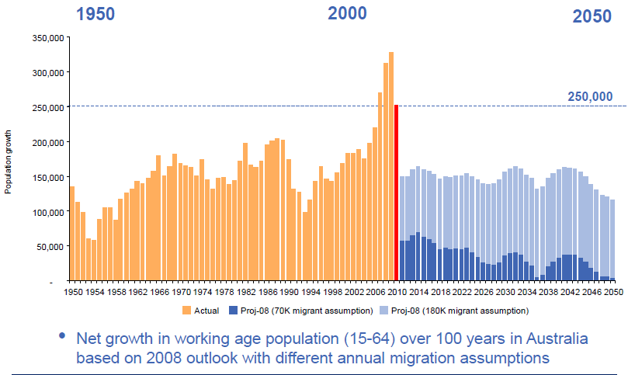
Australia is moving from baby boomers to baby bust... we need more tax or more tax payers
Source: Bernard Salt, Living Literacy Forum, 6 June 2011
32

Slide 33
Why we need to improve foundation skills
Source:
1 ABS, 4228.0, Adult Literacy and Life Skills Survey, Summary Results Australia (2006)
33
33
Notes:
Major points from Workforce Development Strategy
Poor LLN skill levels in the general population and workforce. Stimulating the participation of those who are on the margins of the workforce is a critical priority.
The supply of LLN professionals is insufficient to meet current training needs across the national. Need to entice more practitioners into the field, ensure the availability of pathways into the field and adequate professional development opportunities for existing practitioners.
Increase the LLN skills of VET practitioners. This should include measures to develop the adult LLN training workforce, including considering the identification and addressing of language, literacy and numeracy issues as core – rather than elective – component of the Certificate IV in Training and Assessment.

Slide 34
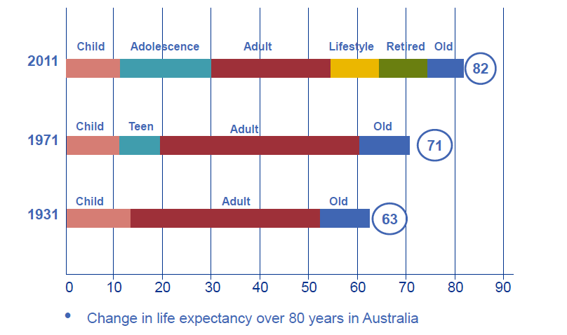
The increase in life expectancy is creating new market segments... Opportunity for literacy programs
Source: Bernard Salt, Living Literacy Forum, 6 June 2011
34

Slide 35
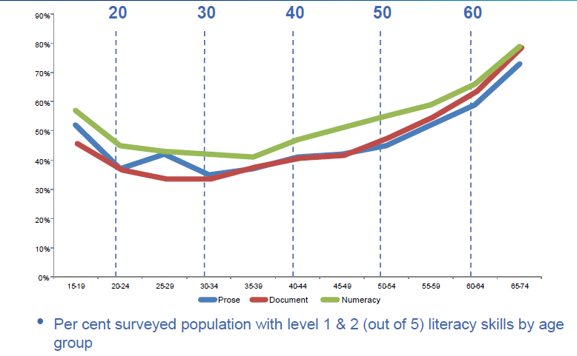
Who is functionally literate?
It would seem those who leave the workforce or who have yet to enter the workforce
Source: Bernard Salt, Living Literacy Forum, 6 June 2011
35

Slide 36

National Workforce Development Strategy
Helping to better plan Australia’s skills need
for the next 15 years

Slide 37
Our approach: long term view in uncertain times
Workforce and education trends
Planning for an uncertain future
Modelling and projections
Analysis historic data
4 Scenarios – probable future worlds
Access Economics
Australia’s skills and workforce development needs – Discussion Paper
Consultation with industry, providers, States/Territories and peak bodies
Where are we now?
Where are we headed?
Where do we want to be?
How do we get there?
2025
Notes:
This paper takes a long term view of our economy and uses a range of scenarios to assist in planning for national workforce development in an age of uncertainty. The purpose of the paper is to engage industry and other stakeholders in the development of policy options to address these challenges. Based on the different scenarios this paper has modelled the gap between the future demand for skills and the supply of skills to our workforce.
The 2010 workforce development strategy, Australian Workforce Futures projected:
the size of the workforce needed to 2025 in a number of scenarios
what qualifications were required
what was holding us back and a series of policy responses. Eg. Increase in tertiary enrolments of 3% per annum, emphasis on skills utilisation, improving language and literacy, targeting increase in participation to 69%
The 2012 strategy will incorporate updated workforce and qualifications data
The 2012 strategy is not an aggregation of state and sector plans
It addresses national issues
It is complementary to and informed by state and sector plans
It will recommend high level approaches that will aim to have a positive impact on meeting skills and workforce development needs

Slide 38
Approach to the 2012 strategy
Scenarios Modelling Analysis Strategy
Plausible worlds (but not predicting the future!)
Projections of demand & supply side implications of the scenarios
Analysing the uncertainty, commonality, differences and risks of the scenarios
The policy recommendations balance aspirational goals and risks, after assessing key differences between the scenarios
Each process informs the next
38

Slide 39
Getting the skills mix right
‘Higher-level skills are increasingly demanded by the knowledge-based economy’¹
Demand Side
Sustainability
Supply Side
Migration
Older and novice workers
The changing nature of work
Low and unskilled workers
Globalisation
39
1. Froy, F, Giguère, S, Hofer, A, eds, 2009, Designing Local Skills Strategies, Local Economic and Employment Development (LEED), OECD Publishing.
Notes:
The trends that are influencing Australia’s need for more skills–at all levels but especially for higher level skills—include the changing nature of work, increased globalisation of markets and new skills needs to respond to climate change impacts and broader issues of sustainability. On the supply side, it is important to consider the needs of workers who are unskilled or have low skills, older workers and novice workers. Migration plays a key role in managing the supply of skilled workers to our economy.

Slide 40
What the future might hold

Slide 41
The scenarios
  Sustained prosperity and a restructured economy
  Uncertainty to 2015 with low growth and knowledge-based recovery
1. The Long Boom
2. Smart Recovery
4. Ring of Fire
3. Terms of Trade Shock
  Risky world – multiple shocks
  Resource prices fall, a more balanced economy
41

Slide 42
Comparing the scenarios
Commonalities
Ageing population
Importance of Asia
Technology (but speed of adaptation varies)
Sustainability challenges
Key differences
Migration
Fiscal capacity
Labour force participation
Industry structure
42

Slide 43
Projected employment growth
In May 2012, Australian workforce approx 11.5M
Projected workforce size in 2025 is between:
    12.7M in Ring of Fire (lowest growth scenario) and
    15.1M in Long Boom (highest growth scenario)
Projected job openings (new and replacement jobs) in 2025:
    4.3M in Ring of Fire to
    6.4M in Long Boom
Highest growth occupations (all scenarios)
    Professionals
    Community & personal service workers
    Managers
Health care and social assistance strongest employment growth in all scenarios
Source: ABS, Deloitte Access Economics
43

Slide 44
Projected occupational employment growth by scenario
Average annual growth | Long Boom | Smart Recovery | Terms of Trade Shock | Ring of Fire
Managers | 2.5% | 2.0% | 2.0% | 1.3%
Professionals | 3.1% | 2.6% | 2.7% | 1.6%
Technicians & trade workers | 1.3% | 0.9% | 0.5% | 0.2%
Community & personal service workers | 2.9% | 2.4% | 2.9% | 1.6%
Clerical & administrative workers | 1.4% | 0.9% | 1.0% | 0.1%
Sales workers | 1.2% | 1.0% | 1.1% | 0.3%
Machinery operators & drivers | 0.9% | 0.3% | 0.3% | -0.2%
Labourers | 1.0% | 0.6% | 0.5% | -0.1%
44

Slide 45
Education qualifications forecasts
Share of those employed with post-school qualifications, by 2025
 | Long Boom | Smart Recovery | Terms of Trade Shock | Ring of Fire
Proportion with post school qualifications | 75.4% | 70.3% | 73.7% | 65.0%
Annual number of additional qualifications required to 2025 | 831,900 | 643,800 | 726,100 | 411,500
In 2011 the share of employed persons with a post-school qualification was 59.8%
Source: Deloitte Access Economics (2012) ‘Economic modelling of skills demand and supply’ - derived from p.iv and tables 5.18-5.21
45

Slide 46
Qualifications demand
Annual change in employed persons by highest level qualification, 2011-2025 (%)
Qualification | Long Boom | Smart Recovery | Terms of Trade Shock | Ring of Fire
Postgraduate | 5.2 | 4.1 | 4.6 | 2.1
Undergraduate | 3.9 | 3.1 | 3.4 | 1.6
Adv diploma / Diploma | 2.7 | 2.1 | 2.3 | 1.1
Certificate III / IV | 4.3 | 2.9 | 3.5 | 1.4
Certificate I / II | -3.8 | -2.4 | -3.5 | -1.1
Total post school quals | 3.8 | 2.8 | 3.2 | 1.4
Cert III and above | 4.0 | 3.0 | 3.4 | 1.5
Source: Deloitte Access Economics (2012) ‘Economic modelling of skills demand and supply’ - derived from tables 5.6 -5.9
46

Slide 47
Projected qualification supply less demand (based on labour force) annual average 5 years to 2025
Qualification | Long Boom | Smart Recovery | Terms of Trade Shock | Ring of Fire
Postgraduate | -71,180 | -43,579 | -57,939 | -725
Undergraduate | -106,109 | -65,394 | -90,628 | -2,458
Adv. Diploma/ Diploma | -61,180 | -49,539 | -55,818 | -23,290
Certificate III/IV | 9,004 | 38,111 | 22,909 | 59,311
Certificate I/II | 64,236 | 66,657 | 65,493 | 64,351
Total | -165, 229 | -54,745 | -115,982 | 97,189
47

Slide 48
Contribution of participation on education

Slide 49
Education matters to participation
Older workers
Increasingly, mature-aged people are participating in work, particularly in professional occupations.
Young workers
In January 2012, 26.8% of teenagers of working age were neither working nor engaged in full-time learning.
Source: ABS 6227.0 Education and Work, Australia, May 2011 (aged 15-64 years).
49

Slide 50
The pay-off from investment
An investment of an additional 3% per annum in Tertiary Education can achieve a workforce participation rate of 69% by 2025 compared to the IGR projected rate of 64%(1)
  69% is consistent with increased access to employability skills and experience overseas
A participation rate of 69% will halve the projected age-dependency ratio and improve government budgets.
Approximate estimates (Productivity Commission methodology) show an annual improvement in the operating balance of Australian governments of around $24 billion (05/06 dollars)(2)
In addition there would be improvements in productivity through upskilling.
Source: (1)(2) Skills Australia (2012), Australian Workforce Futures
50

Slide 51
Implications for post compulsory education

Slide 52
Opportunities for VET
The strength of the Australian economy means there are “once in a generation” opportunities for tertiary providers on the demand side.
There are opportunities for growth with the shift to demand led funding - publicly funded VET enrolments increased by 4.6% between 2010 and 2011 to almost 1.9m.
However, challenges for public providers – e.g. 56.4% increase in the number of publicly funded students choosing private providers between 2010 and 2011.
TDA recently issued a National Charter for TAFE with principles for effective operations in an increasingly contestable environment.
Source: NCVER, 2011, Students and courses
52

Slide 53
Opportunities and Challenges for Adult and Community Education
Trends for public funding:
Demand –led
For accredited training
For whole qualifications
Paid on outcomes such as course completions
Lower unit costs
Not recognise support services
Challenge – metrics that recognise
Long-term nature of work with most disadvantaged
Need for non direct delivery support services

Slide 54

THANK YOU
https://twitter.com/#!/AWP_Agency

