Slide 1
*
U3A Online: building a virtual community
Dr Rick Swindell AM
Founder: Brisbane U3A 1986
Co-founder: U3A Online 1998

Slide 2
The Foresight Project
“Learning must continue throughout life. This can have a direct effect on mental health and well-being across all age groups, and has particular promise in older people.”
Beddington et al. The mental wealth of nations. Nature, vol 455, Oct 2008, 1057-1060.
“as people move into older age, learning should be encouraged and actively promoted, as this can protect against cognitive decline” (p. 1058).
U3A in Australia – 2012: 242 groups; 77,000 members
Voluntarism: $25.5 million dollars
Swindell et al 2011. University of the Third Age in Australia and New Zealand: Capitalising on the cognitive resources of older volunteers. Australasian Journal of Ageing.

Slide 3
Social isolation caused by fractured social networks
In later life, social networks threatened by:
Death of a loved one
Illness/Incapacity
Being a carer
Divorce
Relocation
Poor transport
etc
U3A Online – the world first virtual U3A open to all older people world wide, and to younger disabled people

Slide 4

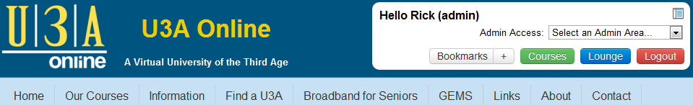

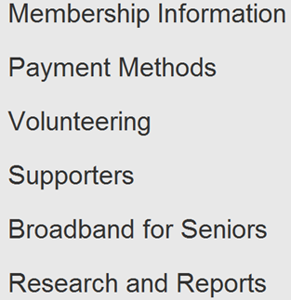
www.u3aonline.org.au

Slide 5
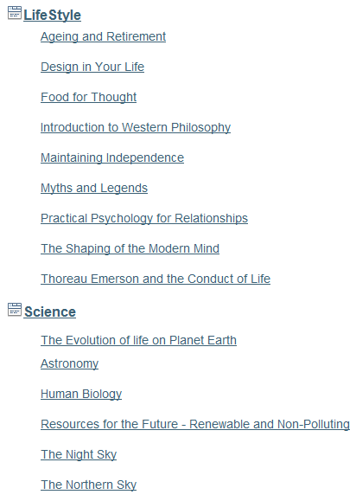
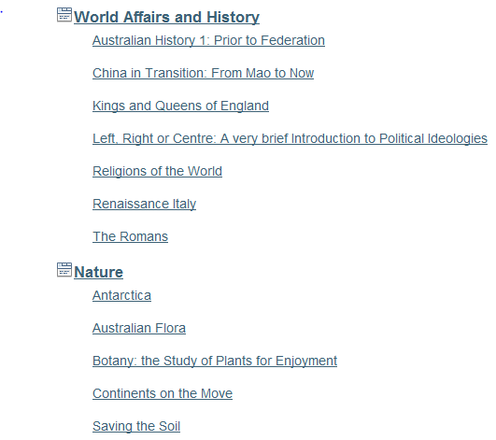

Slide 6
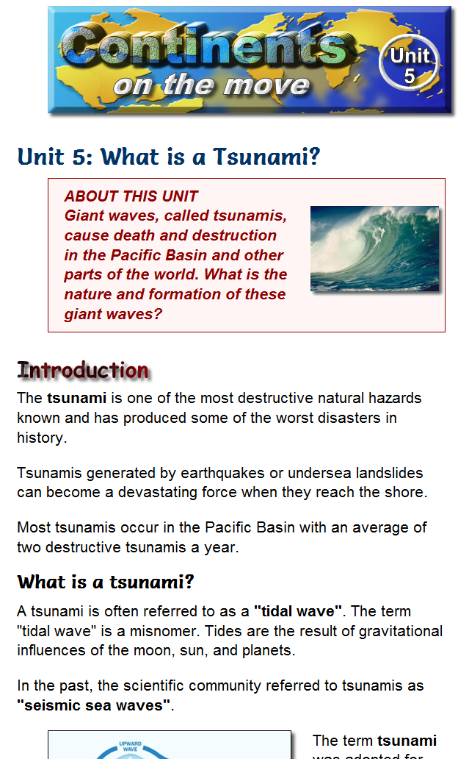

Slide 7
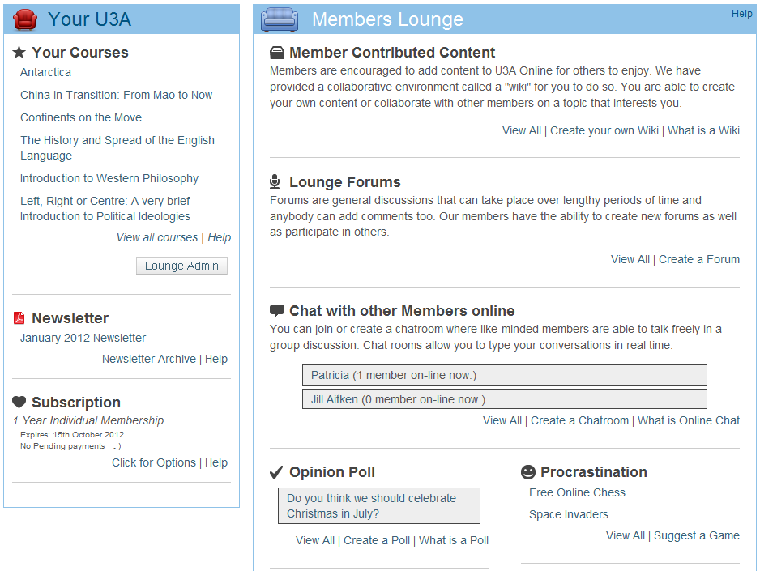

Slide 8
What target audience is U3A Online reaching?
I am partially blind with limited short sight. I am extremely grateful to U3AOnline as I now have an interest at home - am happy working on my own and life has again a meaning.
I’ll go as far as to say that being totally absorbed in my most recent online course has saved my sanity this year.
I care for my wife who has Alzheimers. Have done so for the past 8 years.
I love "virtual meeting" people from other regions, walks of life, with different viewpoints
I feel as though I belong to something to keep my mind off my pain, also helps keep my brain working.
I am the primary carer for my frail mother who at nearly 100 needs full time care now. Being able to access a service like this is one way to feel less isolated from the world outside.

Slide 9
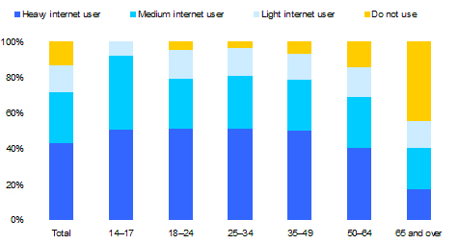
Internet Usage for Australia
87% all Australians have used the Internet (ACMA May 2009)

Slide 10


Never used 47%
Source - ACMA 2009: “Australia in the Digital Economy”
Roy Morgan Single Source Database “Non-internet users 12-month period, July 2007–June 2008”.

Slide 11



Consortium partners
The Broadband For Seniors Program
$15 million project to install 2000 Internet kiosks for Australian seniors 2009 - 2011
Plus $10.5 million continuation funding 2011-15

Slide 12
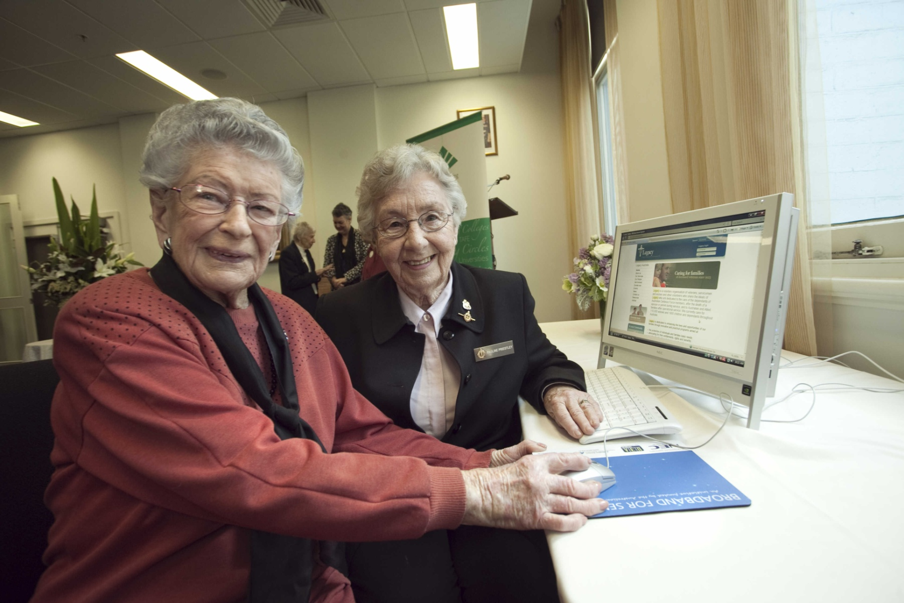
1 on 1 peer education
Pauline Priestley (right), 86, shows May Rush, 102, how to use the internet in a BFS kiosk

Slide 13
U3A Online for CALD isolated people
Approx 1.75 million people in Australia speak a language other than English at home
Ancestry | English not spoken at home (number)
Italian 4.6% | 375,000
German 4.3% | 80,000
Chinese 3.2% | 495,000
Greek 2.2% | 290,000
TOTAL 19.5%

Slide 14

The project
1. Plan
Consult with
CALD communities
Language selection
Subject and
media selection
Technical design
2. Develop
Site build
Content
development
and translation
Train
administrators
3. Roll out
Work with selected
CALD organisations
Train the trainers
Train seniors
Almost completed.
Funding to be sought
Notes:
14

Slide 15
Summary
U3A Online courses and resources improving qol of many isolated people
Partner in the $25.5 million BFS project
Multilingual versions of U3A Online in planning stage

