Slide 1

Does the Emerging Discipline of Community Engagement -
Foster Lifelong Learning and Community Resilience?
Australian Study Circles Network Pty Ltd
31 Twyford St, Williamstown, 3016
+61 (0) 401 009 113
ABN 30 139 605 468
Notes:
PREP:
LARGE POST ITS
Mary – slow me or quicken me
Workbooks - Posters - Lit Review articles x 5. Each set in a manila folder -Blank butchers paper
Marker pens -Half A4 sheets –Blutak -Butchers paper - Empower’, ‘Collaborate’, ‘Involve’, ‘Consult’ and ‘Inform’
Prep – Butchers paper for Plans and planning
On tables – pens – butcher paper x 2 – coloured paper – blu tak
Mix groups up - SIGNS
1.30 hours to go
START
Intro me – DSE CE / ASCN / WCEC / ALA / USA
We are doing a 2 day ‘in service’ course in 1 and half hours
“Civic Participation” = CE
We will do activities and a hypothetical – burning questions at the end

Slide 2
Workshop Aims
To see a range of views on what community engagement is
Provide an opportunity to think beyond current experiences

Slide 3
Workshop Aims
To see a range of views on what community engagement is
Provide an opportunity to think beyond current experiences
Become familiar with, and understand the purpose of the IAP2 Spectrum
See how stakeholder analysis is integral to community engagement planning

Slide 4
Workshop Aims
To see a range of views on what community engagement is
Provide an opportunity to think beyond current experiences
Become familiar with, and understand the purpose of the IAP2 Spectrum
See how stakeholder analysis is integral to community engagement planning
Exposure to the engagement plan templates
Understand the unique position of community engagement planning within broader projects
Notes:
Let’s think how we can define ‘CE”

Slide 5
What is Community Engagement?
1. Read at least one article and consider,
According to the article/s
  what is community engagement?
  what are the benefits of community engagement?
  who is the community?
Notes:
1.25 hours to go
Instruction
Ask each table group to open the manila folders containing different community engagement articles.
Each participant is to take at least one article each to read.
Ask participants to consider the following questions as they are reading:
According to the article, what is
community engagement?
What benefits are claimed?
Who is defined as the ‘community’?

Slide 6
What is Community Engagement?
1. Read at least two excerpts each and make notes answering questions According to the articles
  what is community engagement?
  what are the benefits of community engagement?
  who is the community?
In groups, elect a scribe to record . Each person reports back a brief summary of their answers
Notes:
Next, ask that each table appoint a scribe who will take notes as the group discusses their findings.
Each participant is to share a summary of their findings with the rest of the group while the scribe captures the information on the butcher’s paper provided.
6

Slide 7
What is Community Engagement?
1. Read at least two excerpts each and make notes answering questions According to the articles
  what is community engagement?
  what are the benefits of community engagement?
  who is the community?
In groups, elect a scribe to record . Each person reports back a brief summary of their answers
3. Whole table decides on the essence of CE, writes on card and reports back to whole group
Notes:
After they have had an opportunity to discuss their findings, the group is required to agree on a word or a phrase that defines the essence of community engagement, drawing on their review of the literature.
Ask the scribe to write this definition on the coloured sheets. Brief – IN CAPITALS – 5 Words Max
When all groups have finished, a representative from each group is then required to read this definition out aloud to all participants and pin up the card on the wall.
Ask the participants:
What do these responses tell us about the essence of community engagement?
Explain that this activity shows there is no single answer as to what is community engagement, but there are some common principles.
Saved me doing a powerpoint with definition
7

Slide 8
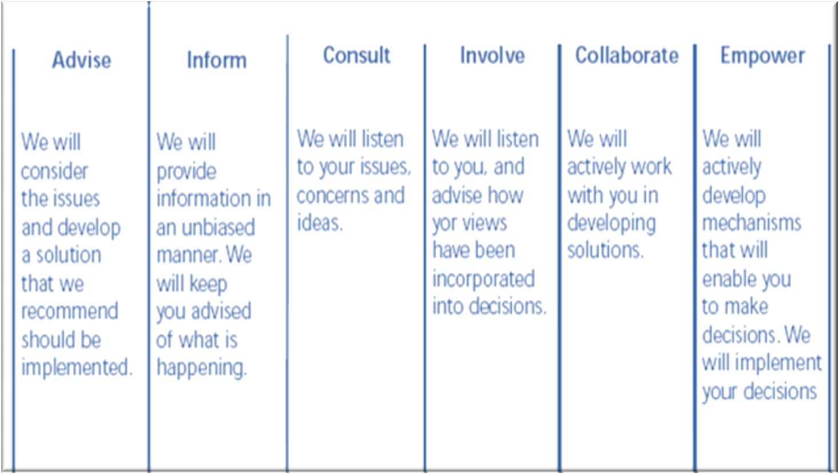
IAP2 Spectrum
Notes:
1 hour to go
Who has seen?
I used at DSE
ASCN use – when we plan D2C Programs
Go to Book – Read Through
Do Activity in groups
PIP Verses DAD)

Slide 9
What is a plan?
What are the advantages of a Plan?
What are some of the issues if you don’t have a Plan?
Notes:
30 min to go
Mt Everest?

Slide 10
A plan is…
A useful document
Both and object in itself…
And a statement of intent
Notes:
Noun and Verb

Slide 11
Steps to Developing a Community Engagement Plan
Mind Map
Negotiables - Not Negotiables
World Bank Stakeholder Analysis
Engagement Plan
Notes:
25 min to go
Demonstrate how to do a CE plan using these steps
When at last step – the Plan – next slide

Slide 12
IAP2 Spectrum

Slide 13
Does…
The IAP2 Spectrum
Stakeholder Analysis
CE Planning
Community Engagement
Help Foster Lifelong Learning and Community Resilience?
Notes:
10 Min to go
On Whiteboard - Brainstorm
Give out Handouts – run through

Slide 14
Did we reach aims?
To see a range of views on what community engagement is
Provide an opportunity to think beyond current experiences
Become familiar with, and understand the purpose of the IAP2 Spectrum
See how stakeholder analysis is integral to community engagement planning
Exposure to the engagement plan templates
Understand the unique position of community engagement planning within broader projects
Notes:
5 min to go
Run through.
Questions

