Slide 1
Building a resilient and responsive learning community for disengaged young people
A partnership approach
Presented by Louisa Ellum &
Simone Dawson

Slide 2
Today’s workshop
Understanding the regional, provider and individual education needs of at risk, disengaged and vulnerable young people
What does a partnership approach offer to education providers and young people?
Working from a big picture, regional approach to enable good practice at a provider level
Building resilient and responsive practice through outward facing approaches.

Slide 3
Our partnership
Inner southern region of metropolitan Melbourne
Flexible Engagement and Learning Network (FELN)
Bayside, Glen Eira, Kingston Local Learning and Employment Network (BGK LLEN) – equivalent to ‘Partnership Brokers’
Working together to create a system and landscape of education provision for our most at risk young people

Slide 4
Understanding the ‘life worlds’ of our young people
Our reality:
Disengagement from school
Lack of broad education and training provision
Significant mental health issues
Substance abuse
Pockets of extreme poverty
Homelessness/ couch surfing
Our challenge:
To build a resilient and responsive network of providers to support our young people’s educational and life worlds needs.

Slide 6
This is our local reality of non-mainstream school provision
SkillsPlus Intermediate & Senior CVCAL 15+ (Cheltenham)
LEEP - Foundation to Senior VCAL (Chelsea)
Oakwood School program 12+ (Noble Park)
Holmesglen Vocational College 16+ Intermediate & Senior VCAL (Moorabbin)
Sandybeach CGEA 15+ (Moorabbin) and IMPACT engagement program 15+ (Sandringham)

Slide 7
What is your local reality?
Alternative to mainstream school provision?
Engagement of ‘Partnership Brokers’?
Understanding of the ‘life worlds’ of our young people?
Community supporters of young people at risk?
Opportunities for partnerships cross sector?
Opportunities for a regional approach or network?

Slide 8
Developing partnerships at both regional and provider levels
Partnerships never look, act and function in the same way. We need to consider the real nature of the partnerships we are establishing and what the real outcomes will be:
For the students
For the education providers
For the partnering agency/agencies
For the community as a whole.

Slide 9
Creating holistic educational opportunities through partnerships
Welfare and well being support
Volunteer opportunities
Piloting initiatives and ideas
Seeking resources and funding
Strengthening relationships with schools
Professional development for trainers, facilitators and teachers
Support with pathways and career development

Slide 10
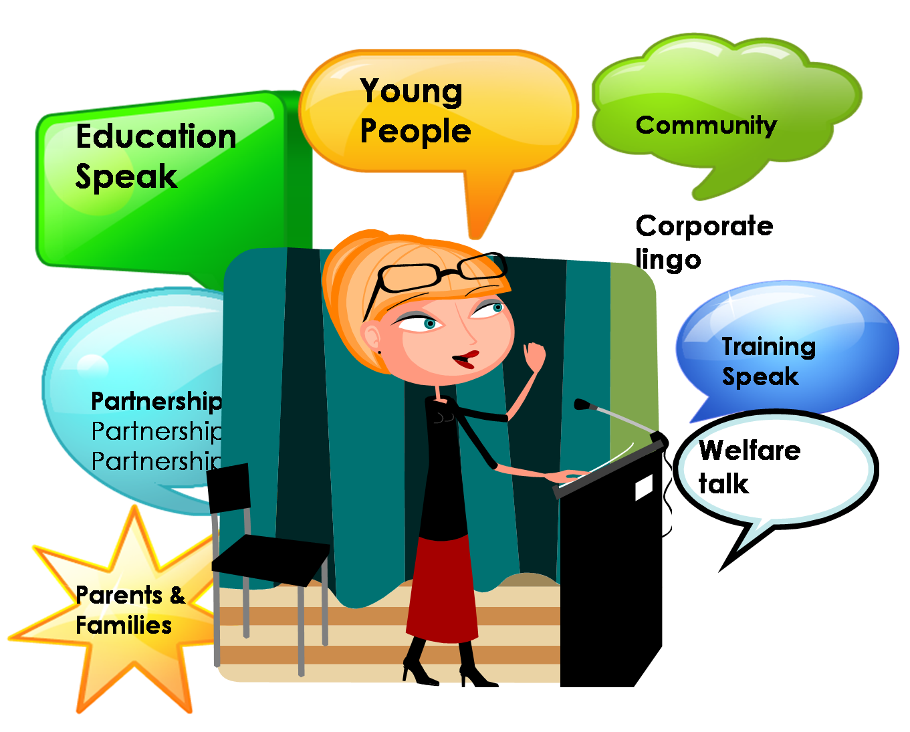
Being aware of our communication

Slide 11
A provider’s approach - SkillsPlus
Our Mission is to improve the life options of disadvantaged individuals through employment and learning opportunities.
Disability Employment Service (DES)
• Job Services Australia (JSA)
• Language, Literacy and Numeracy Program (LLNP)
• National Disability Coordination Officer (NDCO)
• Workplace Training
• Learn Local
• Youth Education

Slide 12
Youth Education
“I never though that I could achieve what I have since I have been at SkillsPlus; I think I could try anything.” Fabien, VCAL Student
We offer three key qualifications to our young people:
Certificate I in Work Education
Certificate II in General Education for Adults (CGEA)
Victorian Certificate of Applied Learning (VCAL)

Slide 13
Partnerships are the key…
To enable every student to have an appropriate educational experience and have success, organisations need to be outward facing and engage with the community for support and build strong relationships.
Know your expertise – know your limitations…

Slide 14
Our clients… and their life worlds
School refuser
Homeless
Drug addicted

Slide 15
Mapping your reality
What steps can you now take to:
Develop a local or regional approach to building a resilient and responsive learning community for young people?
Understand and respond to your young people’s life worlds needs through partnerships?
Understand your own expertise and limitations and use this to build a network of supporters?
Be outward facing and seek partnerships to build a holistic educational experience for your young people?

Slide 16
Questions?
and thank you…

