Slide 1
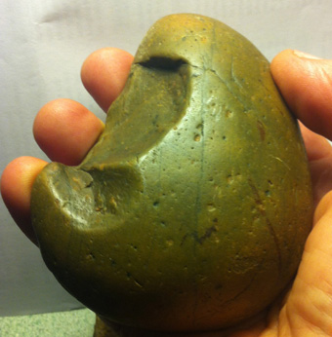
Adaptability
eloura or hammerstone, metamorphic river gibber
Found in University of Canberra car park.
How does lifelong learning speak to values of resilience & sustainability?
John McIntyre

Slide 2
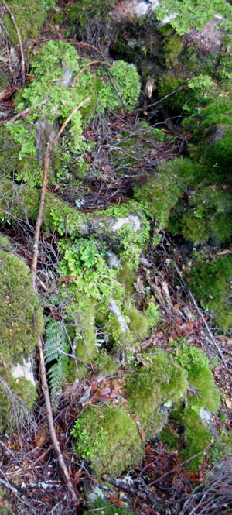
Adaptability is —
one of several core assumptions of the lifelong learning ‘ethic’
learning that accommodates new experience and results in development
not the same thing as resilience and sustainability (not synonymous)

Slide 3
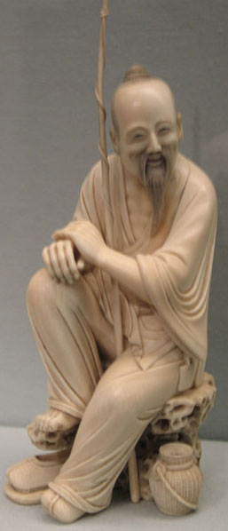
... as personal value
willingness to remain open to experience and change
fitness to conditions: being well-adapted to meeting life’s challenges
neuroscience, brain plasticity and consciousness—mind as adaptive and evolving
learning is [ethically] good in a range of ways (Bagnall)

Slide 4
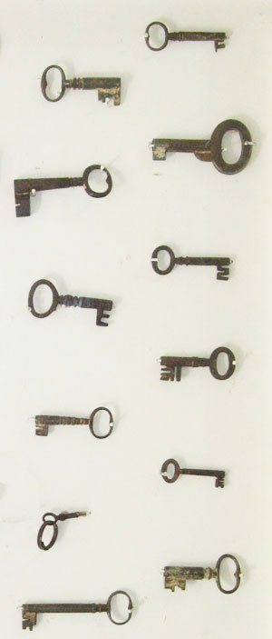
… as personal capacity
lifelong learning presumes a capacity to make choices and ‘enabling competencies’
without personal resources, learning is a high risk—low return equation (social risk)
The dark side: Social Darwinism—survival of the educationally fittest (=the best adapted)

Slide 5
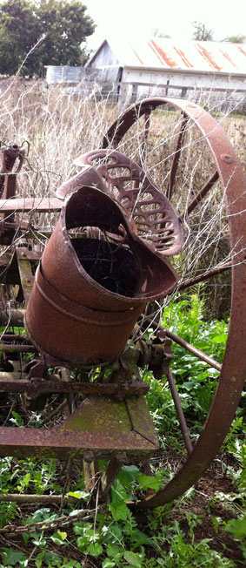
Adaptable communities
Adaptability as value in settler society (nostalgia for colonialism)
Resilience and ‘adaptive capacity’ (ecological theory)
Can we do better than ‘social capital’ as a theory of social and cultural resources?
How is learning a resource?

Slide 6
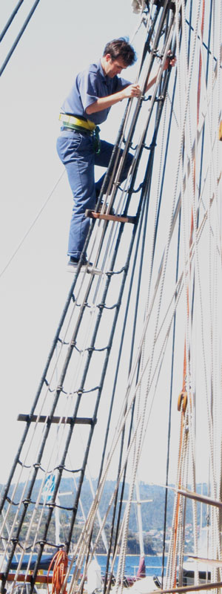
Adaptable organisations
The ‘nimble ACE provider’ as an adaptive organisation (Brown et al)
Adaptability as enterprise in a competitive environment
Strategic development of organisational capability
Organisational sustainability and staff resilience

Slide 7
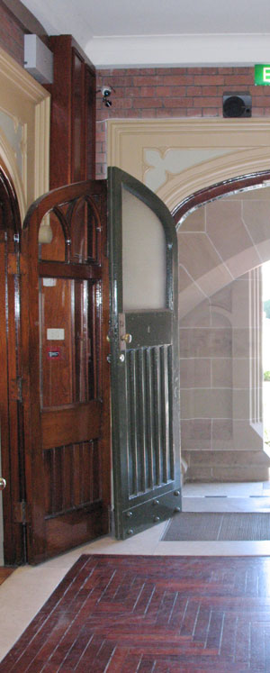
Adaptable institutions
lifelong learning challenges institutions to adapt to a learner-centred system or wither
discourses of learner pathways, credit transfer, articulation, recognition, diversity
flexibility = institutional adaptability
‘change madness’ as a failure of adaptation

Slide 8
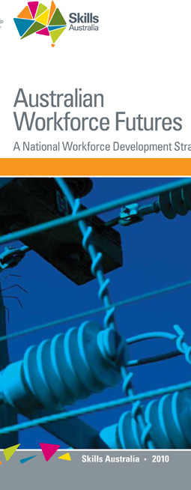
Adaptability in policy
Adaptability is key to the new discourse of workforce development
Adult learning is seen as pivotal to making adaptive workers e.g. mentoring
Focus on ‘key transitions’ of life in COAG framework (change)
All values are subordinated to economic competitiveness

Slide 9
Cultural adaptability
how far East can we go from here?
taking cultural learning seriously e.g. Asian languages
wisdom traditions: contemplative practice and mental resilience
beyond resilience as a national character myth
adapting to new times: ‘southern theory’ (Connell)

