Slide 1
Leadership Onkaparinga
Lifelong learning…building resilient communities
Presented by
Joanna Giannes, Project Officer Leadership Onkaparinga
Notes:
TITLE
Highlight the Title here and Presented by text and enter your name and title. Include other information if you need to, but try and keep the text to a minimum. Too much text will make this screen appear cluttered.

Slide 2
Leadership Onkaparinga
Lifelong learning…building resilient communities
How building leadership skills in the Community builds resilience, enhances confidence and develops skills individually and collectively.

Slide 3
What is Leadership Onkaparinga?
A program that integrates specialised learning in building leadership capacity in the community
Key elements of education
imagining a better future
systemic thinking
critical thinking and reflection
participation in decision making
working in partnerships
(Tilbury and Wortman 2004)

Slide 4
Active Citizenship
Georgia Rydon
Active Citizen
Magic Harvest
An active citizen is someone who takes a role in the community
Active citizens take action in order to improve their community, to make a difference

Slide 5
Leadership Onkaparinga
Leadership Onkaparinga has to date enabled 88 residents over 6 years to access this structured program where key outcomes have been;
an increased level of confidence to address community issues;
to deal with ‘people of authority’
to be an advocate for their community

Slide 6
Leadership Onkaparinga Framework
Leading Self
Conscious Use of Self The primary tool for anyone wishing to manage change in a human system is the configuration of intellectual, emotional, and physical energies that a particular person brings to the situation.
Leading Relationships
Impact of Self
Leading the Project
Process and procedure
Leading the Community
Community Capacity Builders Framework (Sharon Zivkovic)
Health
Education
Business
KPI’s
KRA’s
Sustainability
Decision Making
Collaborative Planning
Influencing
Negotiating
Conflict Resolution

Slide 7
Key statistics 2012
38 Registrations of interest.
20 Selected, 17 actual participants
2012 Leadership Onkaparinga run in evening and weekend workshops
6 Project Mentors
23 Facilitators
2 Tours
Numerous staff behind “the scenes”
Commenced 16th February
Graduation 2 August 2012
100% Retention Rate
2 Direct Employment Outcomes
Numerous project initiatives

Slide 8
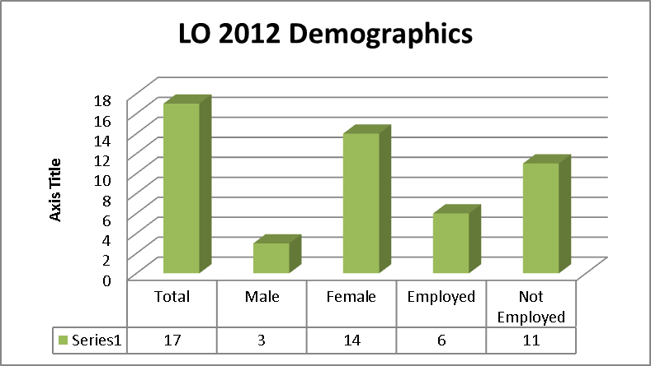

Slide 9
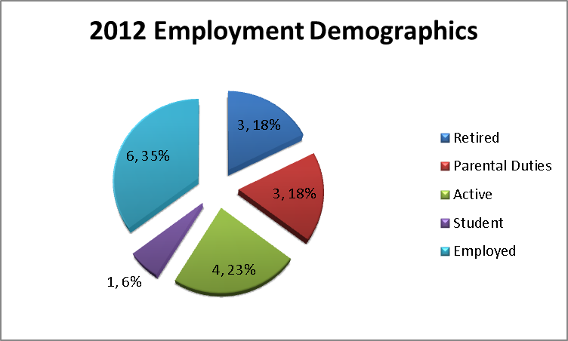

Slide 10
2012 Participants Initiatives

Slide 11
Leadership Onkaparinga
Program Design
Our materials and methodologies in our program move beyond the traditional to amplify learning.
Mentoring
Theory
Community Project

Slide 12
Leadership Onkaparinga
Program Design
Tours
Simulations
Art and Music
Story Telling
Action Learning Projects
Psychometric Profiling
Post Program Learning (Masterclasses)

Slide 13
Leadership Onkaparinga Program Design : Community Capacity Builders 7 perspectives
Health
Education
Welfare reform
Business
Sustainability
Decision making
Collaborative planning

Slide 14
Leadership Onkaparinga
Program Content
Community Capacity Modules | Sharon Zivkovic
Community Capacity Builders Framework Community Based Research Understanding the Changing World Participation and Collaboration Managing Place Healthy Communities Learning Communities Enterprising Communities Sustainable Communities Community Leadership | Communication for Collaboration Community Deliberation Community Visioning Strategic Planning Opportunity Analysis Creative Resourcing Managing Community Projects Developing Community Organisations Social Marketing and Promotions Evaluating Community Capacity

Slide 15
Leadership Onkaparinga
Program Content
Modules
Leadership DiSC profiling Community Research Project Management 1 & 2 Governance Sustainability Water proofing the South Economic Development Annual Business Planning Marketing and Event Management Community Engagement Community Development Appreciative Inquiry Community Centres Public speaking Cultural Awareness

Slide 16
Leadership Onkaparinga
Meta Leadership
Meta-leaders…seek to influence and activate change well above and beyond established lines of their decision-making and control.
These leaders are driven by a purpose broader than that prescribed by their formal roles, and are therefore motivated and capable of acting in ways that transcend usual organizational confines.”
Decisions are complex, and there are always competing factors.
The word Meta- is a prefix and is translated from Greek – μετά as: "after", "beyond", "along with", "adjacent", "self", “behind”;

Slide 17
Leadership Onkaparinga
Meta Leadership -Integration of 5 Elements
Leading up
Leading down
Leading across siloed boundaries
Understanding the problem you’re dealing with
Understanding yourself as a leader
Dr Leonard J Marcus and Dr Barry Dorn
“Leadership is a complex process of bringing a lot of different people together simultaneously…”

Slide 18
Connections: Leadership Onkaparinga
Staff
RTO
Elected Members
Industry
Residents
Community Centres
External Facilitators
E-Learning
Education
Workforce

Slide 19
Connections: Leadership Onkaparinga
2012 Projects/Initiatives
Food sustainability – Million Mile Diet
Magic Harvest (incorporating Art and Nature for better Mental Health
Redevelopment of church to incorporate Café developing pre employment skills
Walking /cycling path from Christies Downs to Noarlunga centre
Tourism site for Fleurieu Peninsula to Chinese markets
Animal management - Development of Manual and Education Programs
Theatre company with a focus on Youth
Infusion pumps for disadvantaged (Diabetes)
Coastal Onkaparinga info centre – promoting Port Noarlunga
Food collection/health/hygiene for homeless
Nutrition for Aged
Mobile Phone Training for isolated Seniors
Corella Management for Old Noarlunga
Play Café for Young Mothers
Volunteer Management Induction Training Manual
Southern Business Magazine
Post Natal Depression Support Group – Aldinga Beach

Slide 20
Connections: Leadership Onkaparinga
Sample of Previous Projects/Initiatives
Youth issues including graffiti reduction and peer support programs.
Health initiatives including development of cancer support group
Intergenerational projects to support ageing communities to remain connected through computer training
Developing environmentally sustainable futures
Supporting families to connect with their children through play
Tribe FM Community Radio Station Willunga
Indigenous food garden
Men’s health and Wellbeing
Seven Sisters Bush University (Indigenous Healing and Knowledge)

Slide 21
Connections: Leadership Onkaparinga
Adult Learner of the Year 2012
Alumni
Project Mentors
Departmental interconnections – eg Youth, Neighbourhood
Masterclasses
2012 and Beyond
Sue Steer Leadership Onkaparinga Graduate2009 Volunteer Support Officer Hackham West Community Centre

Slide 23
Leadership Onkaparinga
2012
The beginnings of real participative citizenship…

