Slide 1
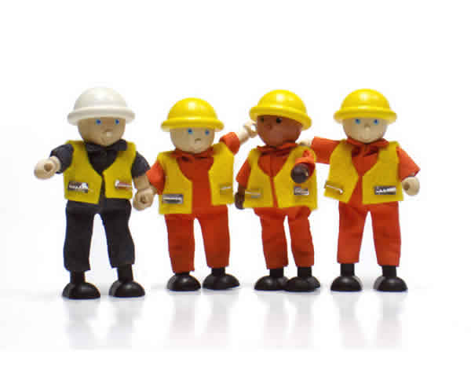
ALA Conference 2012
Developing resilient workers: Learning across working life
Ray Smith
Darryl Dymock
Stephen Billett

Slide 2
Background
Growing requirements for workers to sustain employability across lengthening working lives
Changing nature of work – technology, globalisation, restructuring, etc
Workers need to have and develop the capacities to adapt to those changes to sustain employability . i.e. to become resilient

Slide 3
Definitions
‘Employability’ a contested &
contentious term
As used here: ‘(pro)active adaptability in the work domain’. (Fugate, Kinicki and Ashforth 2004, 17)
Resilience: ‘positive psychological capacity to rebound or ‘‘bounce back’’ from adversity, uncertainty, conflict, failure or even positive change, progress and increased responsibility’. Luthans (2002: 702)

Slide 4
Responding to change
One way in which workers can demonstrate capacity to respond to workplace change, whether adverse or positive, in order to maintain their employability, is through learning and training.
However, opportunities for learning and training that supports continuing employability not guaranteed by individuals’ efforts, but subject to contextual and situational factors

Slide 5
Research project
This paper draws on findings of a national project about how workers develop the capacities they need to sustain their employability across lengthening working lives
Three-year project funded by NCVER:
Change, work and learning: Aligning continuing education and training
Griffith University team

Slide 6
Data collection
Semi-structured interviews with 51 workers
Community services and health; Transport and logistics
How they
perceived the importance of ongoing learning
perceived the relative effectiveness of different sources of learning
preferred to be supported in their learning.

Slide 7
Project focus
Focus of project is continuing education and training, but also asked about initial learning & training
Research did not set out to identify resilience as a capacity in workers
Responses indicate that workers see learning and training as a way of responding to workplace changes

Slide 8
Significance of workplace
Workplace was most highly ranked site for learning for both current and continuing employability
39 noted it as the basis of their initial occupational learning
40 noted it as the basis of their continuing learning.

Slide 9
Significance of workplace 2
Learning through authentic
work activities was consistently
found to offer adaptive learning
opportunities well aligned with enhancing resilience and sustaining employability, provided the activities:
i) are conducted in the actualities of work
ii) are supported by experienced and cooperative others and employers
iii) comprise a developmental pathway that acknowledges and rewards increasing expertise.

Slide 10
Quote
“For this particular job, everything changes every day so … unless you're doing it on the job, there's no way of learning this position. … - Brianna, aged care worker
However…

Slide 11
Quote (cont)
“It would have been a lot easier to learn the job if I had been shown by somebody, especially somebody who's done it.”
Brianna, aged care worker

Slide 12
Quotes: Two truck drivers
Gary : ‘You just had to get in
and do it yourself.’
Barney: ‘I have the basic knowledge and knowhow and you learn each day as you're doing it.’

Slide 13
Learning through work
In these seemingly obvious ways,
workers undertake the
learning necessary to their work
through a reliance on their
personal capacities to accept
challenge, utilise previously
developed skills and use the available resources.

Slide 14
‘Proactive adaptability’
Work in aged care and transport is increasingly highly regulated and characterised by an increasing emphasis on employees holding accredited qualifications and engaging in regular training interventions that satisfy
compliance requirements.
Workers expect and accept that ongoing training is a fundamental aspect of their work and employability.

Slide 15
Towards resilience
All of these processes indicate that the workers are taking responsibility for their own learning in responding to the changes currently occurring in their industries, in ways that Luthans (2007) characterises as resilience.

Slide 16
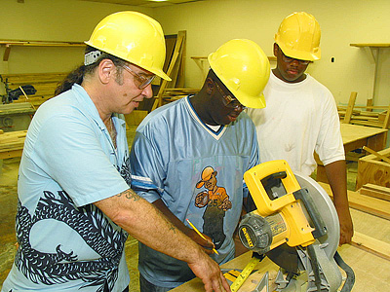
However…
A clear emphasis throughout the responses is of workers needing and wanting to directly engage in learning with someone who knows more than they do and is able to direct their learning ‘properly’.

Slide 17
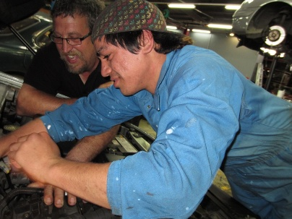
Need for expert support
The three most frequently reported actual forms of learning support were those associated with direct engagement with a co-worker (84%), workplace expert (63%), or trainer in a classroom (61%).

Slide 18
Examples of expert support
‘I have a buddy shift, somebody else teaching me and how to do things well.’ - Noela, health care worker
‘There's blokes here and they have always pointed out the wrongs and rights.’ - Barney,
transport worker

Slide 19
However…
Well-intentioned support of colleagues cannot always be relied on to identify and guide adaptive learning.
Workers are both supported and constrained by structurally determined opportunities to exercise their capacities and aspirations in work.
This is clearly illustrated when learning in the workplace is augmented by the provision of facilitated education and training opportunities.

Slide 20
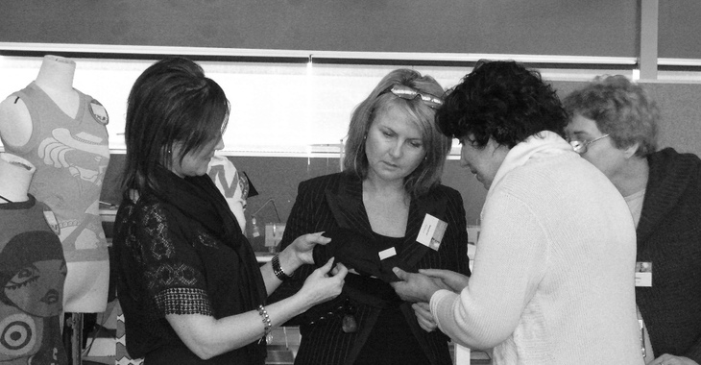
Enhancing resilience
Data suggest enhanced resilience to workplace change best supported by:
learning that meets personal needs through enabling workers to learn together …
in shared workplace-supported arrangements …
that are sufficiently guided by expertise that is relevant to the immediate circumstances of work (and potentially for
future needs)…
and leads to accreditation.

Slide 21
Resilience for now and later
‘We're constantly doing training to update our skills like that. If I'm eager to upskill they'll send me off to a computer course, or a management course, things like that.’ Bianca – disabled care worker
Acknowledges strong personal and organisational connection between updating for immediate workplace performance and up-skilling for future tasks and roles,
i.e. developing resilience in a
complex working environment.

Slide 22
Learning is both an internal and external factor of individuals’ personal resilience.
Learning as Internal: legacy of
successful learning can be
attributed to individuals’
personal efforts, decisions and
priorities as they are enacted
through agentic action.
Individuals can be said to
choose what they find
interesting, challenging and
important and, thereby, how
much of themselves they will
invest in their experiences.

Slide 23
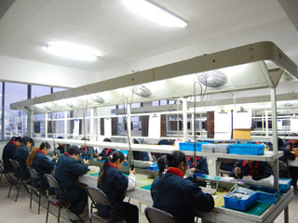
Learning as external
Individual agency mediated by socio-cultural circumstance over which individuals have little to no control (e.g. workplace affordances, changes in employment patterns).
Learning experiences structured by the contexts individuals participate in and the opportunities from that participation.
Sometimes contextual structures are constraining, presenting few if any opportunities for individuals to exercise their agency and overcome threats and barriers to their wellbeing and advancement.
Equally, contextual structures can be invitational, offering a wealth of opportunity to learn, create and progress.

Slide 24
Different goals?
The data advanced above suggest that these workers are quite future-oriented and willing and able to expend the effort necessary to secure and sustain their employability within sets of circumstances that support and advance their aspirations.
Workers’ personal and vocational goals and the organisational and regulatory goals of their employers and governments may or may not align as motivations and targets for the effort required for effective adaptive learning.

Slide 25
Implications 1
Workers and workplaces will need to be more broadly supported to value learning effort expended for futures that are uncertain and unanticipated. Adaptive learning for employability needs to be more than reactive.

Slide 26
Implications 2
The emphasis workers come to place on the need of learning experiences being authentic and situated in practice requires a greater consideration when advancing workplaces as sites of legitimate pedagogy and curriculum enactment: (i.e. sites of structured learning).
So, how experiences are introduced and made accessible, sequenced and prioritised and then monitored and evaluated needs careful consideration if this continued learning is to be effective.

Slide 27
Implications 2 (cont)
There is a role here for education and training institutions. Their learning design expertise could be developed beyond training provision to include organisational management and structuring for learning that helps develop resilience in workers.

Slide 28
Implications 3
Development of learning cultures in workplaces through and for work practice requires that workers are not just left to learn wholly independently when faced with tasks that are beyond the scope of their adaptive learning and are, instead, supported to undertake such learning in work.
The data indicate workers’ need of direct and individualised learning support in two primary forms; access to and guidance from experts and employer sponsored provision within work.

Slide 29
Implications 4
Workers are learners who need to engage fully and willingly in the changes to which they are subject and the changes to which they aspire across their working lives as workplace requirements constantly change.
Effective learning is premised on the attitudes and practices that attend engagement in learning experience.

Slide 30
Conclusion 1
Overall, developing resilient workers
is enabled by work that values learning.
That value is founded on the integration of:
workers individually and collectively
the organisations and workplaces within which they work
the education and training institutions that facilitate accredited learning provision, and
the regulatory bodies that govern that provision.

Slide 31
Conclusion 2
The complexity and intensity of change within contemporary work demands that worker resilience be seen as a social issue and not the sole domain of individual workers who may or may not successfully address the range of demands and stresses their work inevitably brings.

Slide 32
Conclusion 3
Seeing resilience as an individual, employer and social issue should lead not only to the development of individual resilient workers able to sustain their employability, but the emergence of a capable and responsive workforce.

Slide 33
Contact
Dr Darryl Dymock
School of Education and Professional Studies
Griffith University
d.dymock@griffith.edu.au

