Slide 1
Making a case
Lifelong and lifewide learning for all Australians
Professor Barry Golding, President ALA
Associate Dean, School of Education & Arts, University of Ballarat
Opening Presentation to
ALA National Conference, Byron Bay, New South Wales, Australia
11 Oct 2012

Slide 2
Synopsis
There are a range of good arguments
This is not new and we have evidence
The likely Australian solutions and policies may be found elsewhere (eg Scandinavia & China, Indigenous education)
We need to get better at linking lifelong & lifewide learning with wellbeing.

Slide 3
Lifelong learning
‘… includes people of all ages learning in a variety of contexts’ (Schuller & Watson, p.10)
Does not, in my view, have to involve a degree of learning organisation and intention’, as Schuller & Watson (p.10) suggest.
‘Lifelong learning [is] increasingly constructed within a skills agenda’ (Jackson 2011, p.2)
Schuller & Watson, Learning through life NIACE, 2009.
Jackson, S. Innovations in lifelong learning, 2011,

Slide 4
Lifewide learning contributes …
to a range of different (and often intersecting) realms of life.
at any age towards work; but also towards re-creation; occupation; health; identity; wellbeing; fitness; recreation; parenthood; emotions; cognition; empathy; sexuality; family; democracy; community; aesthetics; ethics; entrepreneurialism; use of technology; imagination; literacy; numeracy.

Slide 5
There is a powerful moral argument that lifelong and lifewide learning can:
mobilize people of all ages through the notion of free spaces for agency.
achieve most of of Sen’s human capabilities for wellbeing.
lead towards equal citizenship for all who may be disempowered.
Sen, A. (1985) Commodities and capabilities.
See summary of Sen’s other works in Clark, D. (2005) ‘The capability approach: Its development, critiques and recent advances’, GPRG.

Slide 6
Governments are cutting support for non-work-related, part-time adult education, despite a 2012 UK study (Fujiwara, D., Valuing the impact of adult learning, NIACE) showing …
57% of the $ value of adult education is related to ‘better social relationships’
13% to ‘improvements in health’
11% to ‘ a greater likelihood that people will volunteer on a regular basis’
only 19% (1/5) related to ‘greater likelihood of finding/staying in a job’.
Why aren’t these other benefits valued?

Slide 7
Who said? When?
Allow all people to have education regardless of family background.
People are similar to each other by nature at birth. However exposed to diverse circumstances while growing up, they develop diverse habits.

Slide 8
Confucious 551BC-479BC
in 30s, established in our careers
in 40s, enlightened on many issues
in 50s, well aware of our fate
in 60s, receptive to all kinds of opinions
In 70s, able to act at will without violating principles (wisdom).

Slide 9
Adult learners after Digital Britain Media Literacy Working Group (2009, Table 2, p.18) in Schuller & Watson, p.172; italicized addition from Jarvis (1991)
Life stages | Needs
Young people | Developing educational potential Developing social networks Gaining new knowledge and networks
Adults | Looking for and developing employment Looking after families (health, education)
Older people | Overcoming the risk of social isolation Staying healthy Remaining independent
Before death | Making sense of and reconciling the life one has lived

Slide 10
Grundtvig … Born in Denmark 1783
is still used as a ‘beacon’ for ACE in Europe
believed universities should educate its students for active participation in society and popular life.
promoted values such as freedom, cooperation, discovery, wisdom, compassion, identification and equality
opposed all educational compulsion, including exams, as deadening to the human soul.

Slide 11
There is a range of factors that put adults off formal and accredited learning, keep them unwell & out of work, and exacerbate inequality:
previous negative experiences of schooling
a dislike of formal learning, exams & literacies
limited access to education, training & services that match adults preferred ways of learning across different ages
limited access to computers & internet
age discrimination in employment & training
sickness, disability, caring & family roles.

Slide 12
We have the evidence base, in Mental capital & wellbeing UK Government Foresight project (Cooper et al. 2010); 84 Chapters, 1000+ pages, in four Sections:
Mental capital & wellbeing through life (Sahakian)
Learning through life (Field) Helen
Mental health & ill-health (Jenkins)
Wellbeing & work (Cooper) Stephen
Learning difficulties (Goswami)

Slide 13
Learning in older adulthood
‘The need for continuing education is increasingly important to maximize the potential mental capital trajectory throughout life.’ (Cooper et al., p.25)
There are two principal challenges:
1. ‘… how to ensure that the greatest number of older people maintain the best possible mental capital, and so preserve their independence and wellbeing’;
2. ‘… ensure that the considerable resource which older people offer is recognized and valued by society, and that they have the opportunity to maximize the maximum benefit … both for themselves and for wider society.’ (Cooper et al,. p.23)

Slide 14
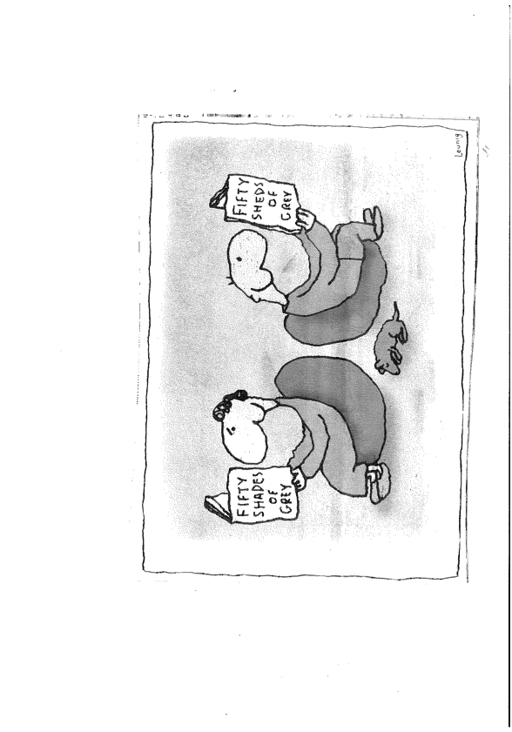
One view of older adult learning
… Leunig, The Age, Melbourne. 29 Sept 2012

Slide 15
Continuing education
Education has important benefits in terms of mental (and physical) health by increasing an individual’s sense of self-esteem, encouraging social interaction and activity ’ (Cooper et al., pp.36-37)
And yet ‘The great majority of those entering older age will have had little education since attending school many decades earlier’ (Cooper et al., p.36)
What opportunities are there left in Australia for adult and continuing education?

Slide 16
‘Barriers’ to learning?
‘Over one third of the adult population have had no formal episodes of learning at all since school-leaving age,’ (Cooper et al. p.352)
One third of Australian adults are functionally illiterate and innumerate to the extent needed to participate in the modern world of work and life. (ABS, 2006, IALLS)
6/10 do not have basic health literacies.
One half of the workforce in Australia have completed no formal education since school,
Why? What should be done about it?

Slide 17
Rethinking barriers (Cooper et al., p.357)
Characteristics that are set very early in an individual’s life: age, sex and family background predicts 75% of later learning trajectories. Once these are taken into account, there is not enough variation left for barriers to make any difference to participation.
Most non-participants are not put off by ‘barriers’, but by their lack of interest in something that seems alien and imposed by others. We need to revise (our ideas) that the existing set-up for learning is appropriate for all, and that the reluctant learner need only be lured back on track.
Evidence: this week the 1,000th men’s shed was opened.

Slide 18
Important conclusions (Cooper et al., p.358-9)
‘Those who ‘failed’ at school come to see post-school learning of all kinds as irrelevant to their needs and capacities.’
‘There is, of course, a correlation between school-level qualification and later educational success, and between educational success and employment, but we have to be very cautious about what this signifies.’
‘Educators do not select their potential students, nor employers their employees, on the basis of their socio-economic status, ethnicity or age, as this is both unfair and illegal. However they do select them on a substitute variable:- prior education – that sums up, and is very heavily correlated, with such background factors. What is the sense of that?’

Slide 19
Frameworks for learning ACSF (suggest adult learning needs to be more relational)
ACSF Aspects of communication | For … | Related to
Personal | Expressing identity | Personal identity/goals
Cooperative | Interacting in groups | Functioning of groups
Procedural | Performing tasks | Carrying out tasks
Technical | Using tools &machinery | Tools, machinery, tech.
Systems | Interacting in orgs. | Interacting in orgs.
Public | Interacting in comm. | Social & community

Slide 20
WHO Determinants of Disadvantage
Suggest adult learning needs to be lifewide
Determinants | Ways of addressing them
Social inclusion | Social inclusion & community engagement *
Unemployment | Employment & productive voluntary work *
Early lives | Inclusion in later lives *
Stress | Recreation, exercise, relaxation, enjoyment *
Inadequate food | Regular, healthy, social meals *
Substance abuse | Information and support for addictions*
 | * Men’s sheds in community settings do this.
 | What is the role of adult learning?

Slide 21
Expenditure on formal and informal learning across four life stages (in UK, 2008: Schuller & Watson, 2009, p.102) confirms that learning is not currently lifelong
age 1-25 = 86%
age 25-50 = 11%
age 50-75 = 2.5%
75+ = 0.5%
How well are these age categories catered for in Australian adult education & training sectors?

Slide 22
Concern that uncritical exhortations for ‘more learning’ …
… may exacerbate the recent explosion in formal training and education for those who can afford pay or who are eligible though government vocational ‘entitlements’, further diminishing the status of people who are poor, unskilled and unqualified or beyond paid work (see Fullick, 2009).
Fullick, L. (2009) Poverty reduction and lifelong learning, IFFL Thematic paper 6, NIACE, Leicester.

Slide 23
The final dilemma after The sprit level, R. Wilkinson & K. Pickett (2009)
Poverty is directly associated with ill-health.
Many of our social problems derive from the mere fact of inequality. Almost everyone loses from living in an unequal society.
The uncomfortable truth is [that] inequalities in education accentuate inequalities in [poverty and ill health] rather than reduce them in an already unequal society. Schuller & Watson, 2009, p.173.

