Slide 1
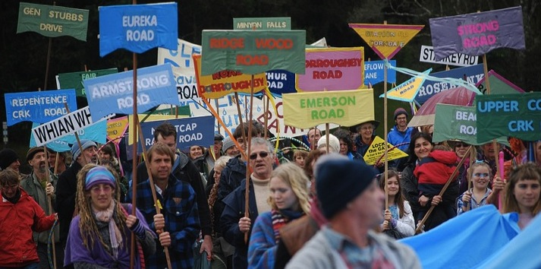
Social Learning and Resilience
How communities can respond creatively to adversity
Annie Kia October 2012

Slide 2
Resilience
The ability of a system to absorb disturbance and still retain its basic function and structure.
Walker & Salt 2006

Slide 3
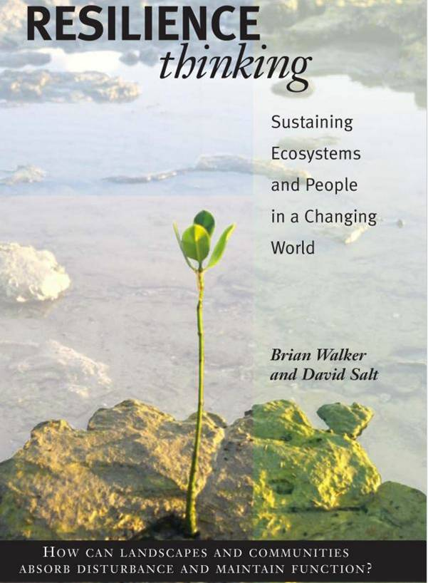

Slide 4
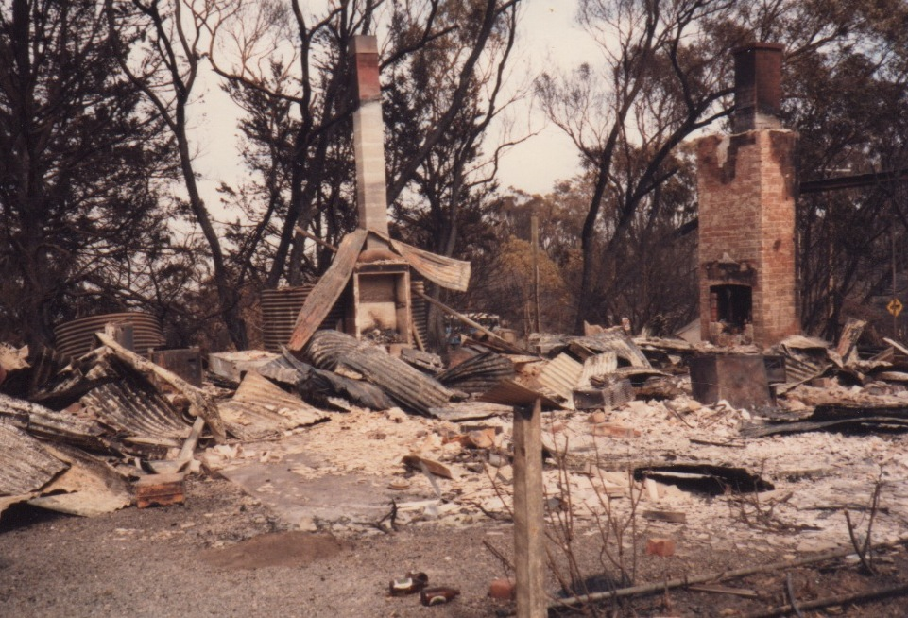

Slide 5
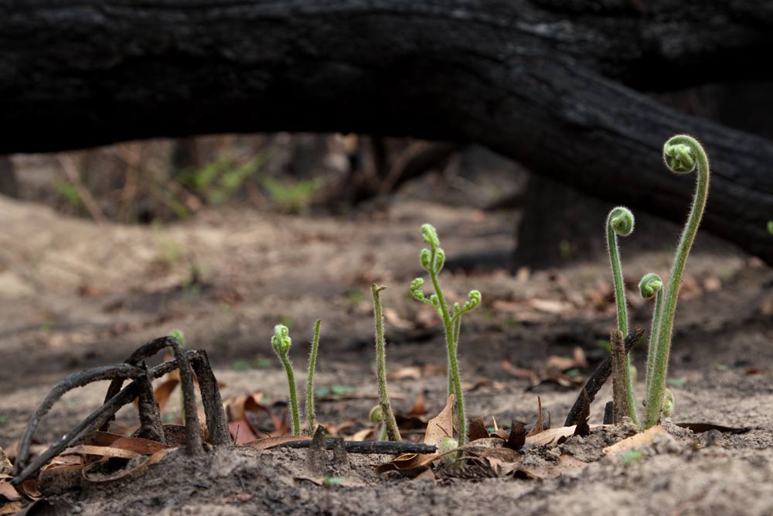
Gary Ayton Photography

Slide 6
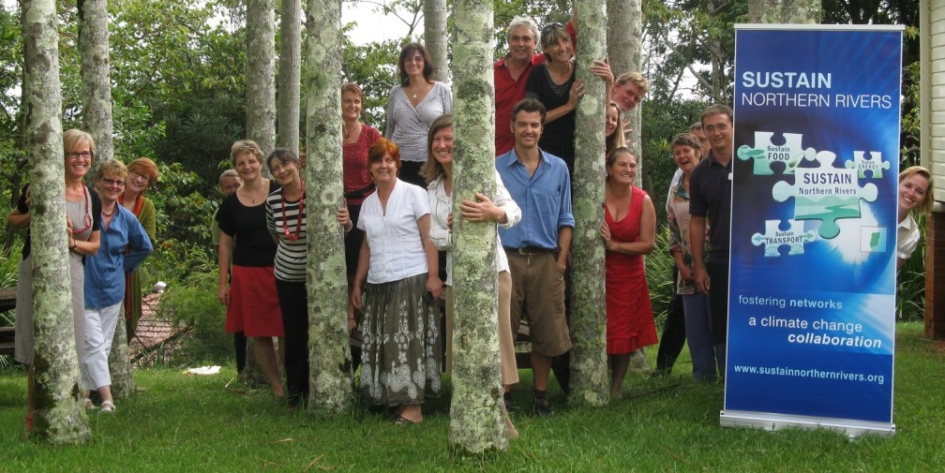

Slide 7
Sustain Northern Rivers = networked intelligence
6
16
12
34
3
LCSAFNC
21
31
18
7
NCAHS
RVC
NSWDET
26
14
43
NRT
NRCMA
35
40
2
NCITAFE
20
17
24
11
NRRDB
8
4
33
42
NEWF
NOROC
15
SCU
BS
44
NRSDC
NSPL
36
Building ‘soft infrastructure’

Slide 8



Slide 9
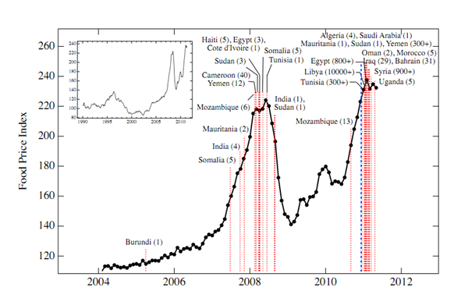
High food prices = political instability
The Food Crises and Political Instability in North Africa and the Middle East
Marco Lagi et al, New England Complex Systems Institute 2011 http://arxiv.org/pdf/1108.2455v1.pdf

Slide 10
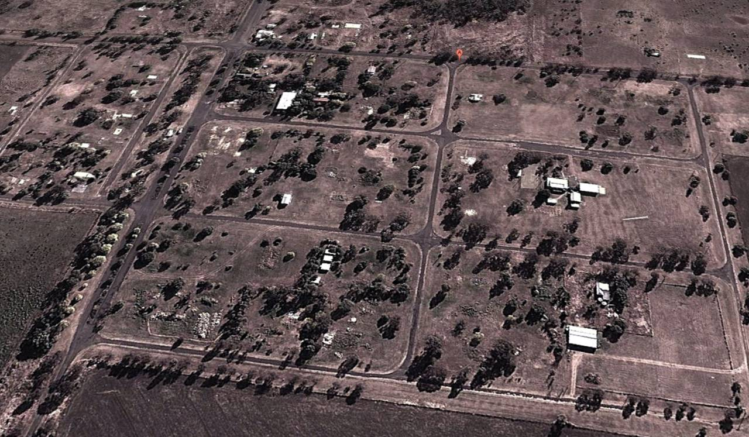
Acland

Slide 11
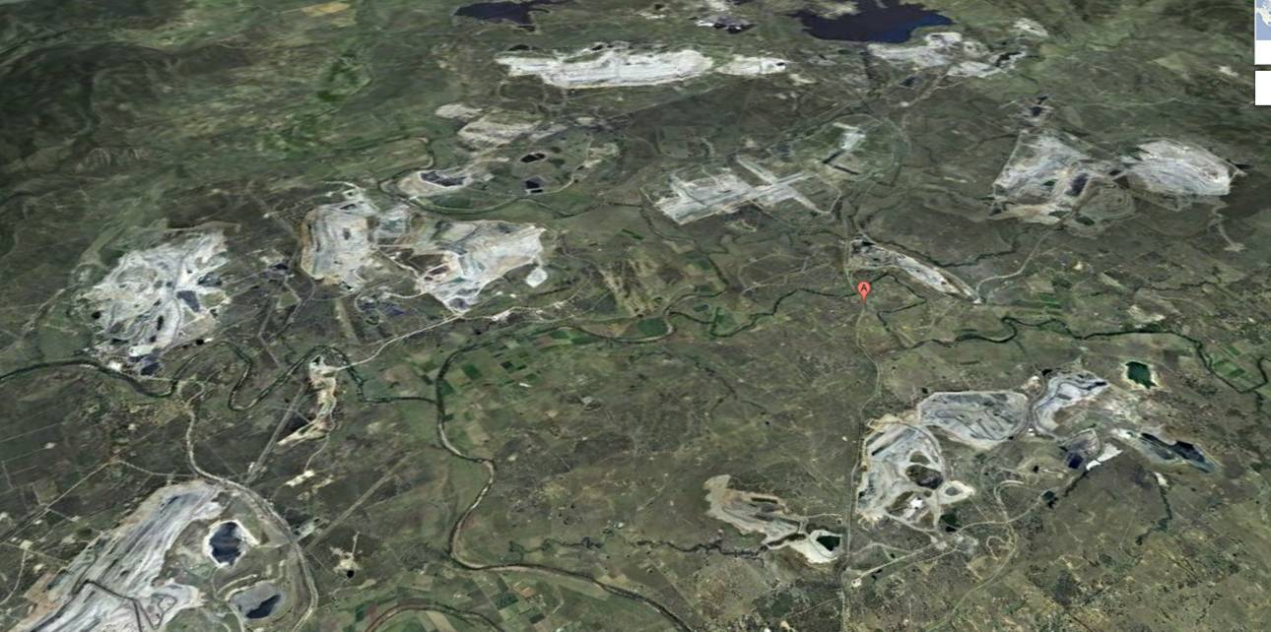
Camberwell

Slide 12
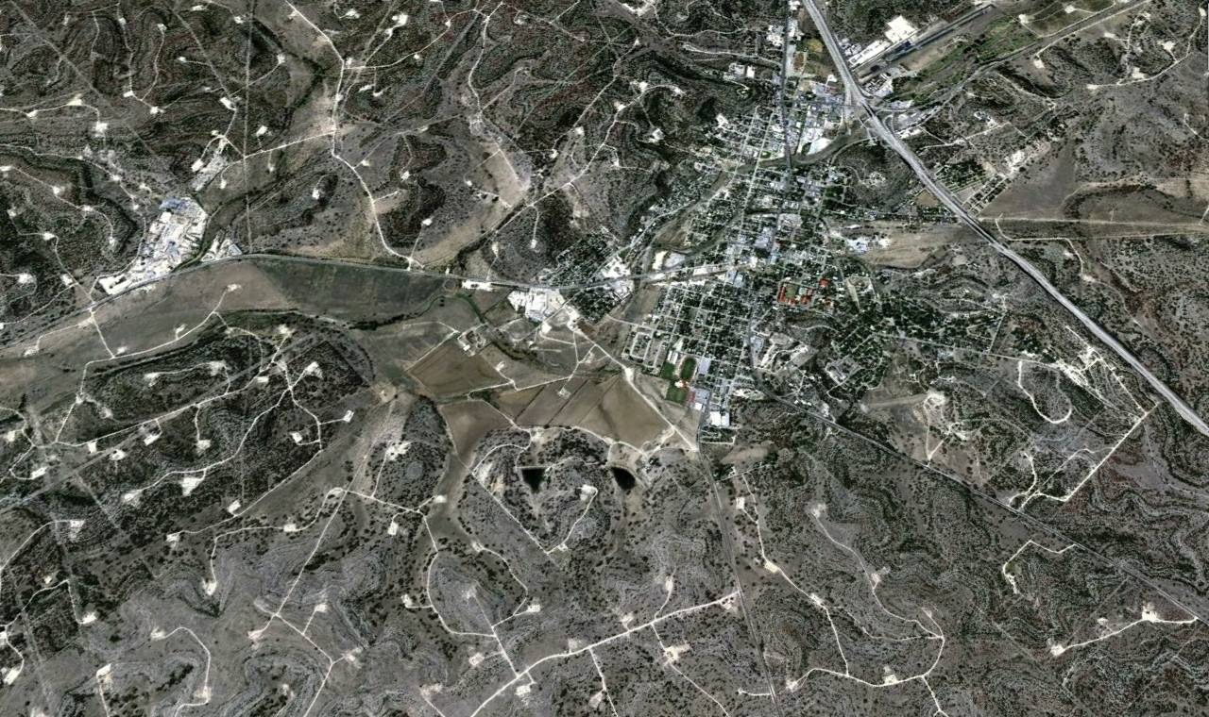
Sonora, Texas

Slide 13
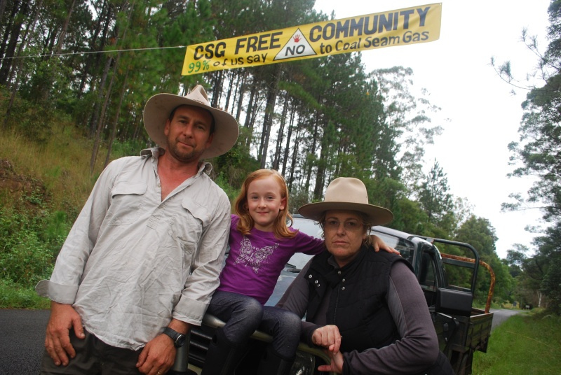

Slide 14
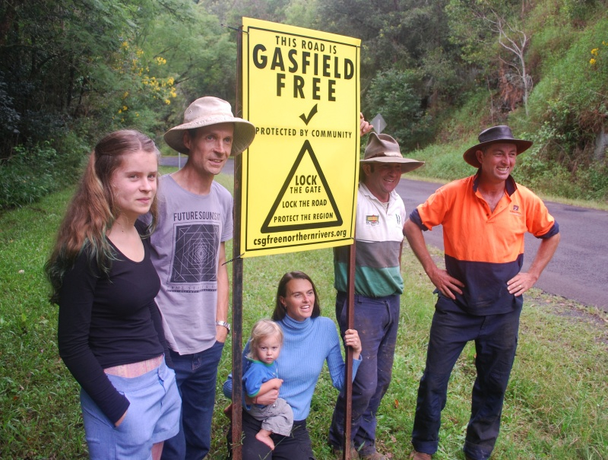

Slide 15
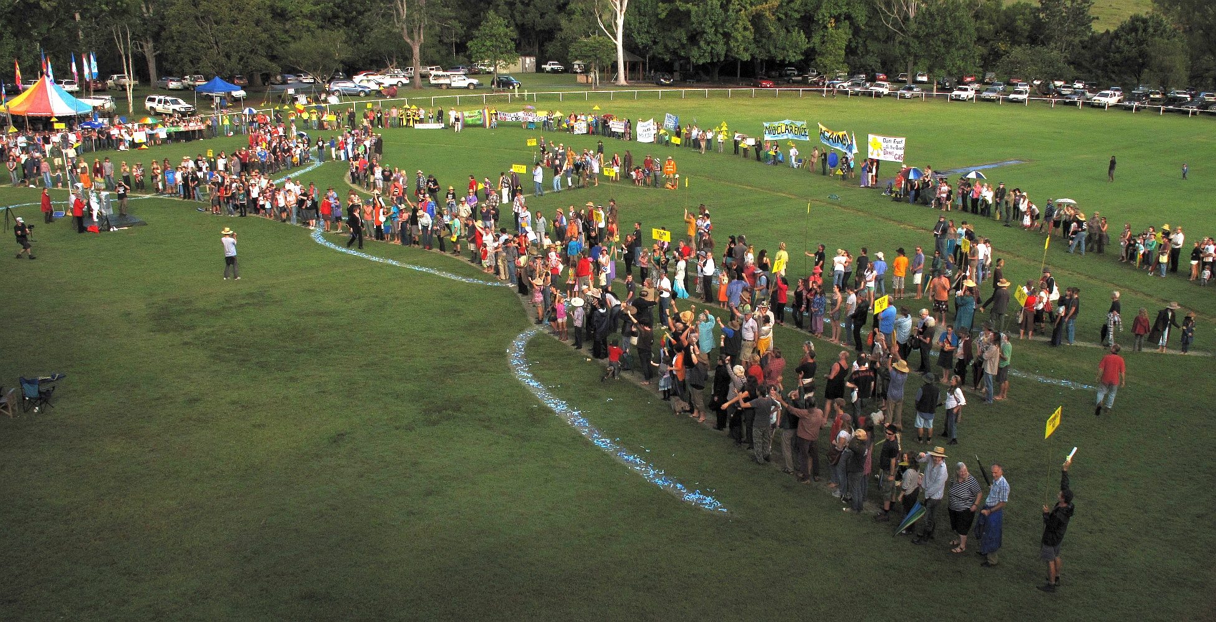
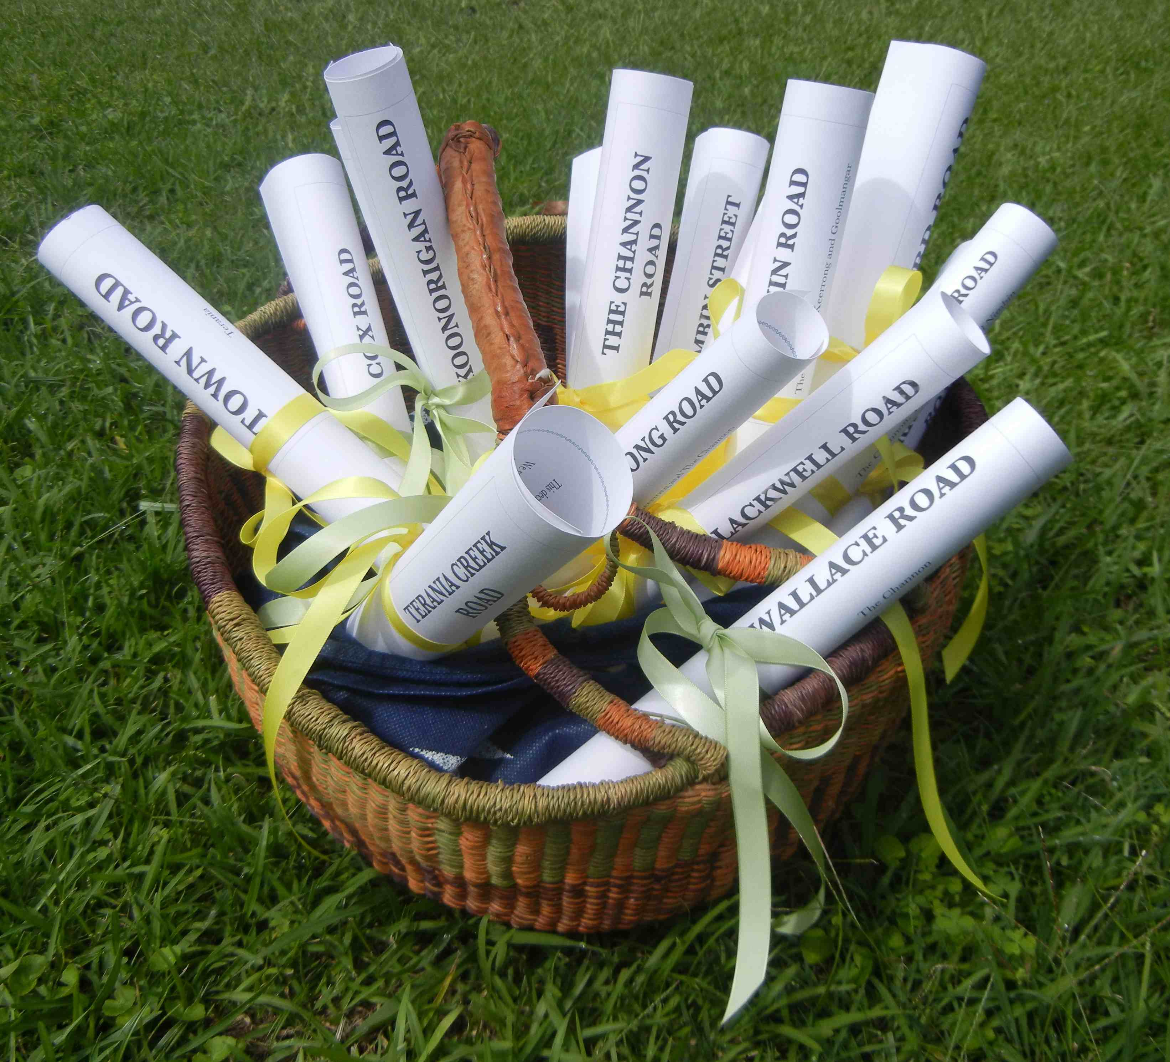
Ceremony

Slide 16
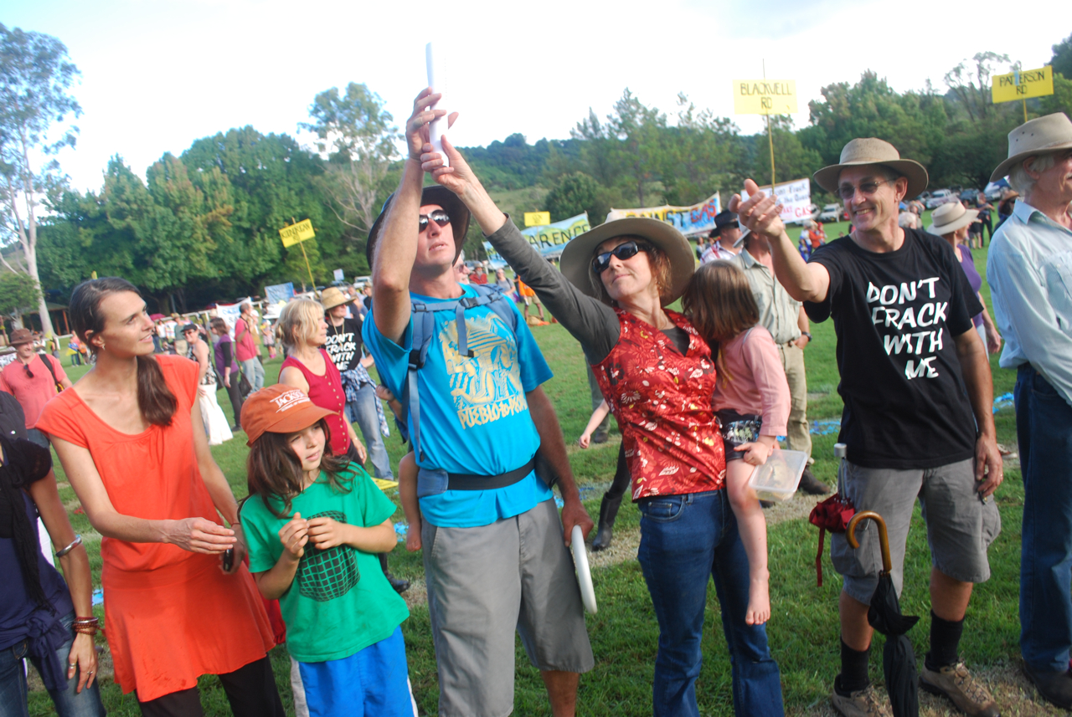

Slide 17
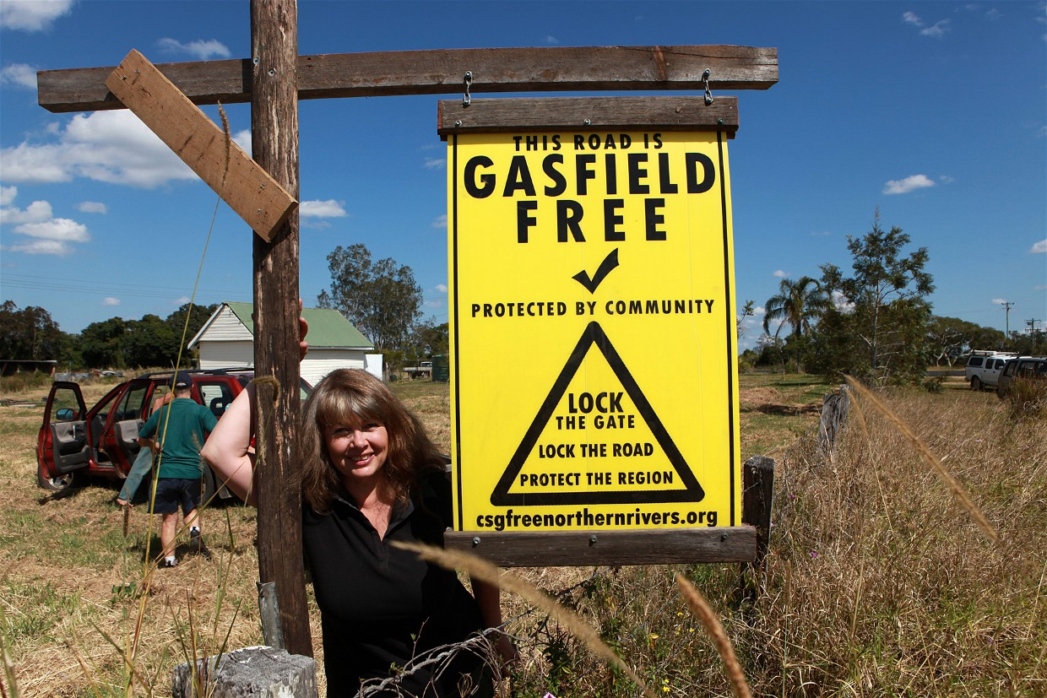

Slide 18
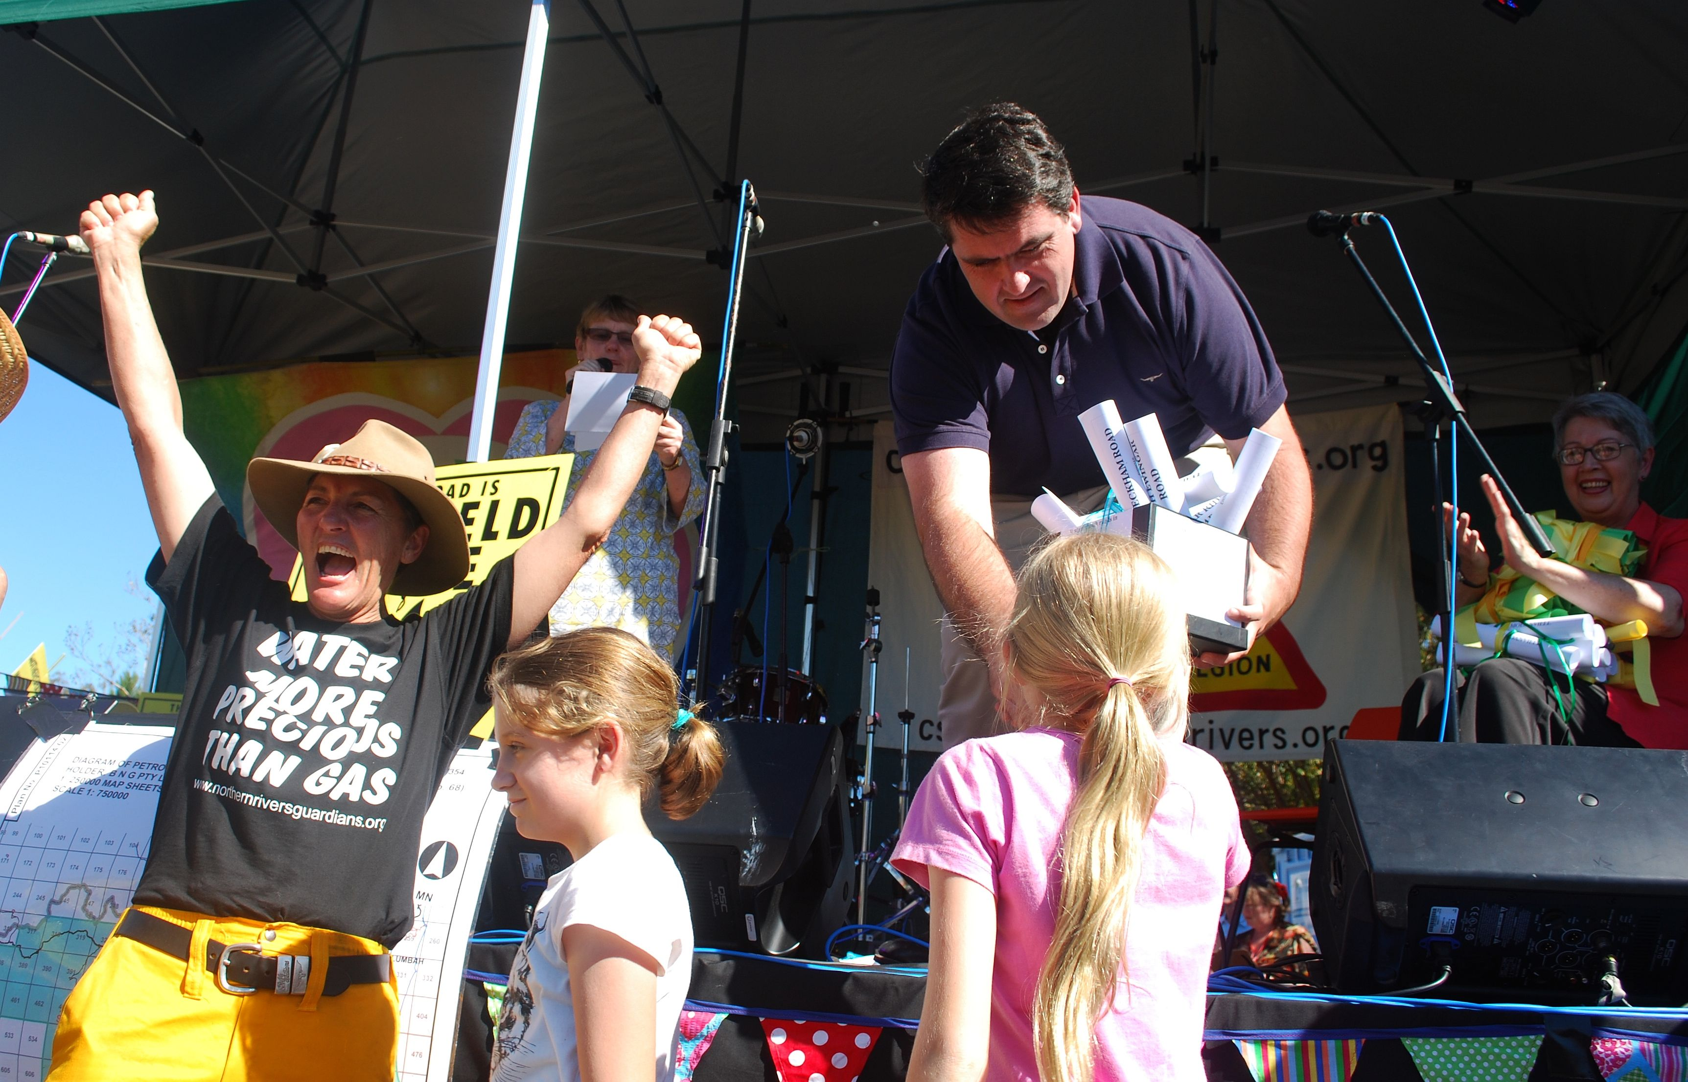
Pride in community

Slide 19
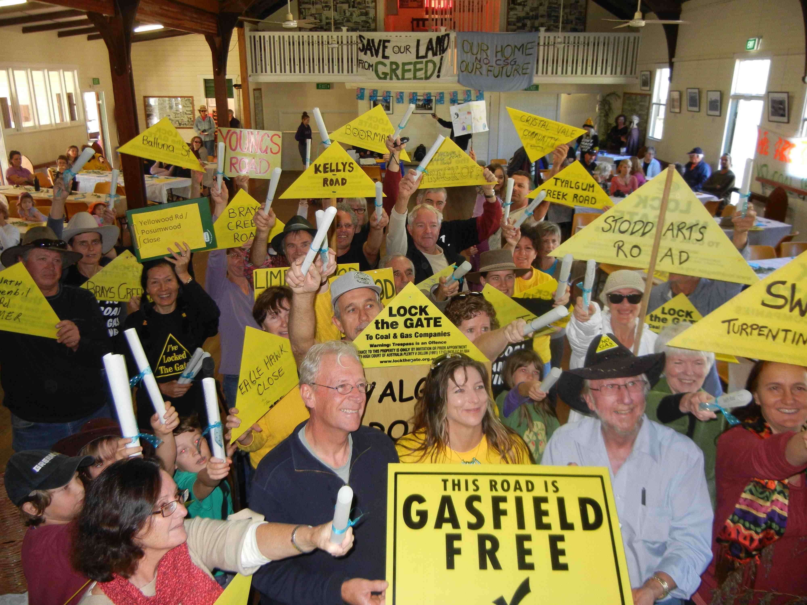

Slide 20
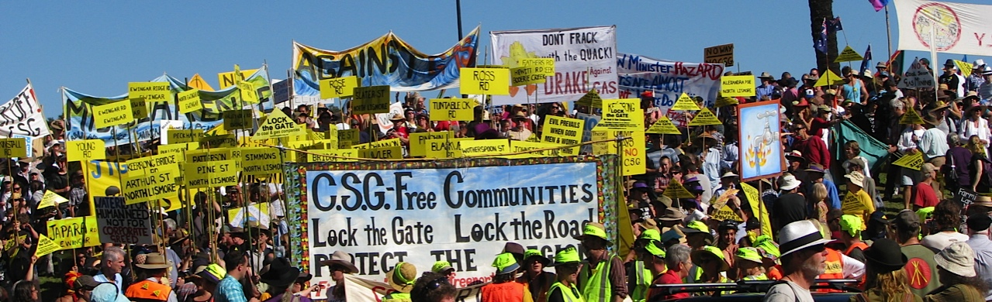
Social learning
Individual skill development
Adult learning is essential for resilient communities

