Slide 1
Lifelong learning – an international perspective
Alan Tuckett, ICAE
ALA
Byron Bay October 2012

Slide 2
ICAE starting points
Commitment to education as a human right, equality, and sustainability
Developing citizen participation is a key role of adult learning
Need to strengthen civil society alliances
Imagine effective alternatives
Work pragmatically within existing structures

Slide 3
ICAE programme priorities
achieving the MDGs, EFA, following up CONFINTEA VI and influencing post 2015
education for sustainability for a climate changing world
decent learning for decent work
sharing good practice in folkbildning and popular education
gender equality, contesting all forms of discrimination; highlighting the needs of migrants
modernising our structure and strengthening partnership

Slide 4
Context 1
On the one hand:
fiscal restructuring
climate change and increasingly extreme weather
accelerating inequality
food, energy, water shortages
persistent conflicts
human rights violations
weakening authority of nation states
growing power of transnational corporations

Slide 5
Context 2
On the other hand:
rising life expectancy
improved living standards for many
potential arising from technological innovation
improved communications
recognition that growth is not enough – and that well-being matters

Slide 6
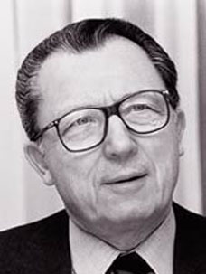
The Treasure Within
Jacques Delors argued in The Treasure Within
that there are 4 pillars for a learning society
learning to know
learning to do
learning to be
learning to live together

Slide 7
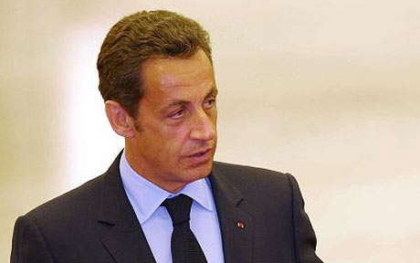
Is growth the answer?
The Spirit Level and the Sarkozy Commission both argue that more GDP does not make for a better life for all

Slide 8
Raymond Williams
At times of change adults turn to learning:
to understand what is happening
to make adjustments in the light of it
and to shape change
Our work is key to an active and informed democracy

Slide 9
Economic Modernisation
Social Inclusion

Slide 10
Wider benefits
prolongs active citizenship
delays impact of Alzheimer’s
learners 13% more likely to give up smoking
learners 34% increase in racial tolerance
learners much less likely to be politically cynical
learners less dissatisfied with their lives
http://www.learningbenefits.net/

Slide 11
Learning has these impacts
whatever your prior education
whatever your social class
Yet adult learning is still described by some as an evidence free zone
http://www.learningbenefits.net/

Slide 12
The Effects of Learning
Individual
Self-maintenance
Personal change
Transforming
Sustaining
Community activism
Social fabric
Collective

Slide 13
Who isn’t there and what can be done about it?
Working class people
Ethnic minorities
Disabled adults
Older people
Young people without qualifications
People living in isolated rural settings
People outside the labour market

Slide 19
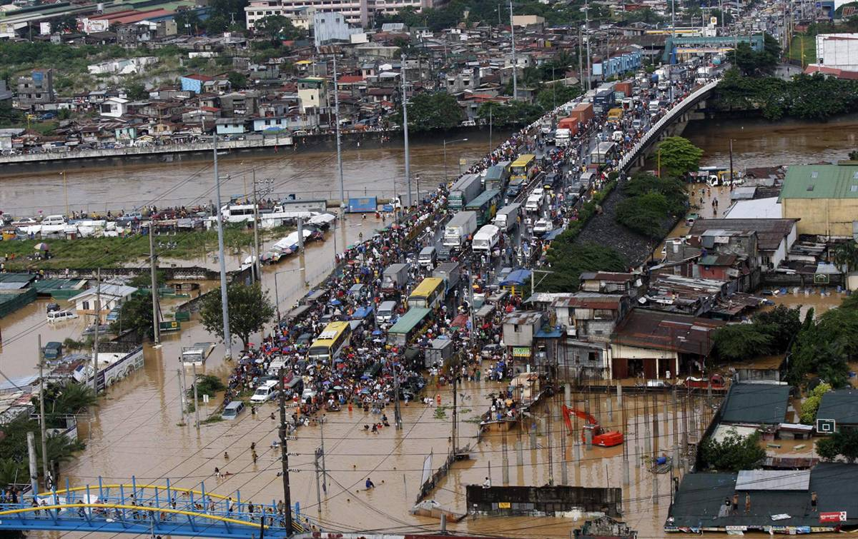

Slide 20
Millennium development vision
The fundamental values are still relevant:
freedom
equality
solidarity
tolerance
respect for nature
shared responsibility

Slide 21
MDGs, and EFA
The Millennium Development Goals were welcomed, as they gave focus
But MDGs and EFA targets for 2015 will mostly be missed – especially EFA goals explicitly affecting adult learners
Should we forget them?
Should we extend the time line?
Should we adopt new targets within the same development paradigm?

Slide 22
UN Task Force – MDGs post 2015
3 Fundamental principles:
Human rights
Equality
Sustainability
4 core dimensions:
Inclusive social development
Environmental sustainability
Inclusive economic development
Peace and security

Slide 23
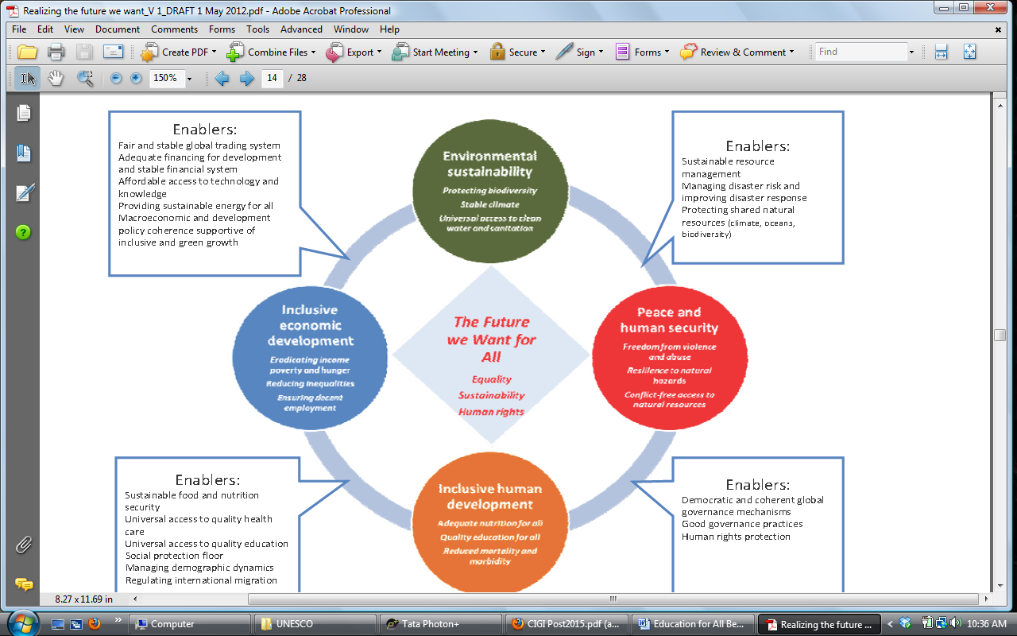
“The Future We Want For All”
Figure 4: Realizing the Future We Want for All
Source: UN Task Team 2012

Slide 24
UN Gen Sec education agenda
Every child in school
Quality (including strengthening educator capacity?)
Global citizenship
What measures can we develop to secure a focus on lifelong learning in the global citizenship dimension?
Where do adult literacy and family learning fit in?
How do we keep a focus on gender equity and on a rights based holistic agenda?

Slide 25
Dilemmas 1
Lifelong learning is a key catalyst for achieving social change – yet that is not widely recognised outside of educational discourse
To win recognition, and affect the outcomes we need to build alliances, yet we risk being submerged. In an overall lifelong learning target involving pre-school to provision for older people scarce finances go to formal provision:
primary
secondary
university
workplace

Slide 26
Dilemmas 2
Education targets shaped in the EFA process are agreed by education ministers
Sustainable development targets will be shaped by high level panel &agreed by environmental ministers and heads of state
MDGs by foreign ministers/finance ministers.
How can we support adult educators to support their education ministers to make the case for the wider impact of adult learning to foreign ministers and to finance ministries?

Slide 27
Dilemmas 3
Civil society organisations collaborating on the post 2015 agenda, and with influence at the UN do not include education interests

Slide 28
What is to be done
CONSULTATIONS – 50 countries; 9 themes:
Inequalities
Health
Education (primary, secondary, tertiary, vocational)
Growth and Employment
Environment sustainability
Food security and nutrition
Governance
Conflict and fragility
Population dynamics

Slide 29
Priorities ?
narrowing the gap between policy and practice
literacies – for women, youth, family
gender equality; inclusion
education for democracy and active citizens
vocational education outside the waged economy
education for sustainability
migrants
capacity building for educators
decentralisation
planning for 2016 and after!

Slide 30
Resources
values
inclusion, diversity, respect for difference
culture – and breadth of focus
imagination
learners’ voices
monitoring, negotiation and advocacy skills
alliances
patience
memory
passion
technologies?

