Slide 1
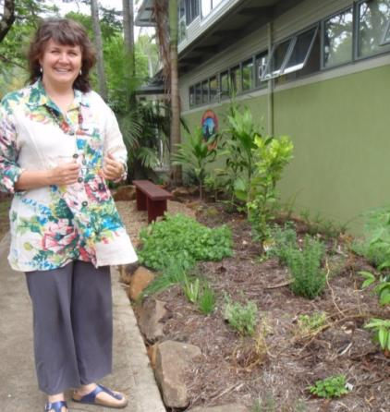
Greening up your Courses & Marketing
Welcome from Katrina Shields
of Byron Region Community College

Slide 2
Webinar topics
Why sustainability courses are needed
7 Principles of Education for Sustainability
Potential topic areas
Finding & supporting tutors
Resources
Marketing your courses
Sharing stories...

Slide 3
Greening up your knowledge Why bother?
The realities of the environmental crisis including climate change.
The larger policy context – a shift to a lower carbon economy and the urgent need for educational leadership.
Sustainability courses are not just more “hobby”, “leisure” or “general interest” courses.

Slide 5
Climate change predictions coming to grips with your own region’s future
NSW Department of the Environment & Climate Change (DECC) and University of NSW forecasts our area needs to prepare for:
“Higher temperatures (between 1-3 degrees), more frequent and severe droughts, and more extreme storms ...leading to flooding.
..Likely sea level rises of at least 40 cm by 2050 leading to inundation of low lying coastal areas. These changes are likely to have significant impacts on agricultural production, water supply, settlements and infrastructure, natural resources, biodiversity and human health.”
See Summary of Climate Impacts – North Coast Region, NSW Climate Change Action Plan Sept 2008 Department of Environment & Climate Change NSW.

Slide 6
The bigger educational picture
UN Decade of Education for Sustainable development.
There are International, national and state policies & action strategies to mainstream education for sustainability into all sectors.
Widespread recognition that adult education will play a key role in bringing about sustainable development. The adult education sector and the VET sector has been recognised as needing urgent up skilling & mainstreaming of education for sustainability.
All training packages have been reviewed to embed sustainability skills, which will require professional development for trainers. There is a an opportunity and responsibility for RTO’s to walk the talk.

Slide 7
The Carbon Tax What influence might this have?
Lots more focus on energy efficiency
New clean energy technologies
New jobs & skills in green areas
Demand for more local food production
Higher expectations of eco literacy (including for trainers!)
Potential funding for community education projects to support these drivers
What role could your centre play?

Slide 8
Education for sustainability rather than about sustainability
“Sustainable development calls for additional and different processes than those traditionally thought of in education.
The quest for sustainability demands new approaches to involve people, rather than convey just a body of knowledge.”
It requires more critical thinking skills, participation at all levels, innovation, new values and new behaviors.”
Daniella Tilbury et al in the National Review of Environmental Education and its contribution to Sustainability 2005….

Slide 9
7 Principles of Education for Sustainability (EfS)
1.Transformation & Change:EfS not simply about providing information, but involves equipping people with the skills, capacity and motivation to plan & manage change towards sustainability- within an organisation, industry or community.
2.Education for all & lifelong learning: EfS is driven by a broad understanding of education that includes people of all ages & backgrounds & at all stages of life & takes place within all possible learning spaces, formal & informal, in schools, workplaces, homes & communities.
3.Systems thinking: EfS aims to equip people to understand connections between environmental, economic, social & political systems.
4.Envisioning a better future: EfS engages people in developing a visions for a sustainable future.

Slide 10
7 Principles of Education for Sustainability
5.Critical thinking and reflection: EfS values the capacity of individuals & groups to reflect on personal experiences & world views, also to challenge accepted ways of interpreting & engaging with the world.
6.Participation: EfS recognises participation as critical for engaging groups & individuals in sustainability.
7.Partnerships for change: EfS focuses on the use of genuine partnerships to build networks & relationships, & improve communication between different sectors of society.

Slide 11
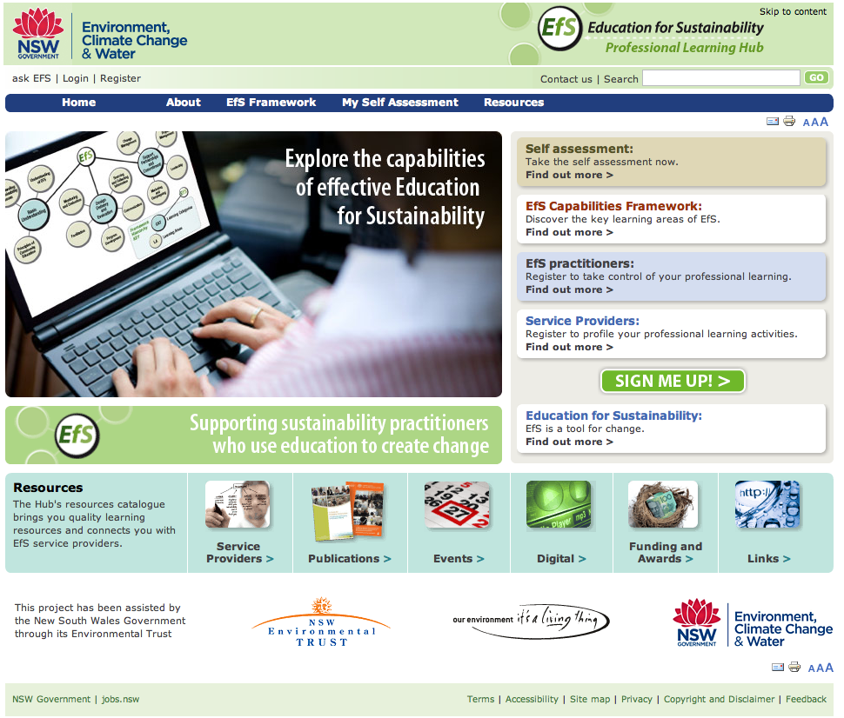
www. efslearninghub.net.au/

Slide 12
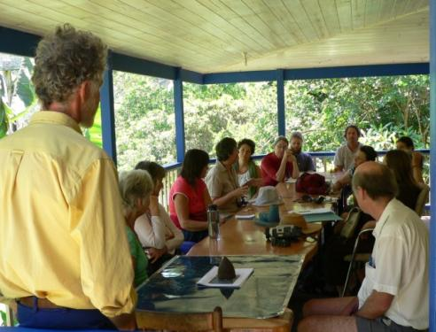
Partnerships for Change.....
A Few examples -
We work with local government to run energy efficiency workshops, tours of the local water facility, provide composting and green cleaning workshops.
Have a partnership with the Mullumbimby Community Garden, with a joint committee to run the education program. We also work with Landcare groups. And have worked with the health promotion unit.
Are providing workshops in food growing in 7 local government areas for a joint local government /state government Northern River Foodlinks Project.
Reflection Question: Are there
any relationships that could be
developed for your sustainability
education provision?

Slide 13
Some sustainability topic areas
Organic food growing, backyard chooks, fruit trees, bee keeping, composting, soil building, making bio char etc.
Natural resource management & appreciation eg. supporting wildlife, non chemical bush regeneration, birds & butterflies, understanding local biodiversity.
Urban sustainability eg. green cleaning, energy efficiency, solar power, water saving, bike maintenance, ethical shopping, permaculture
House design & new building materials eg. energy efficient house design for the subtropics, bamboo design & construction, mud brick building etc

Slide 14
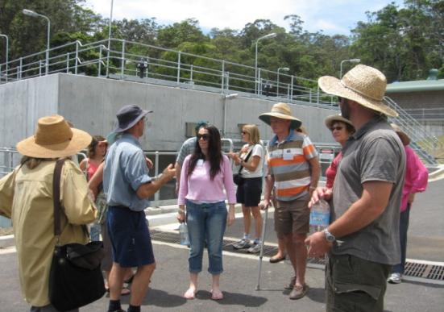
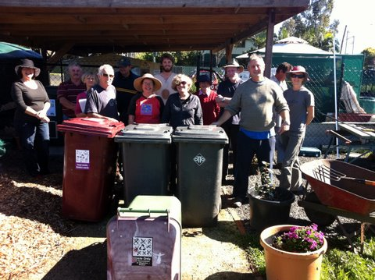
Other p.opular options...
Tours eg sustainable communities, houses, gardens, water facilities, community gardens..
Food events eg. locavore lunches, food preserving, local produce showcases...
Short taster courses can build interest with less commitment ...and keep the cost down.

Slide 15
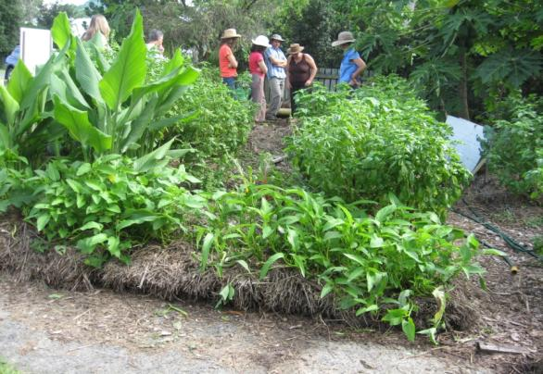
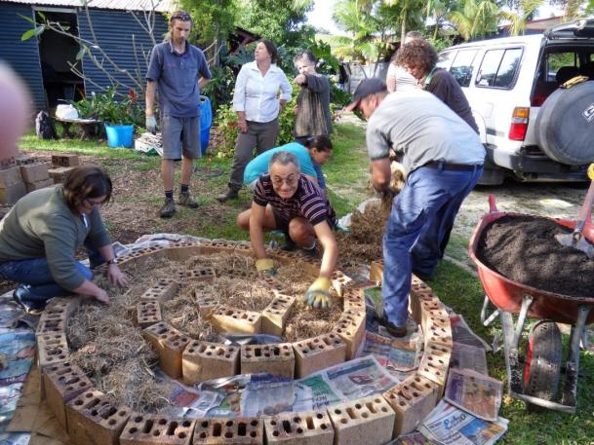
A taste of permaculture day...

Slide 16
Sustainability is not just about “the environment”
The 3 pillars of sustainability:
Include Social & Economic dimensions such as:
Social justice and social inclusion
Supporting Aboriginal culture & heritage
Strengthening community participation, building community resilience, local living economies.
SUSTAINABILITY
Economy
Environment
Social

Slide 17
Living with climate change...
Adult education providers could play a important role in...
Disaster preparedness – for bush fires, floods, extreme storm events, heat waves.
Lessening disruption to food supplies – increasing local food production
Capacity building for community decision making, advocacy skills and local organising.

Slide 18
Finding & supporting tutors
Seek out tutors amongst the dedicated sustainability practitioners.
Sometimes there are funded train the trainer opportunities.
Support & network new tutors - they may not be confident teachers.
Provide inspiring venues (including tutors homes & gardens) that demonstrate the principles in action if you can.

Slide 19
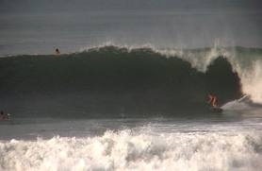
Catch the wave
The move towards sustainability and the low carbon economy is the biggest social movement since the industrial revolution.
You will not be alone.....it is only going to get bigger!

Slide 20
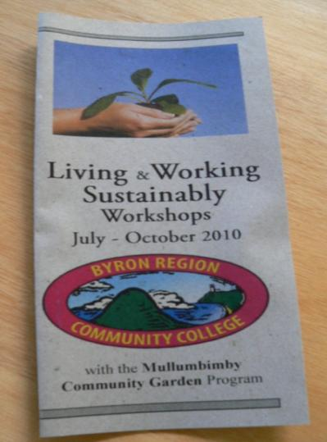
These courses may need extra or new forms of marketing
We use:
A lot of media stories - print and radio
Lucky door prize compost bin from Council
A special flyer
Posters around town
Email networking to target interest groups
Displays at community events
Work with partner organisations.
Reflection Question: What new or extra marketing strategies could you use to reach more people with education for sustainability?

Slide 21
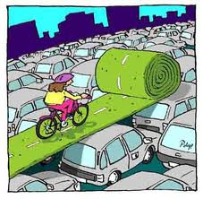
If the centre seems stuck or unchanging
Look to the margins.....
Who are your allies?
Who might be doing something in your area?
What might be progress in this situation- even a little bit?

Slide 22
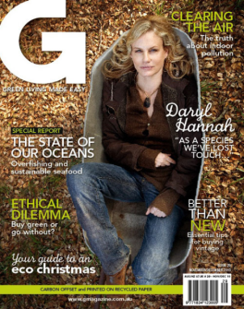
Greening up your information sources
E newsletters: eg. ACF Green home e news, Landcare e news, Biological Farmers Association of Australia e news. National Centre for Sustainability Swinburne e news
Subscriptions to Magazines: eg G magazine, ABC Organic Gardener, Australian Alternative Technology Association magazine.

Slide 23
RESOURCES: Some useful websites…
DET NSW - Green Skills
https://www.training.nsw.gov.au/programs_services/not_funded/greenskills/index.html
DECCW – EETP including partnership funding
http://www.environment.nsw.gov.au/sustainbus/greenskills/eneftraining.htm
TAFE – SI Sustainability Trainer Wiki
http://wiki.tafensw.edu.au/sydney/mylearning/index.php/Sustainability_Trainer_Program#Session_resources
National Centre for Sustainability
http://www.ncsustainability.com.au/
A great video on the underside of production and consumption
www.thestoryofstuff.com
Check-out your eco-footprint
http://www.footprintnetwork.org/en/index.php/GFN/page/calculators/

Slide 24
Green Office Resources
www.greenbiz.com
www.environment.nsw.gov.au/sustainbus/industryandsmallbusiness
www.resourcesmart.vic.gov.au/for_businesses
Queensland Health Carbon Management Unit
www.health.qld.gov.au/carbon_management/green_office_guide.pdf
www.energyrating.gov.au/library/pubs/greenofficeguide.pdf

Slide 25
Reflection Question:
Are there any sustainability courses that interest you and you have the resources to develop?
What do you need to take the next step?

Slide 26
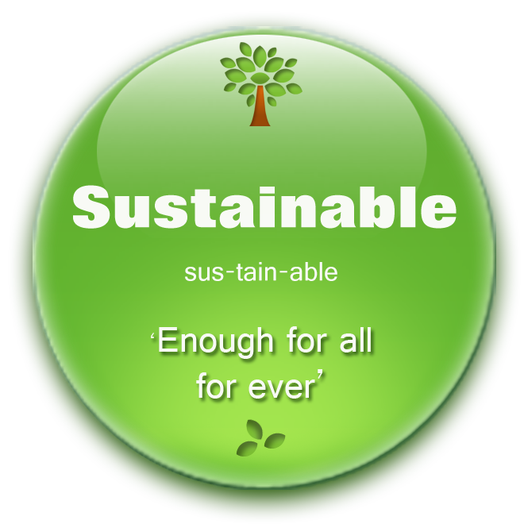
Future sustainability webinar
with Adult Learning Australia
Greening your partnerships, projects, advocacy & networks
Thursday 30 August
Thanks for your participation today from Katrina, Patricia and Michael

